Slide 1
Assessing the quality of nontraditional N95 filtering face-piece respirators available during the COVID-19 pandemic Plana, Tian, Cramer, Yang et al.
Supplementary Material 2: FFP2, KN95, and N95 masks tested

Slide 2
FFP2 masks tested

Slide 3
#1 3M K112

Slide 4
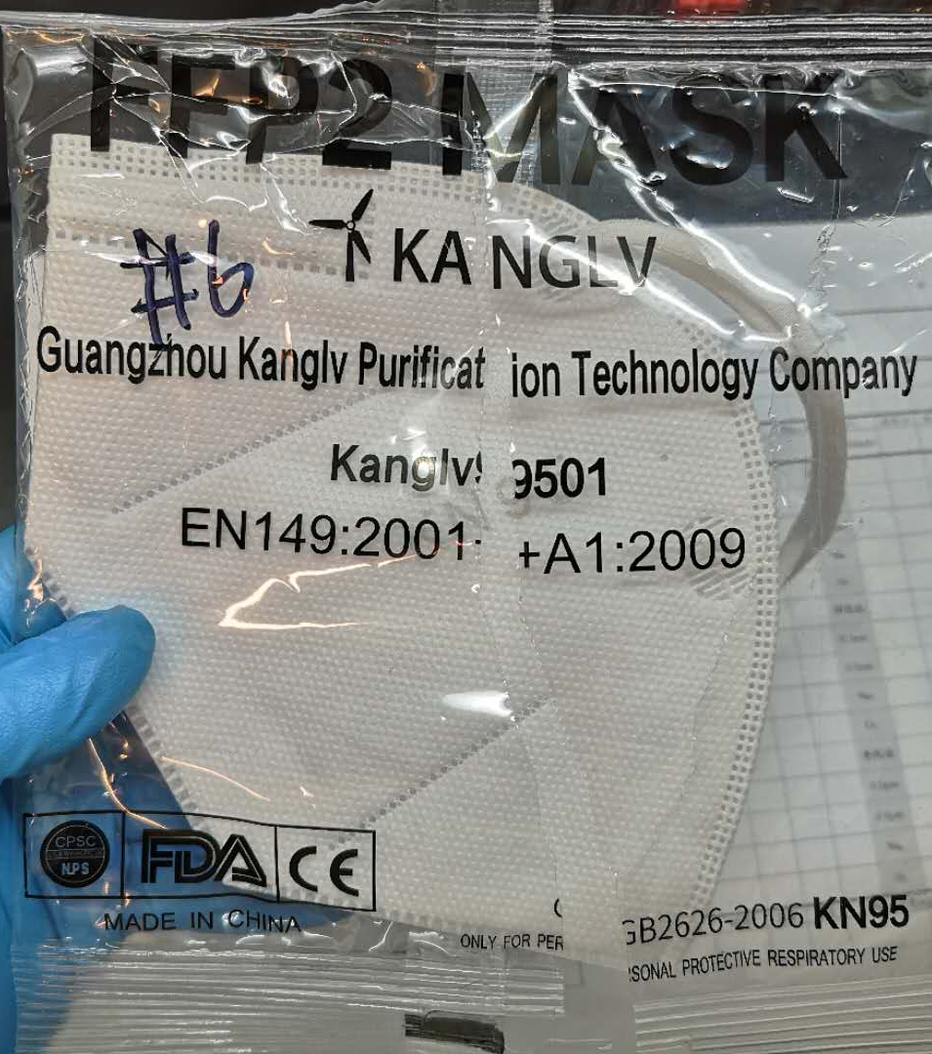
#2 Guangzhou Kanglv 9501

Slide 5
KN95 masks tested

Slide 6
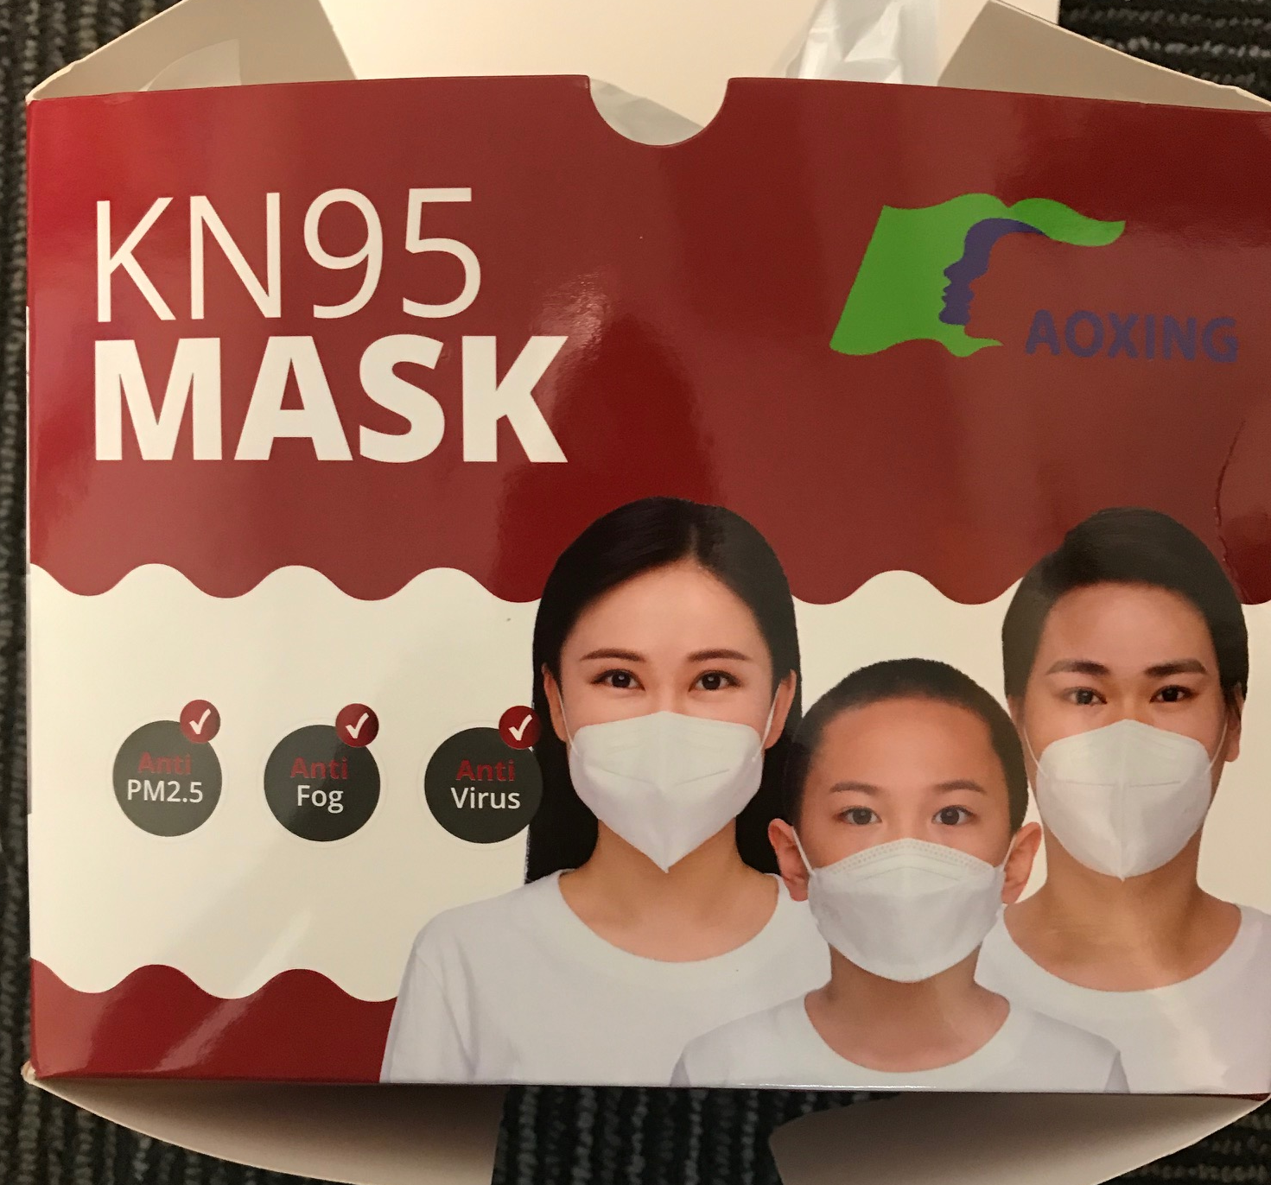
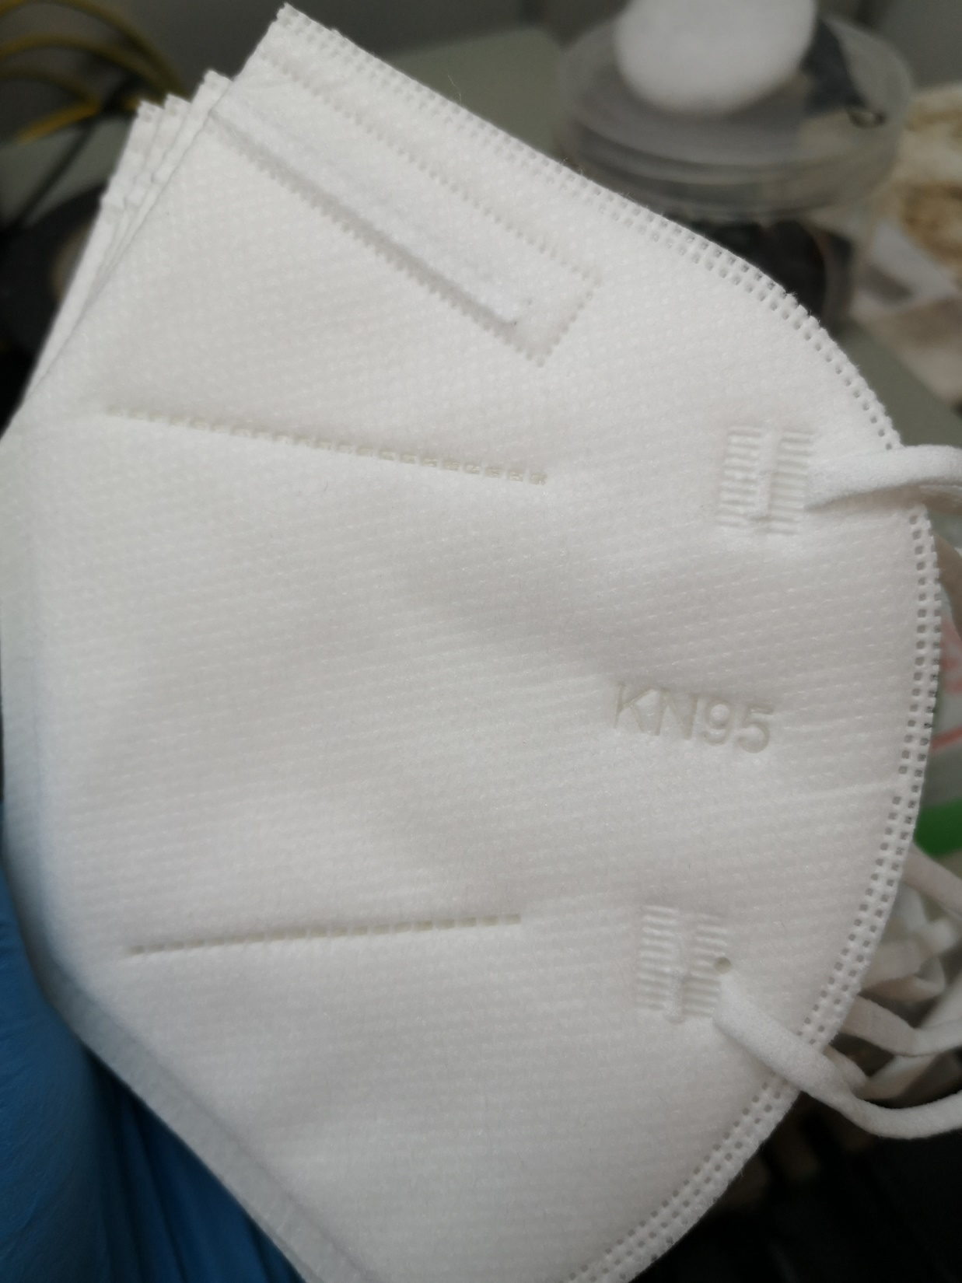
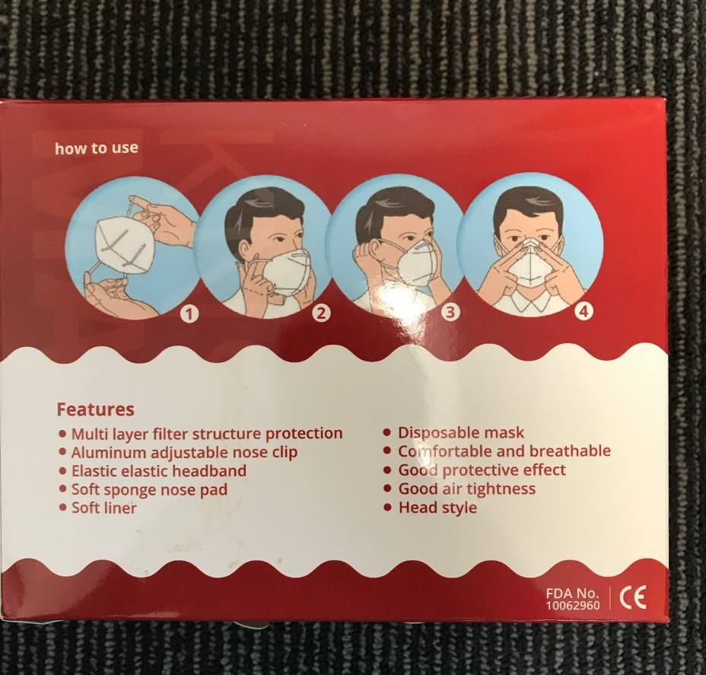
#3 Aoxing KN95

Slide 7
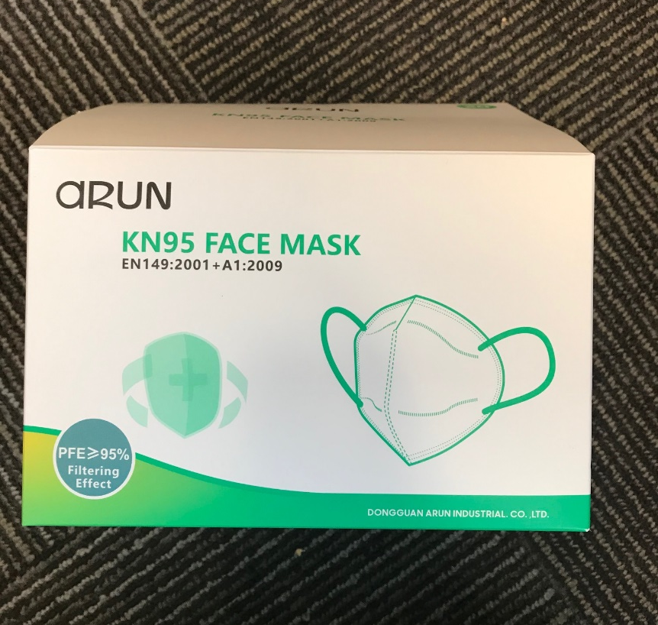
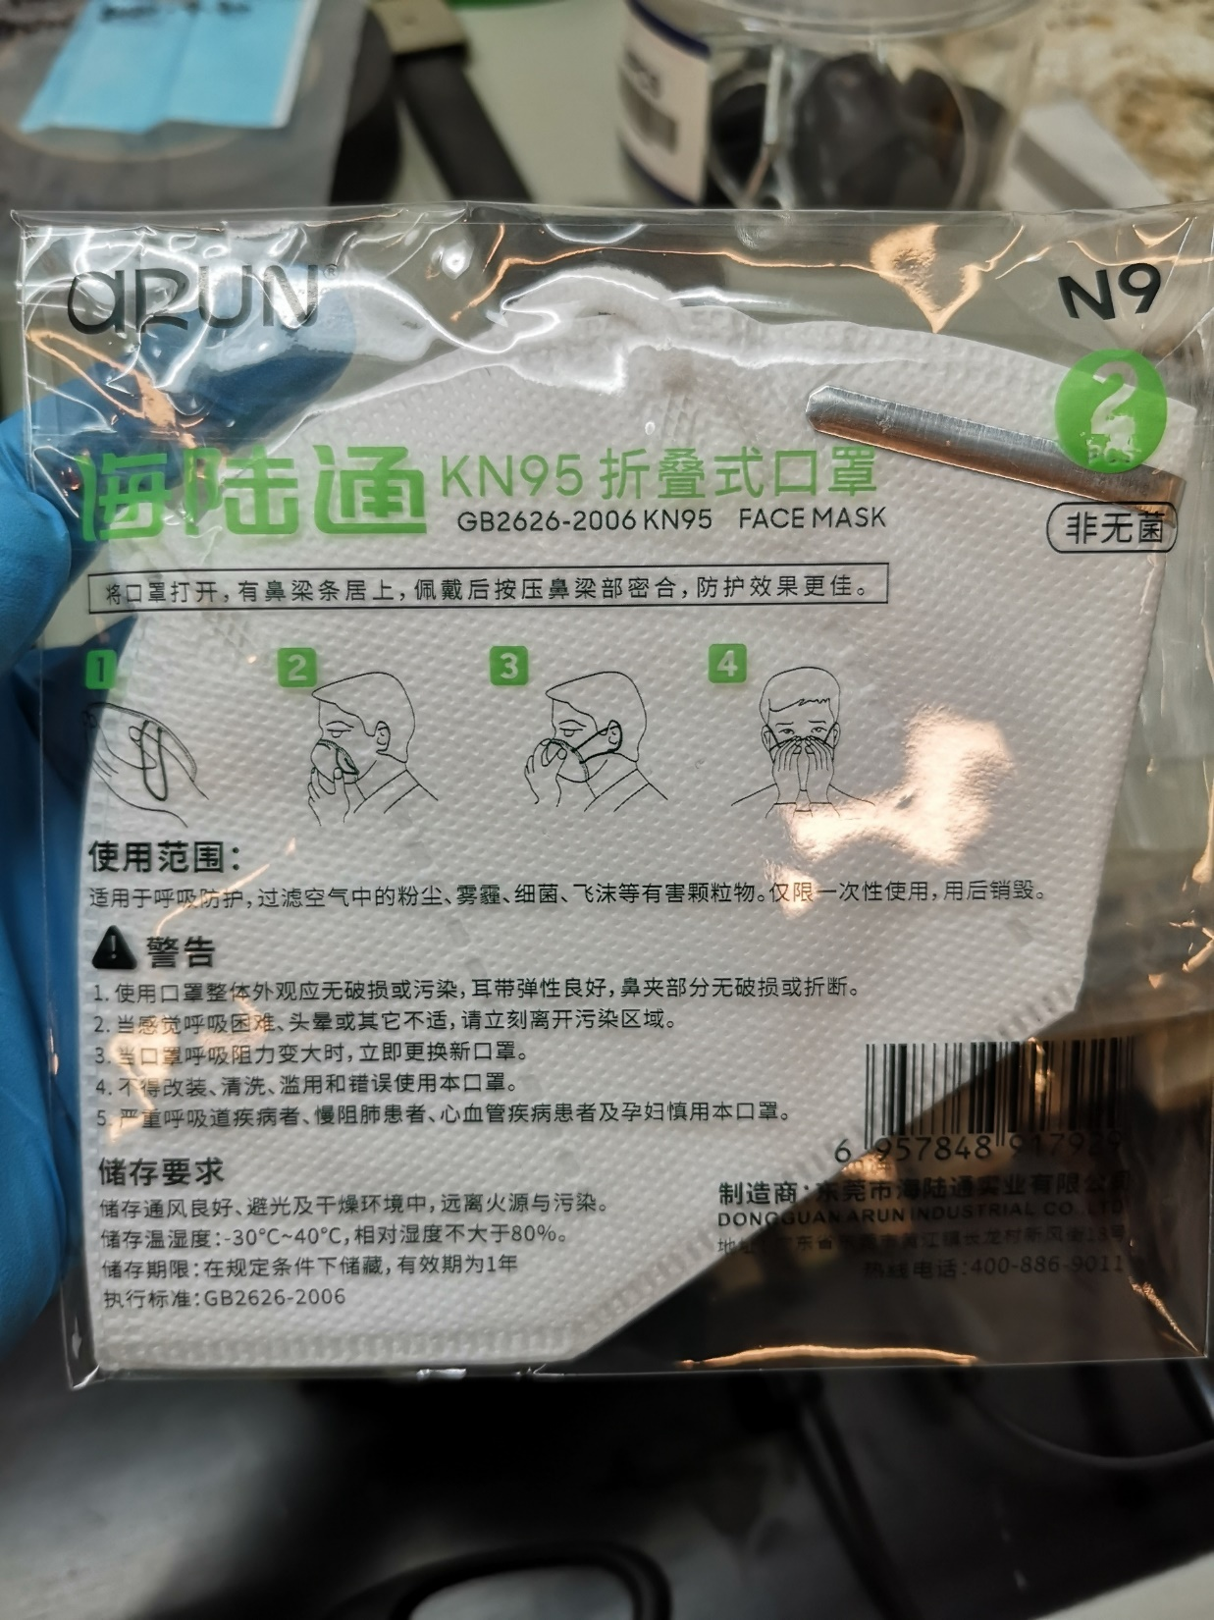
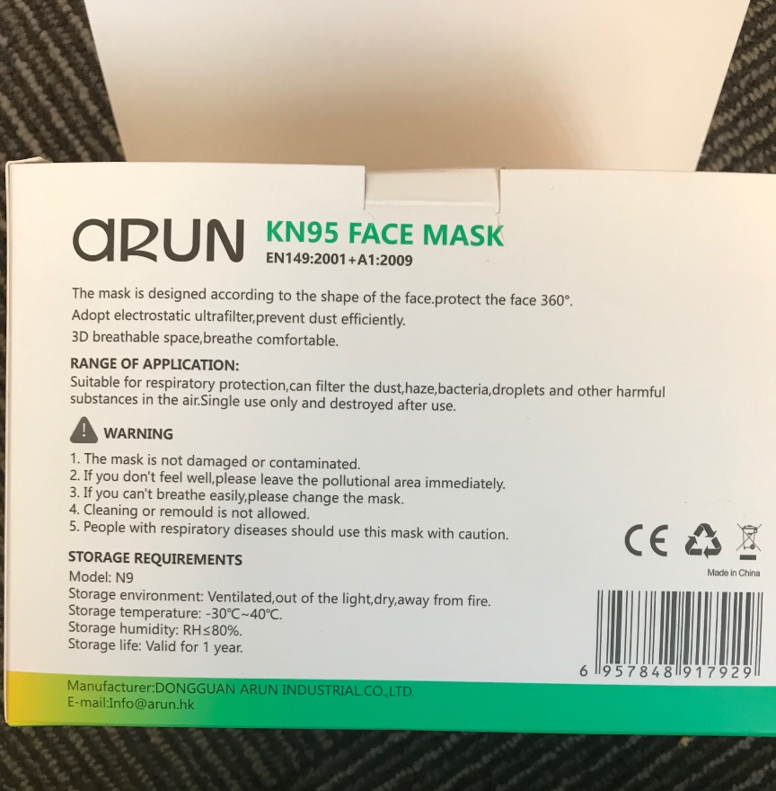
#4 aRUN Industrial Co N9

Slide 8
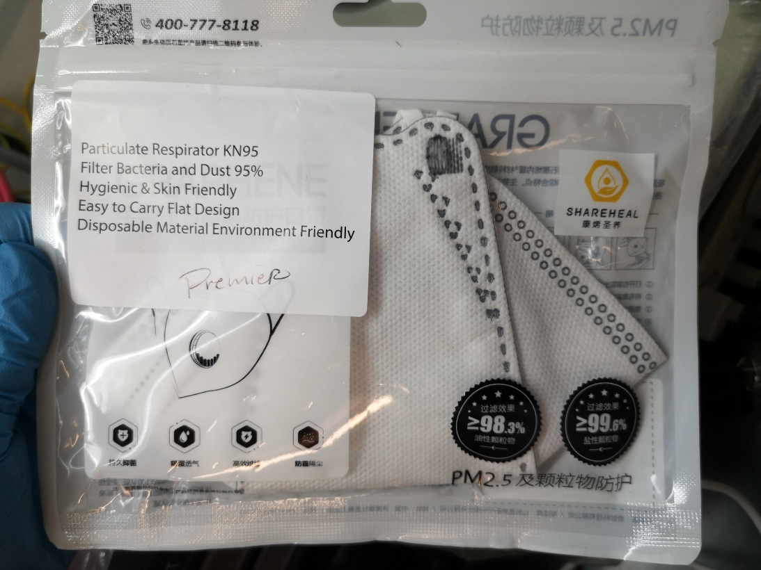
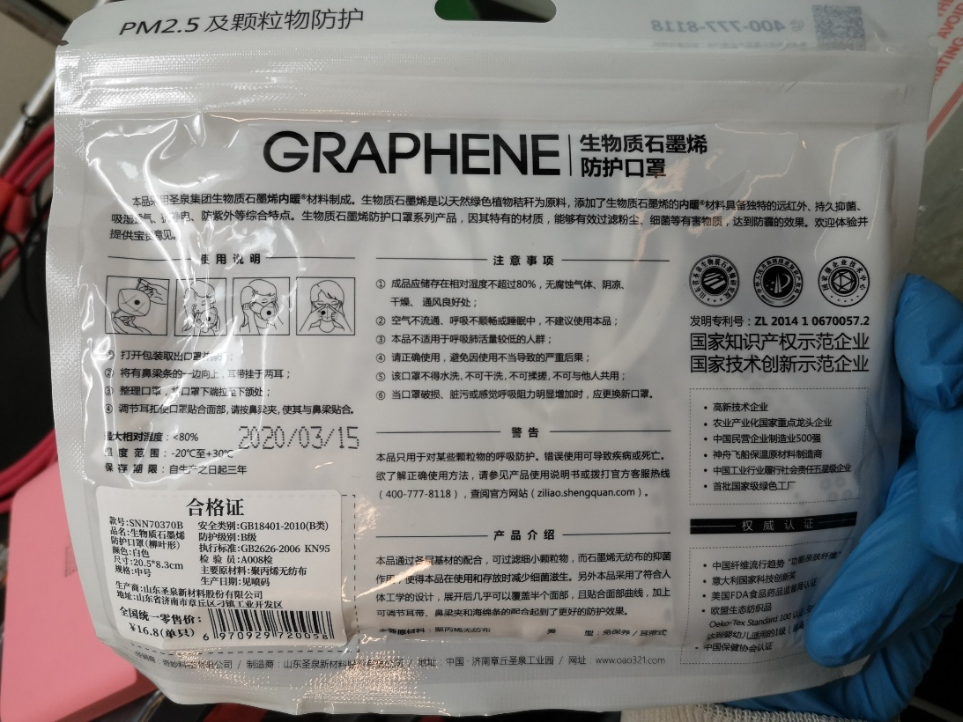
#5 Graphene SNN70370B

Slide 9
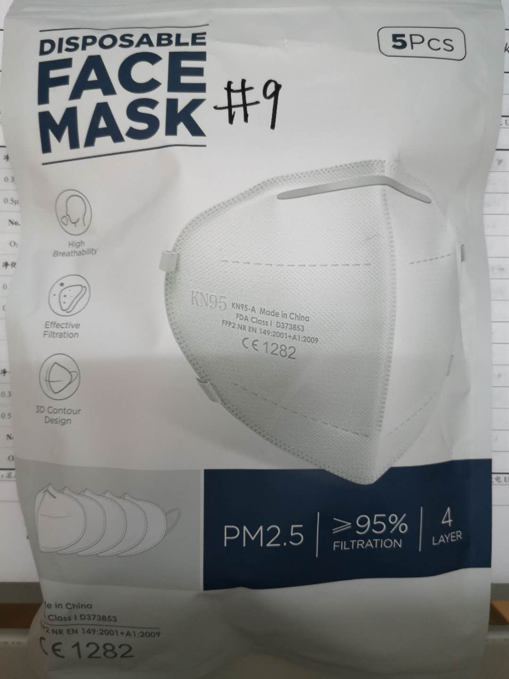
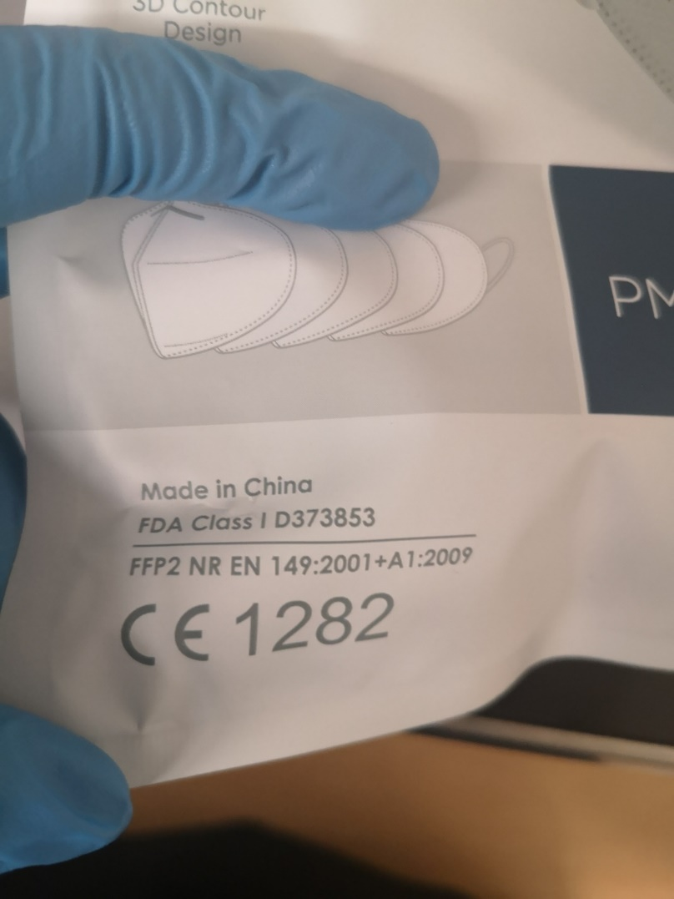
#6 HuaGang Communication Disposable face mask

Slide 10
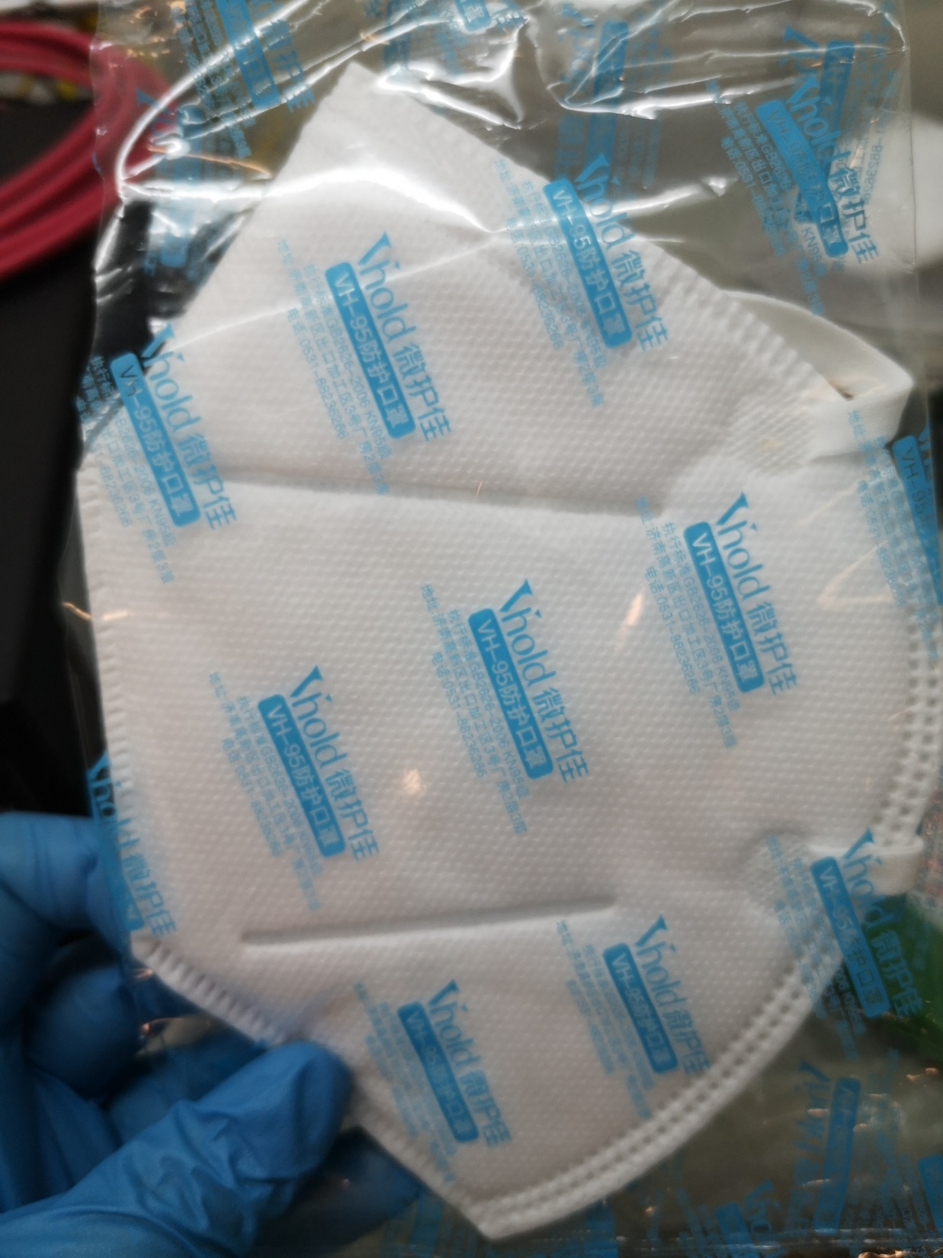
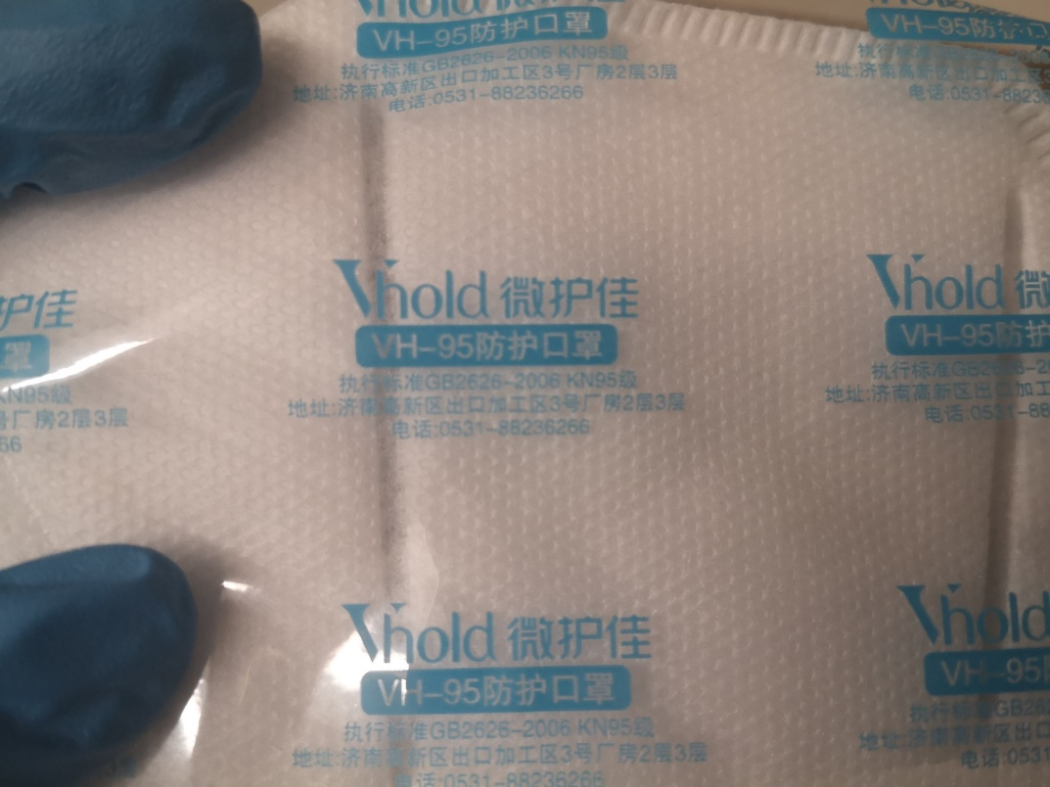
#7 Jinan Vhold Co. VH95

Slide 11
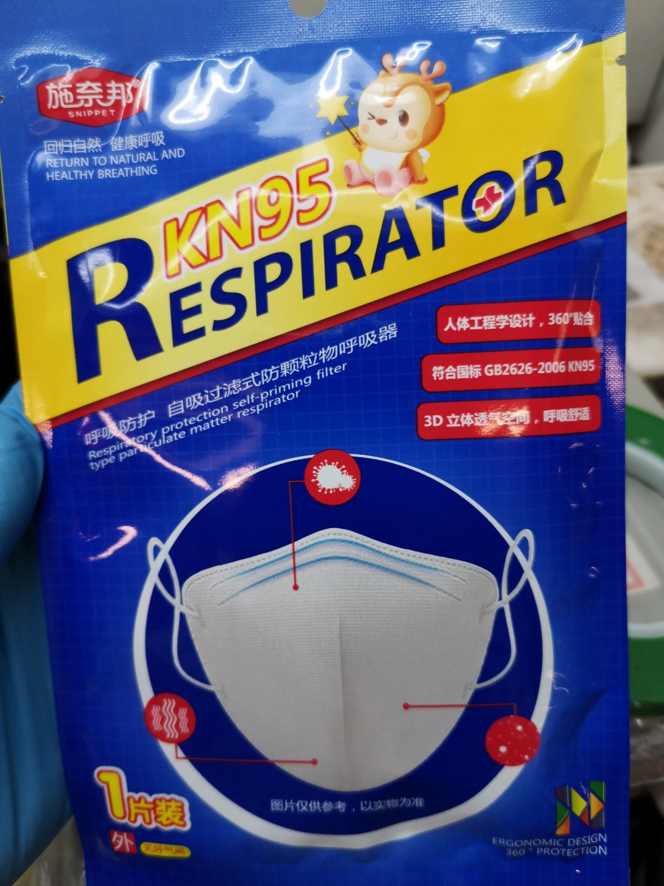
#8 SNIPPET SNB9501

Slide 12
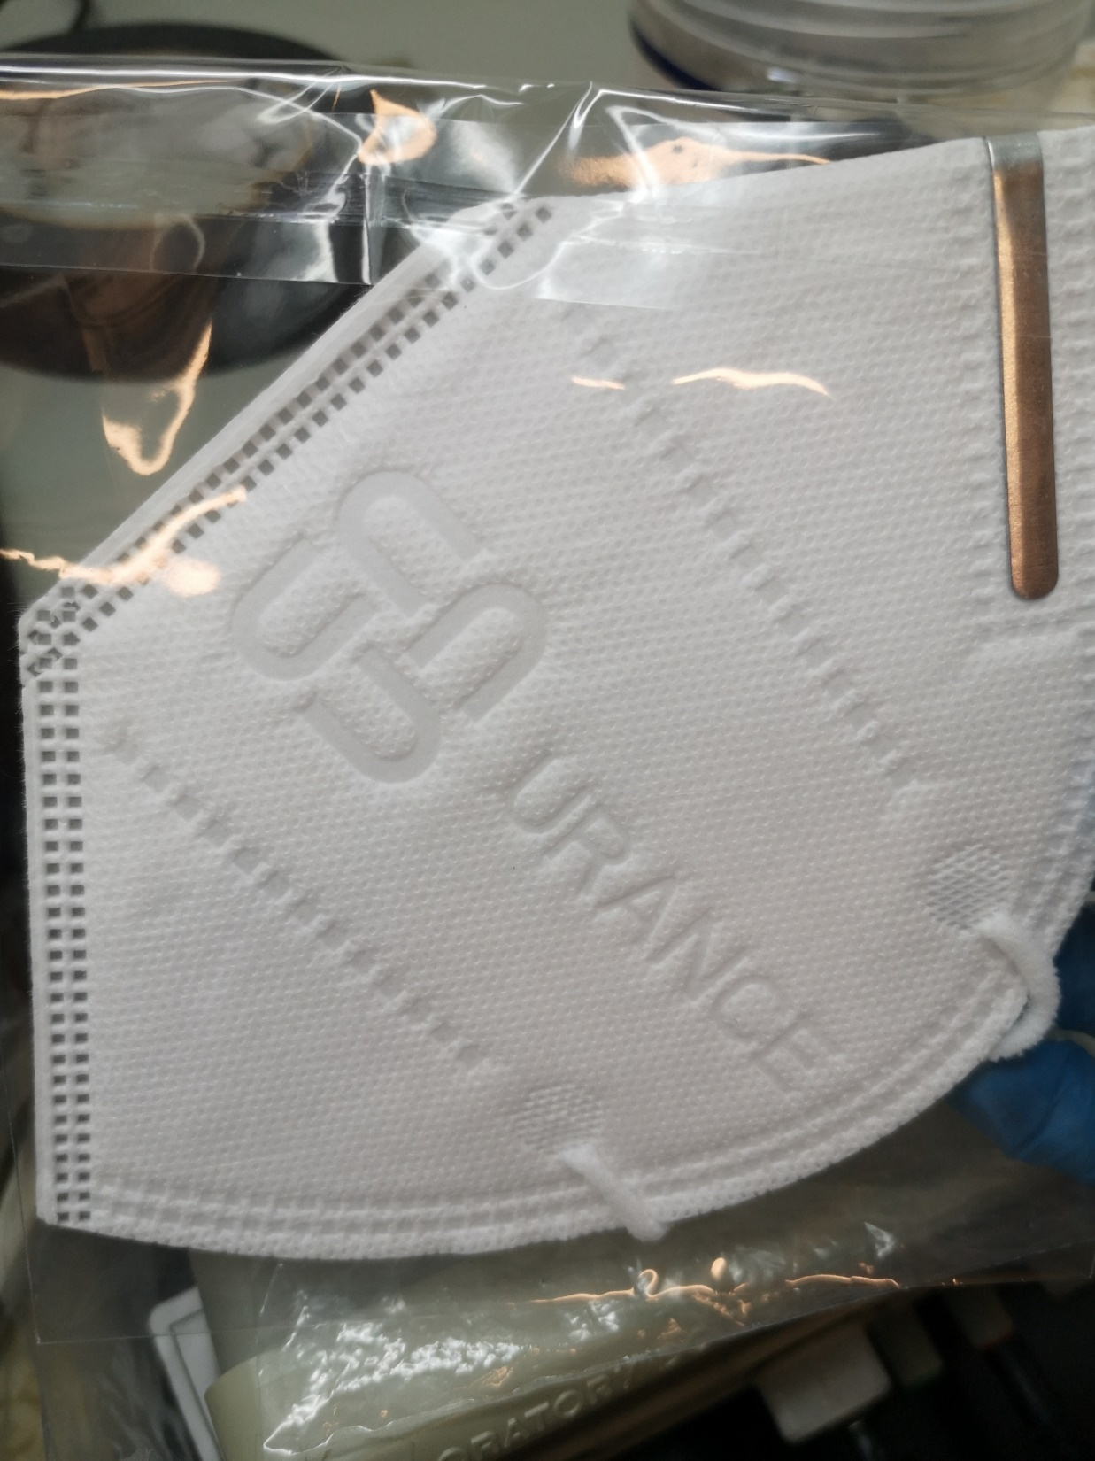
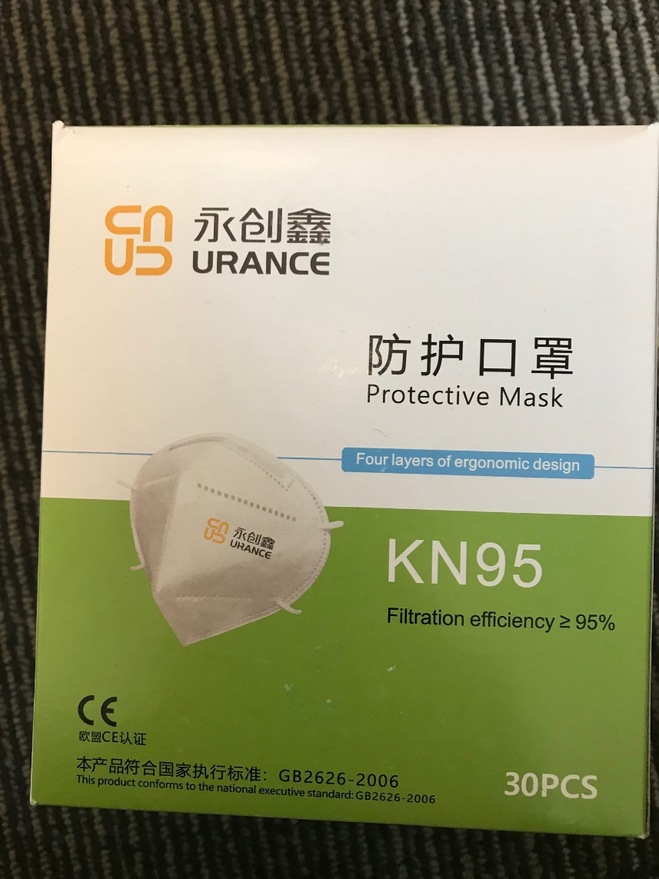
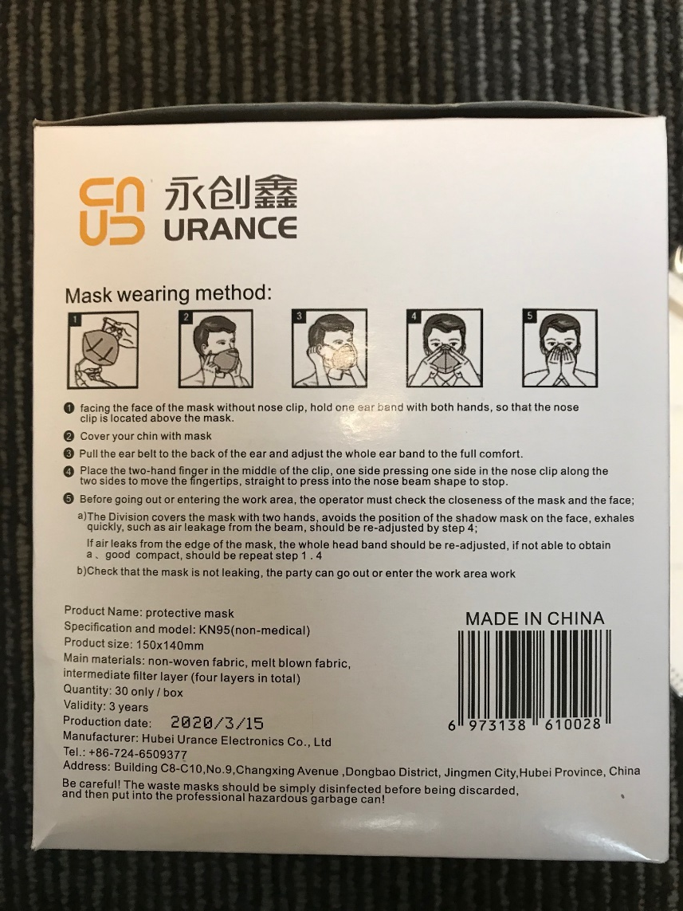
#9 Urance KN95

Slide 13
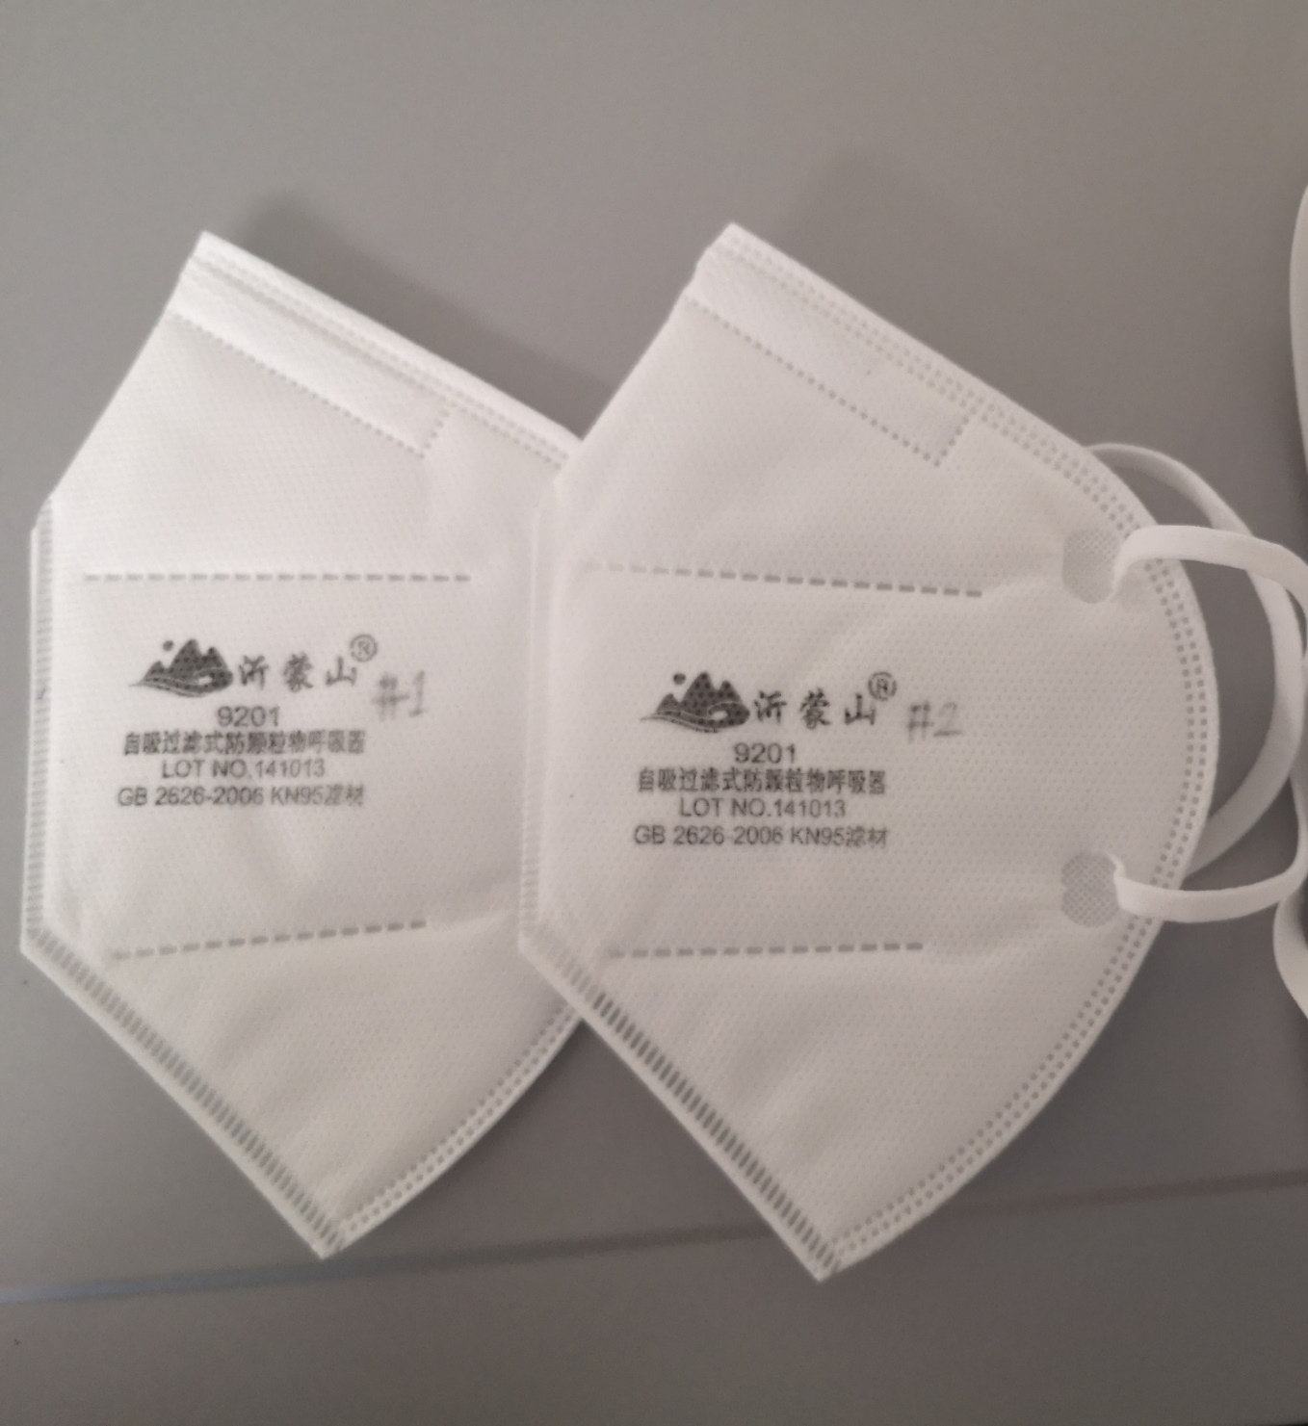
#10 Yimengshan 9201
Notes:
Photos from Nicole

Slide 14
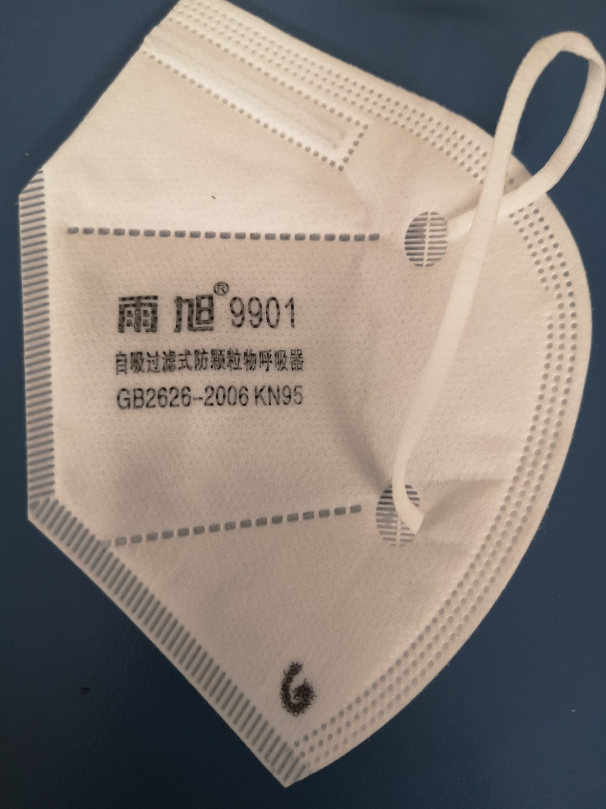
#11 Yuxu 9901
Notes:
Photos from Nicole

Slide 15
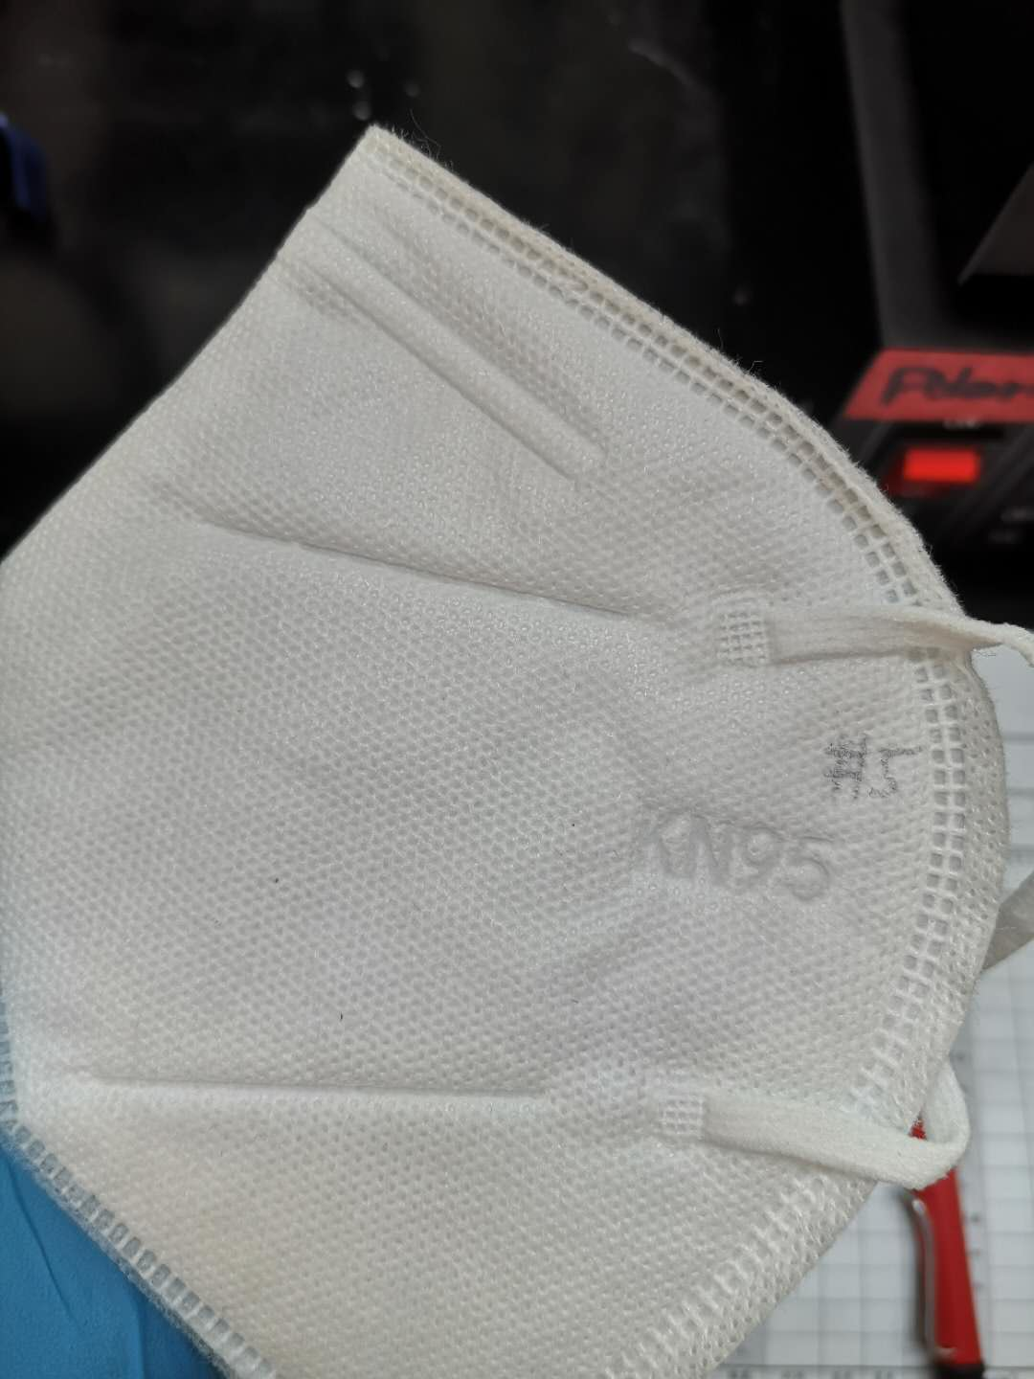
#12 Unmarked batch 1
Notes:
Photos from Nicole

Slide 16
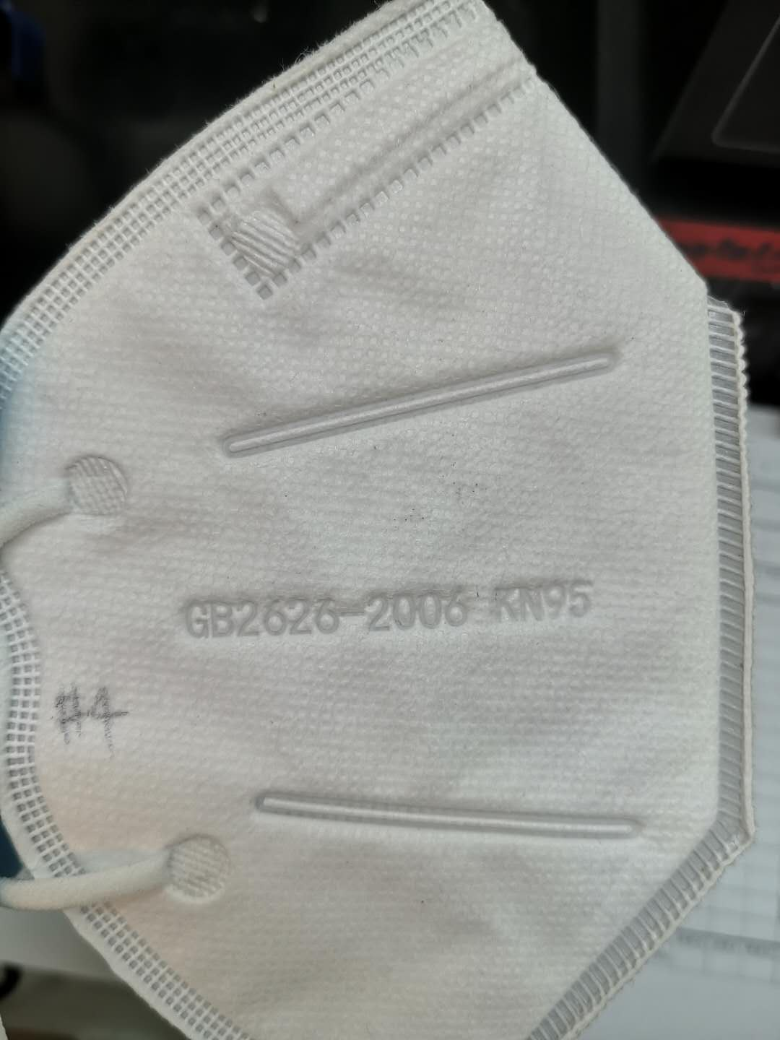
#13 Unmarked batch 2
Notes:
Photos from Nicole

Slide 17
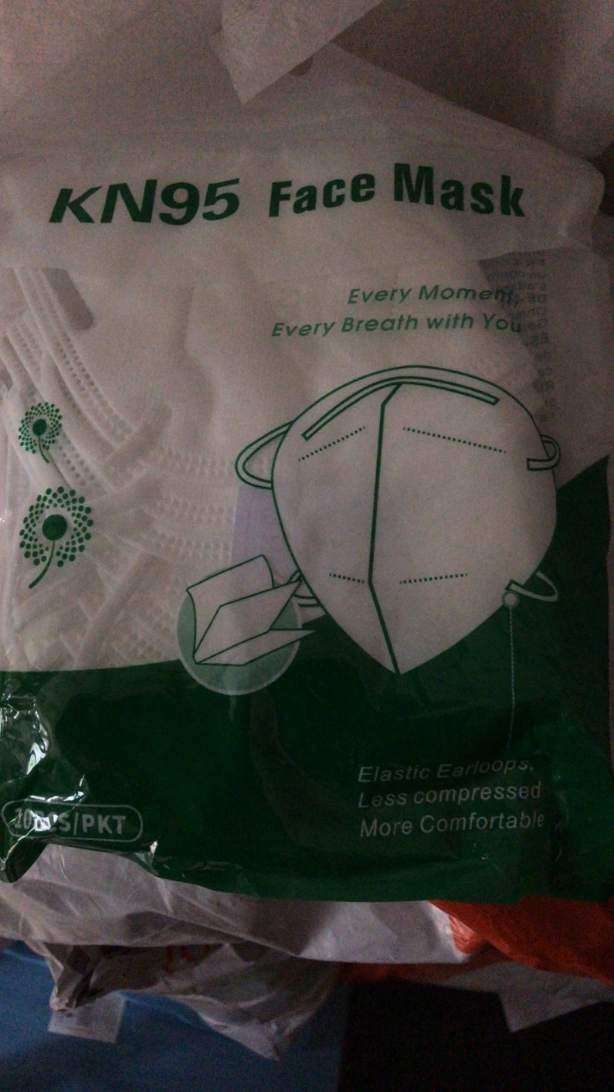
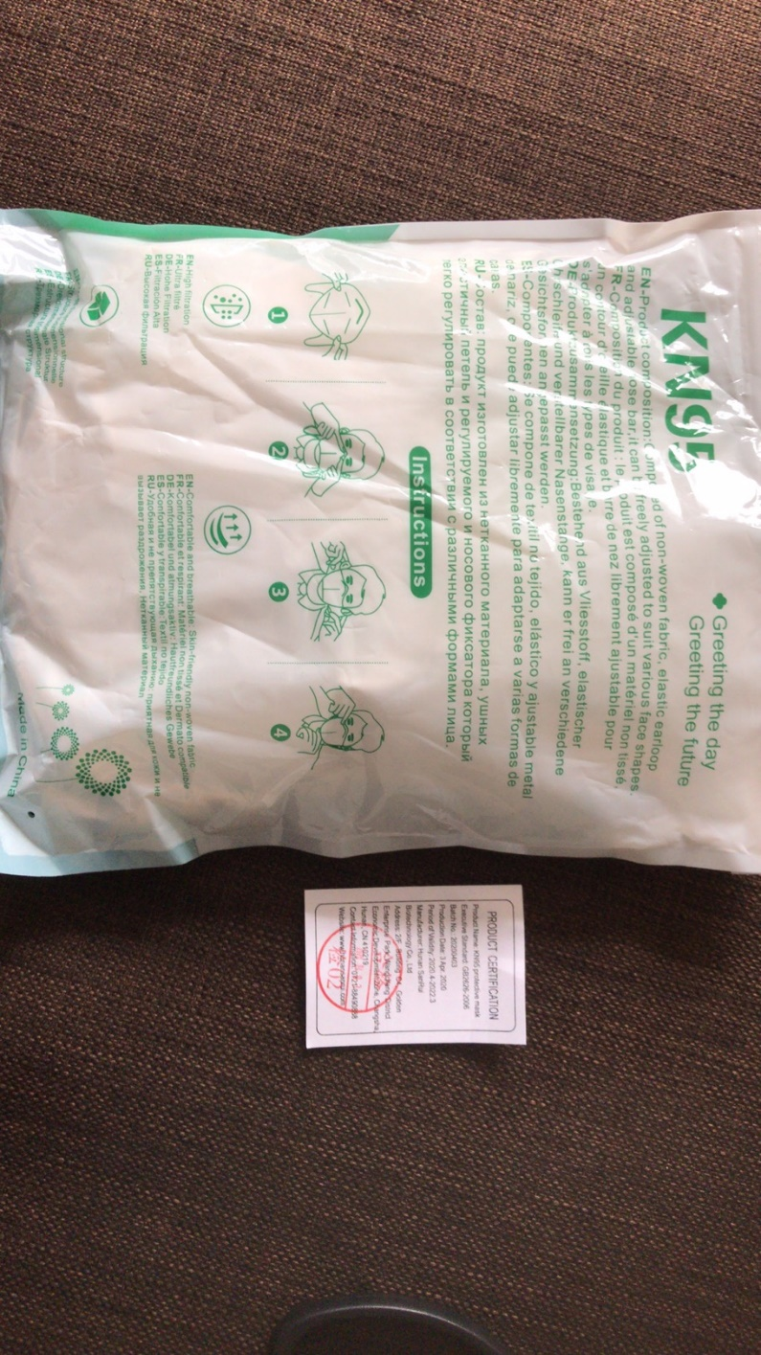
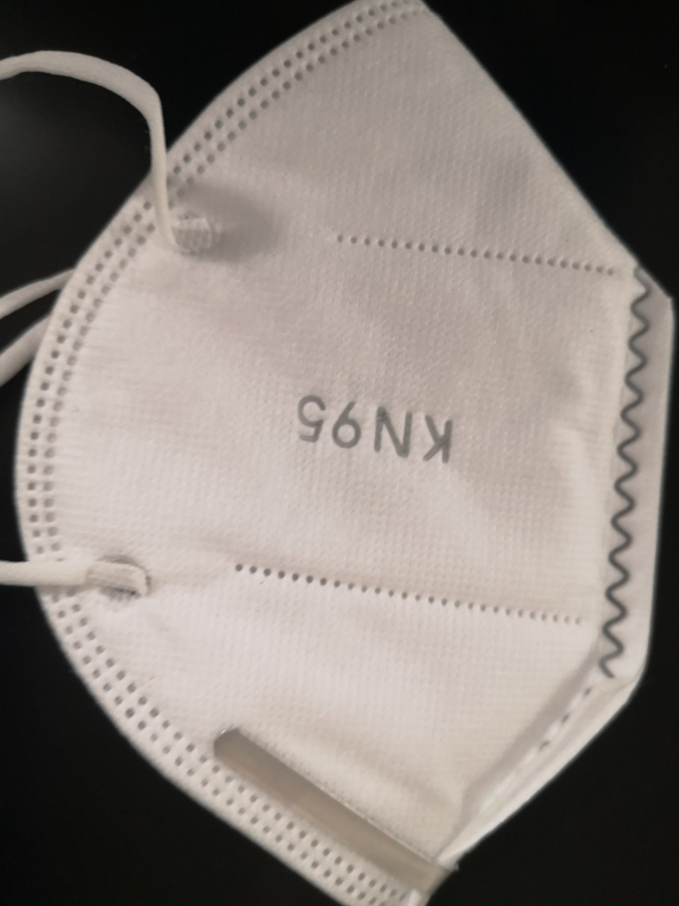
#14 Unmarked batch 3
Notes:
Photos from Nicole

Slide 18
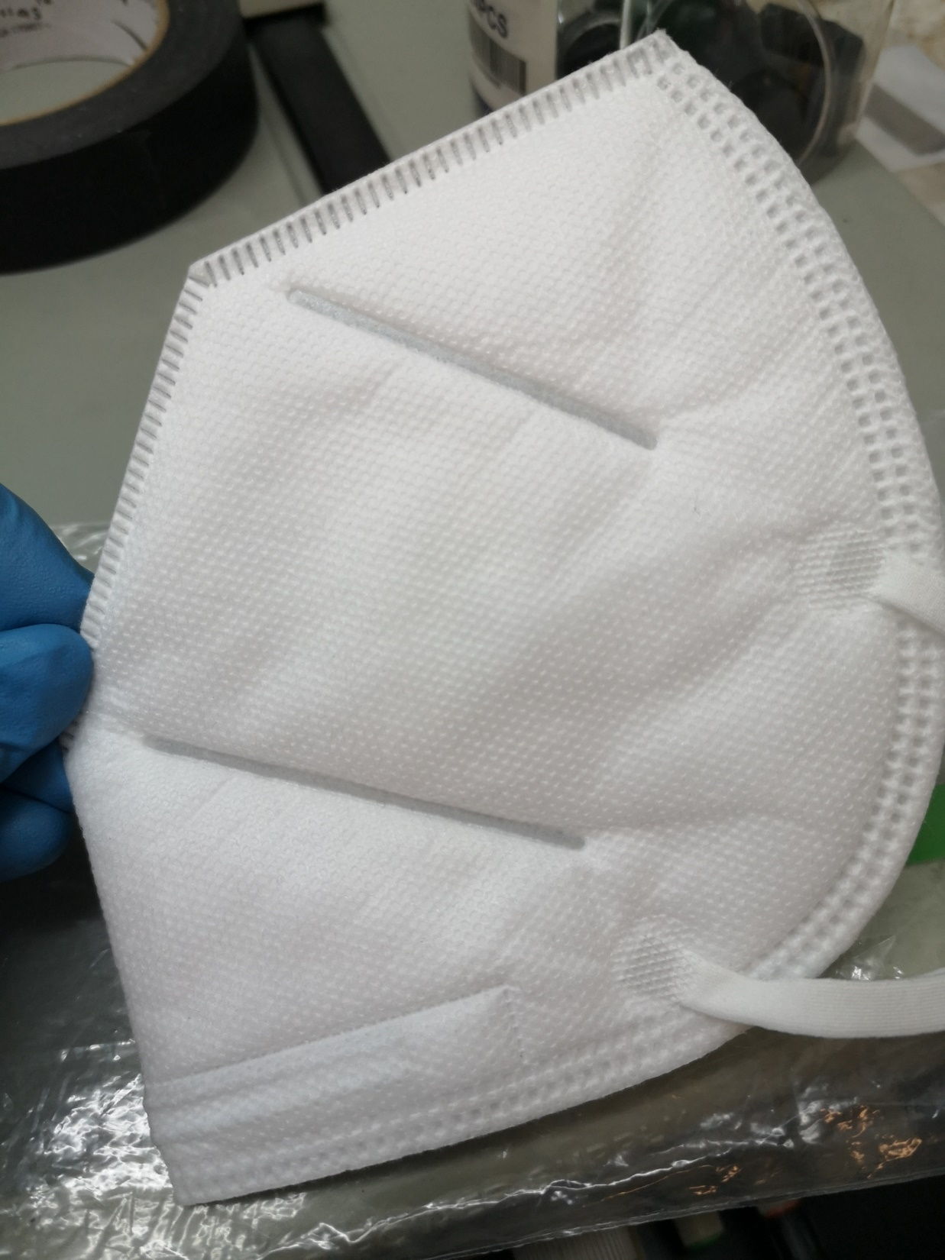
#15 Unmarked batch 4
Notes:
Photos from Nicole

Slide 19
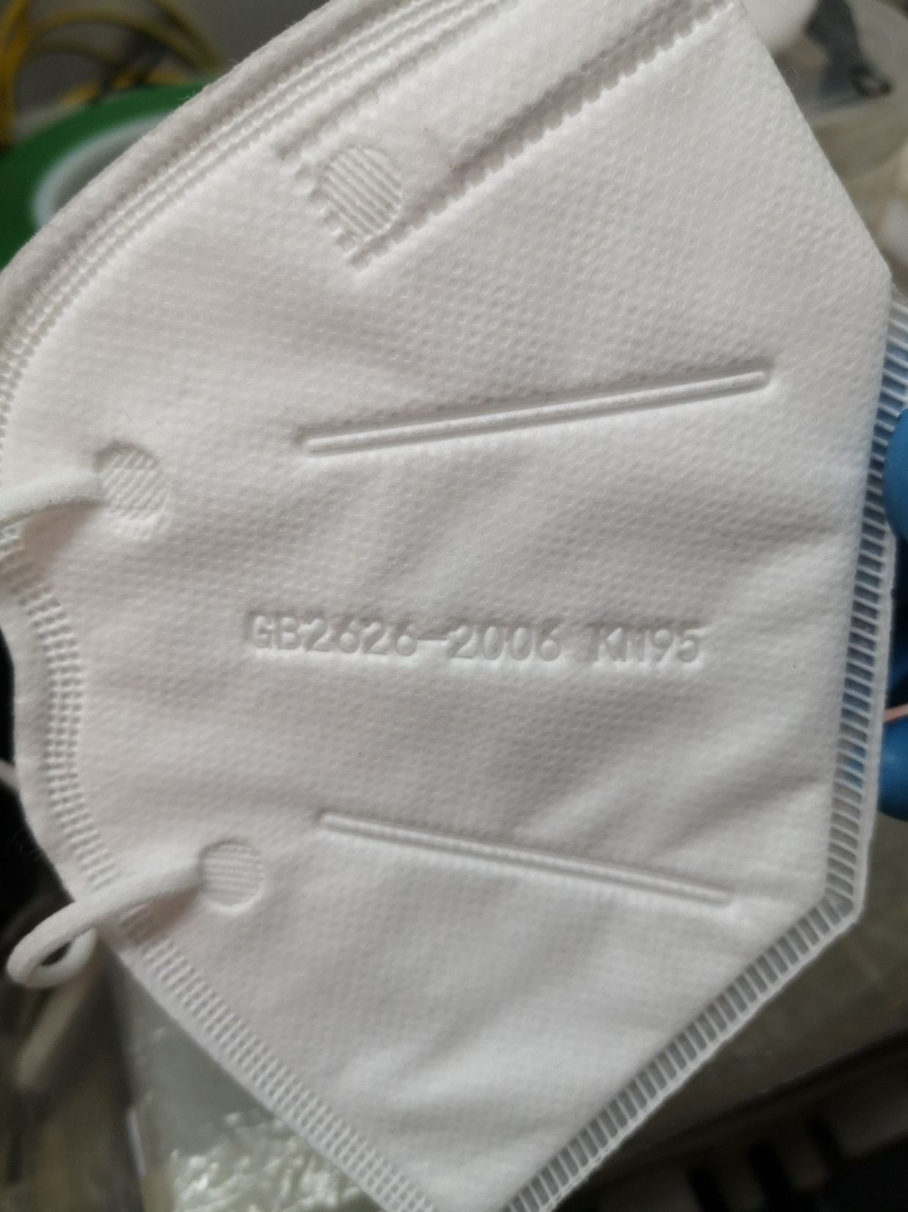
#16 Unmarked batch 5
Notes:
Photos from Nicole

Slide 20
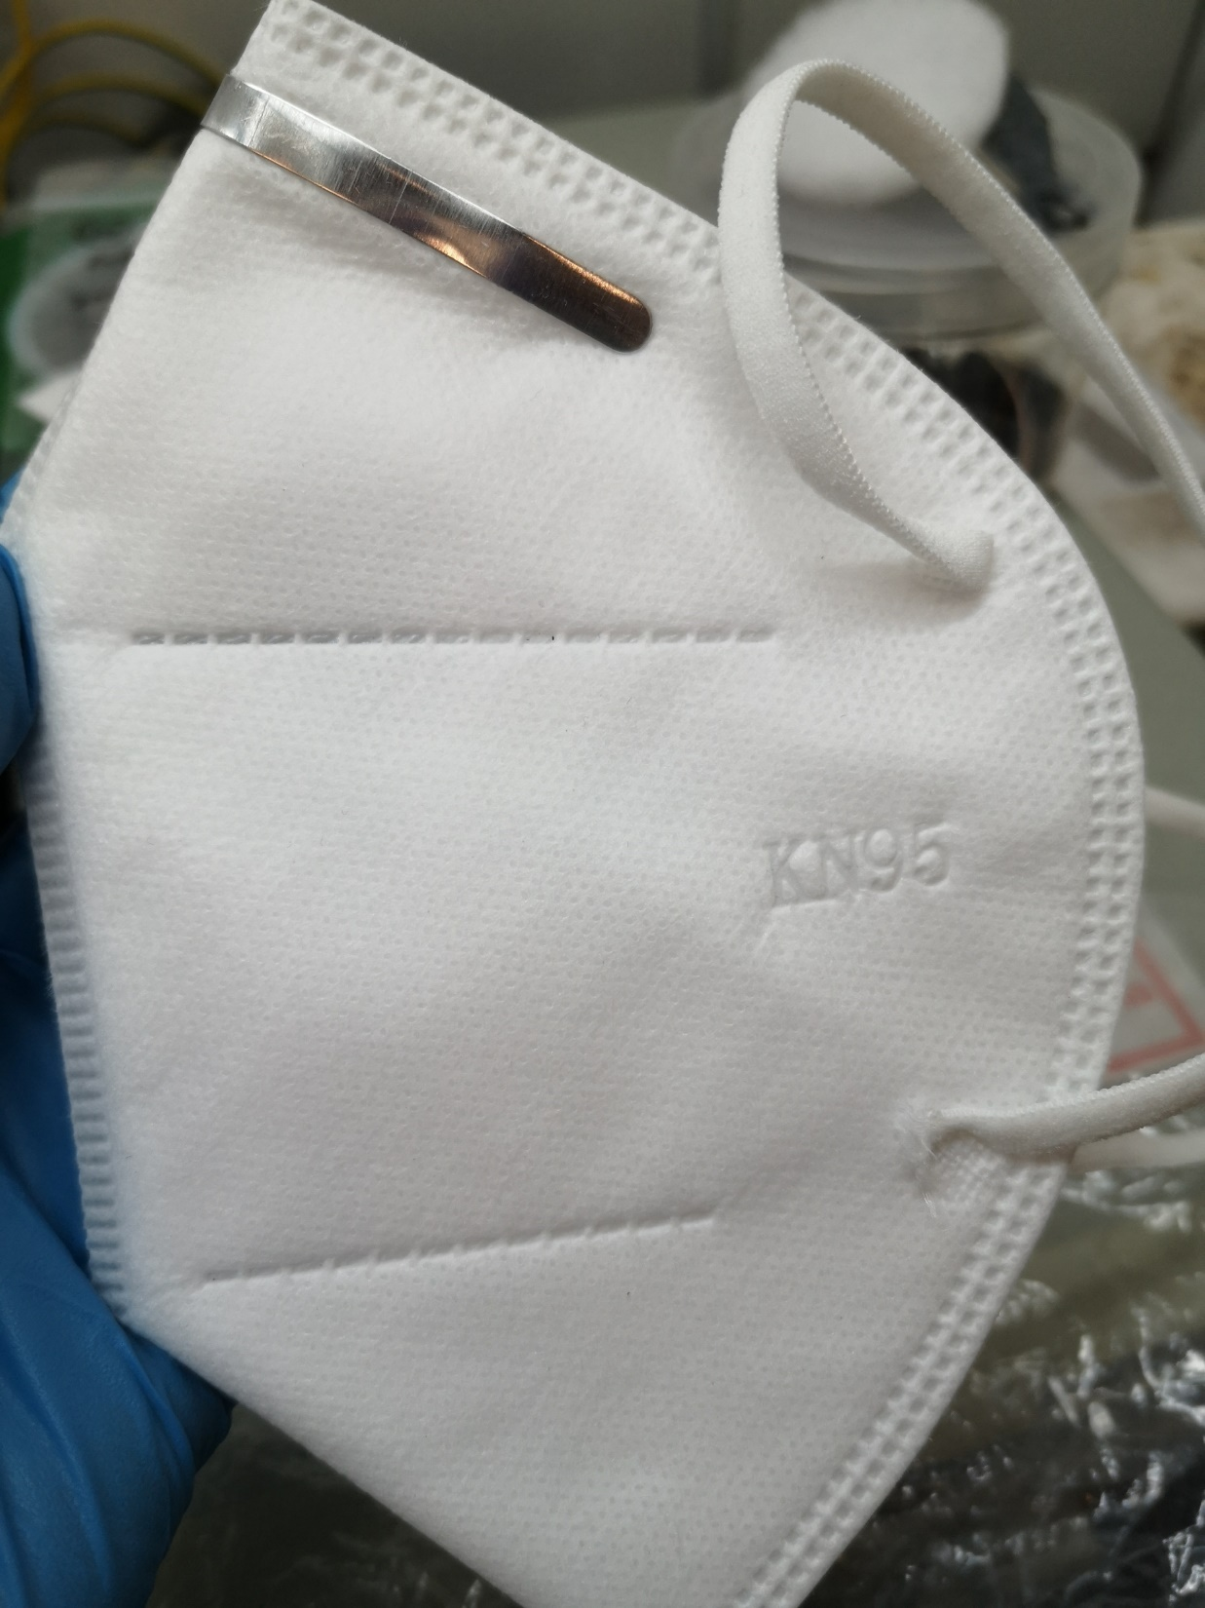
#17 Unmarked batch 6
Notes:
Photos from Nicole

Slide 21
N95 masks tested

Slide 22
#18-20: No images collected
IMAGES AVAILABLE ONLINE
#18 3M 1860/1860s (equivalent mask models in different sizes)
https://www.3m.com/3M/en_US/company-us/all-3m-products/~/3M-Health-Care-Particulate-Respirator-and-Surgical-Mask-1860-N95-120-EA-Case/?N=5002385+3294795990&rt=rud
#19 3M 8210
https://www.3m.com/3M/en_US/company-us/all-3m-products/~/3M-Particulate-Respirator-8210-N95-160-EA-Case/?N=5002385+3294780268&preselect=3293786499&rt=rud
#18 3M 9210
https://www.3m.com/3M/en_US/company-us/all-3m-products/~/3M-Aura-Particulate-Respirator-9210-37192-N95-240-ea-Case/?N=5002385+3291508380&preselect=3293786499&rt=rud
Notes:
Photos from Nicole

Slide 23
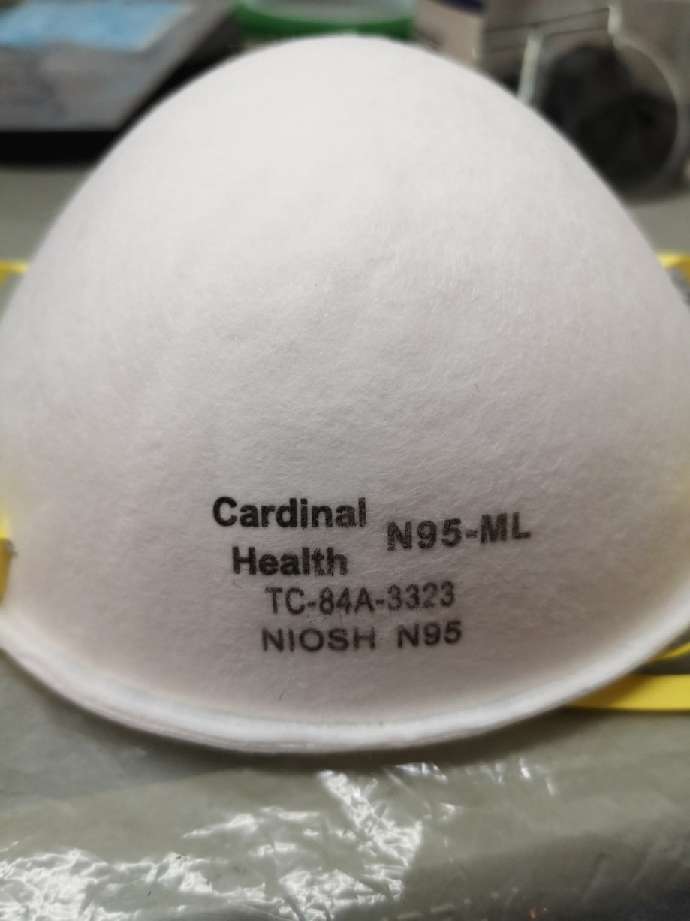
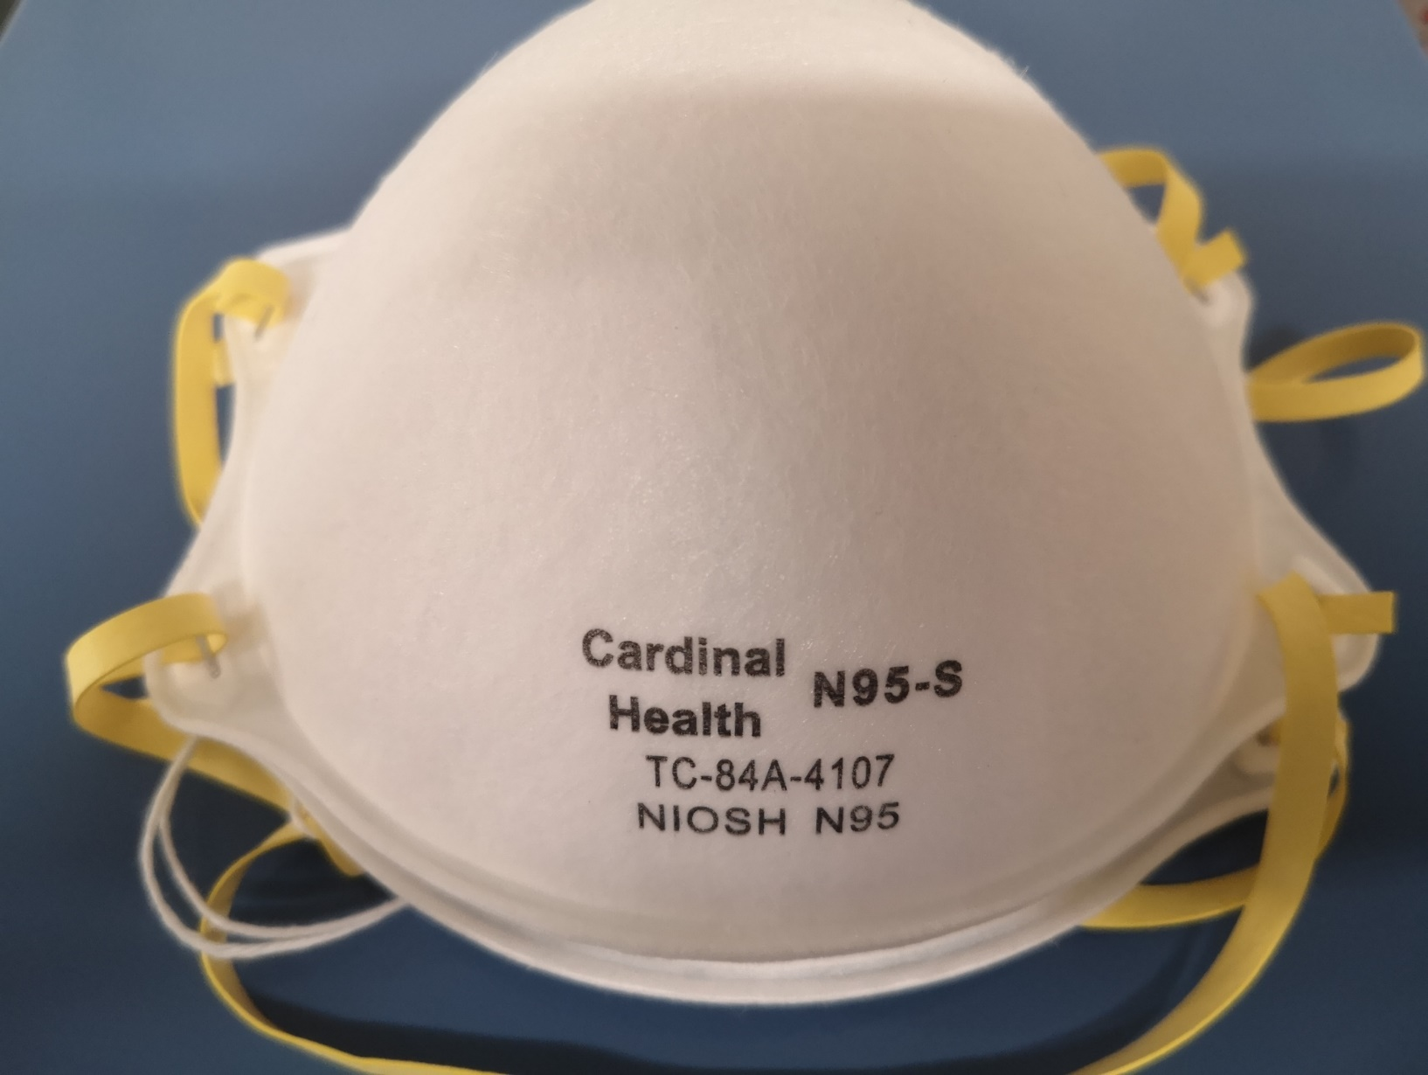
#21 Cardinal Health ML/S
EQUIVALENT MASK MODELS IN DIFFERENT SIZES
Notes:
Photos from Nicole

Slide 24
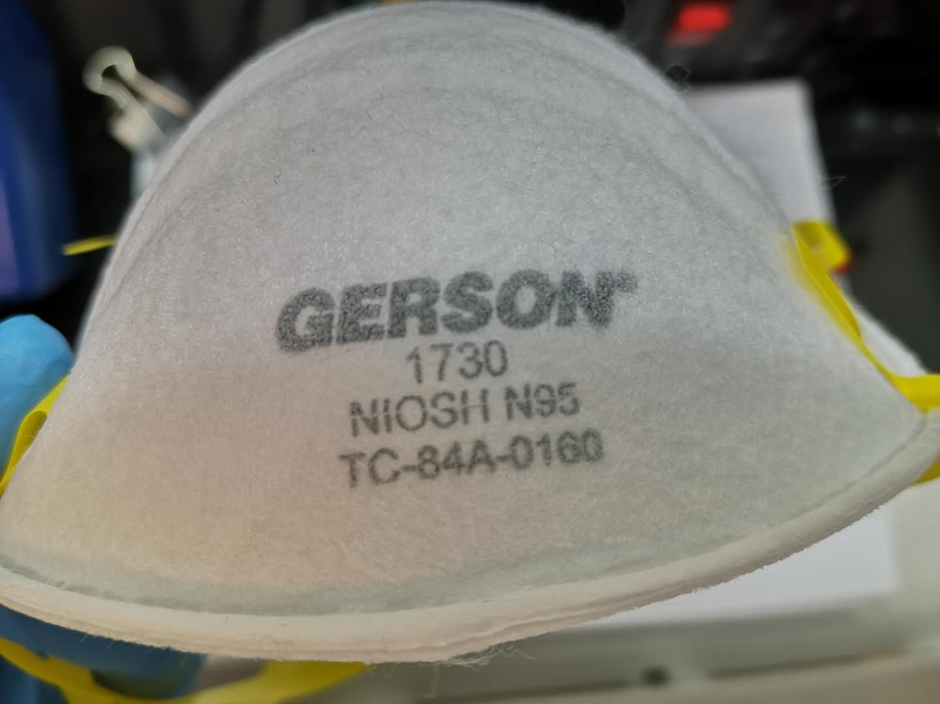
#22 Gerson 1730
Notes:
Photos from Nicole

Slide 25
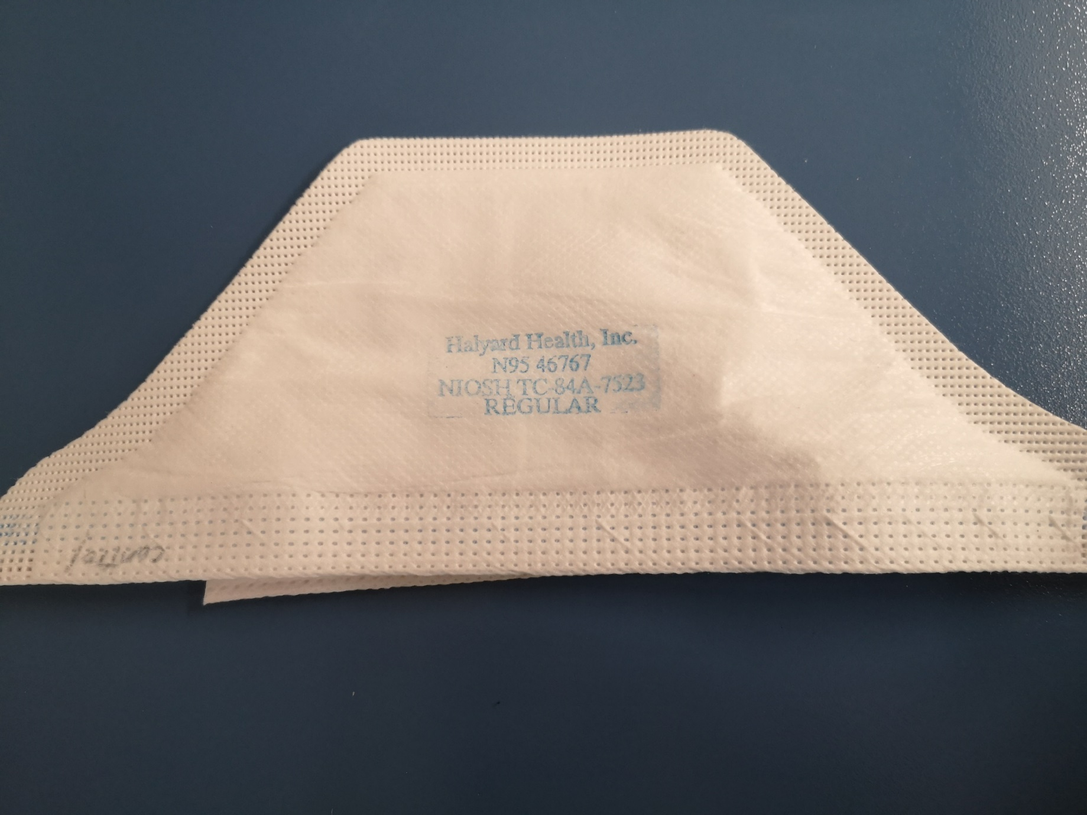
#23
Kimberly-Clark 46767 (duckbill)
Notes:
Photos from Nicole

Slide 26
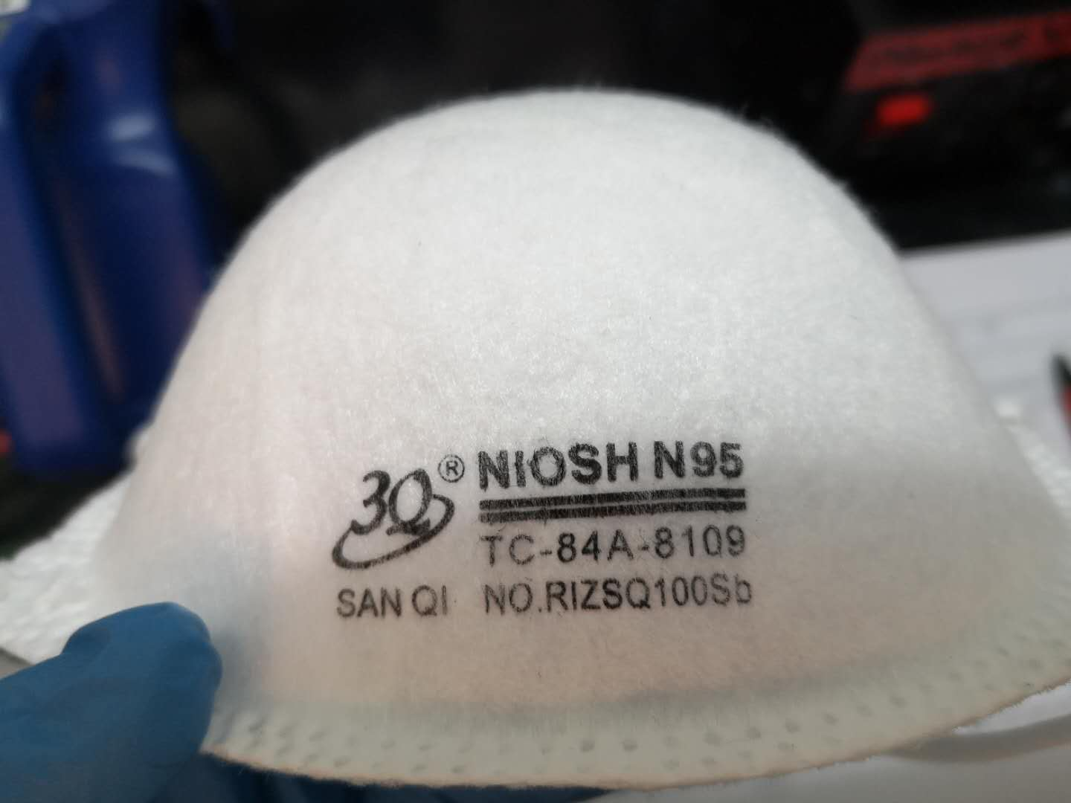
#24 Rizhao 3Q SanQi RIZSQ100Sb
Notes:
Photos from Nicole

Slide 27
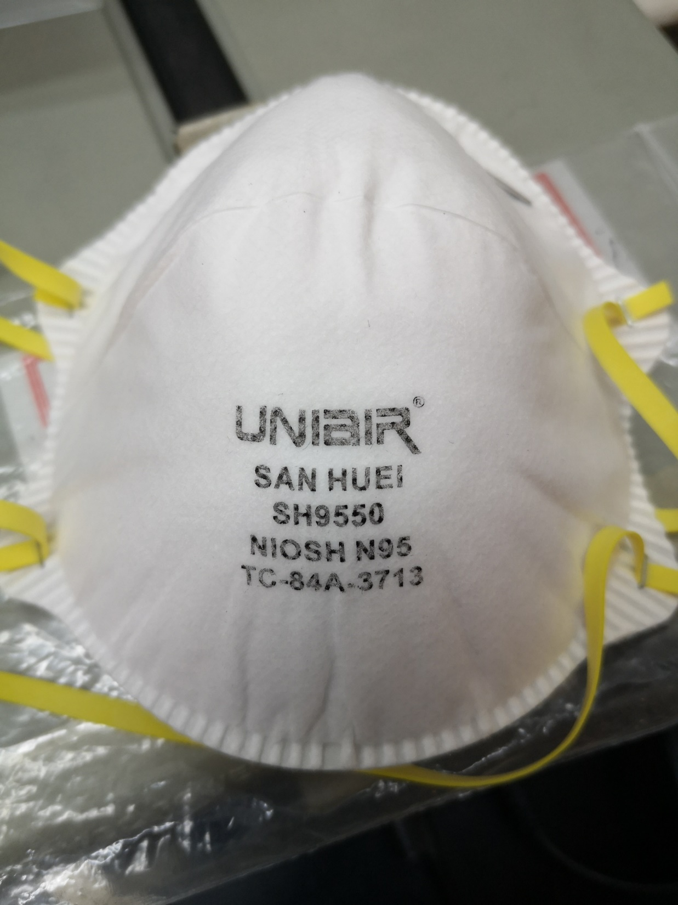
#25 San Huei SH9550

