Slide 1
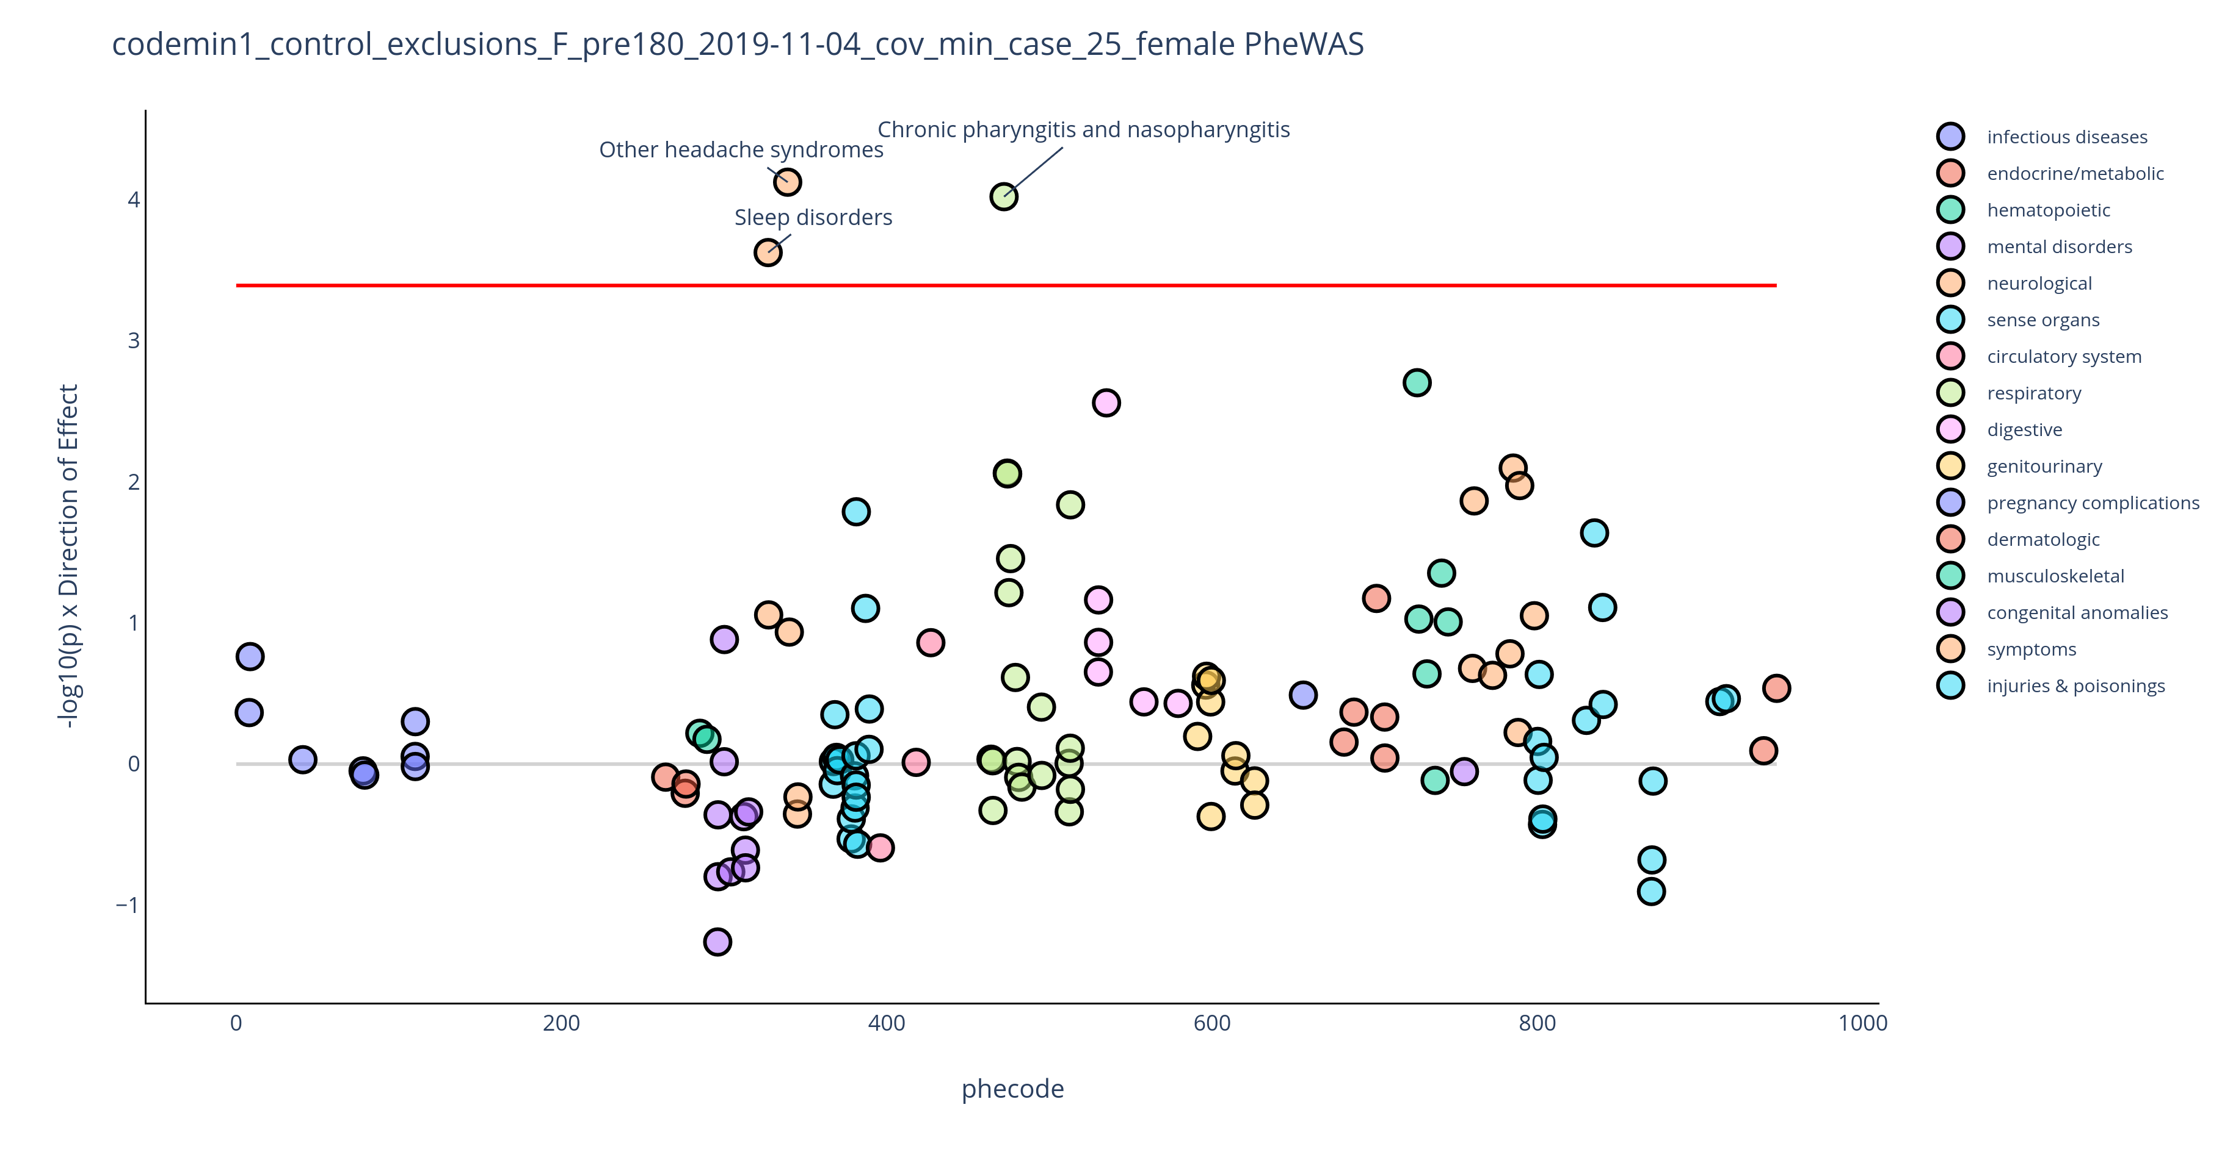
Supplemental Figure 1. Results from a PheWAS of 123 phecodes assigned at least 180 days before the index event in female pediatric PCS cases and matched controls. To ensure sufficient cell counts for interpretable odds ratios, only phecodes with at least 25 affected patients were included. The red line denotes the Bonferroni threshold for phenome-wide significance (0.05/123=4.07x10⁻⁴). Phecodes plotted above the x-axis are associated with an increased odds of PCS while those plotted below the x-axis are associated with a reduced odds of PCS. Interactive plots are available at https://dennislab.ca/resources-and-software/.

Slide 2
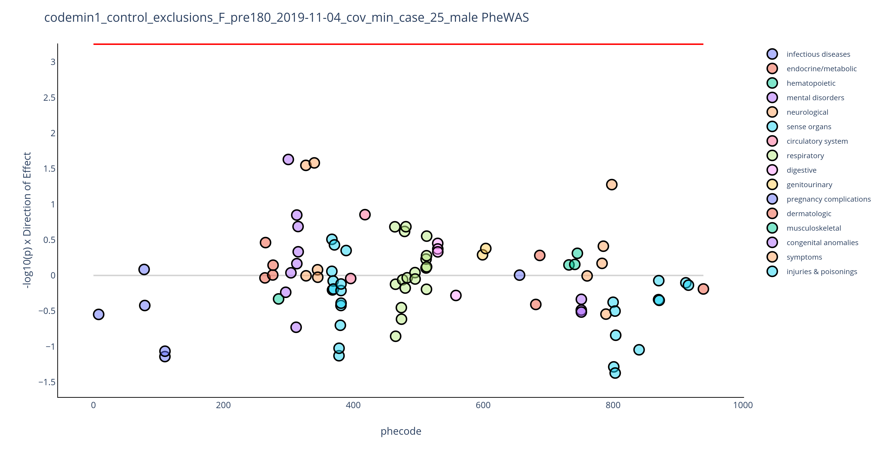
Supplemental Figure 2. Results from a PheWAS of 89 phecodes assigned at least 180 days before the index event in male pediatric PCS cases and matched controls. To ensure sufficient cell counts for interpretable odds ratios, only phecodes with at least 25 affected patients were included. The red line denotes the Bonferroni threshold for phenome-wide significance (0.05/89=5.62x10⁻⁴). Phecodes plotted above the x-axis are associated with an increased odds of PCS while those plotted below the x-axis are associated with a reduced odds of PCS. Interactive plots are available at https://dennislab.ca/resources-and-software/.

Slide 3
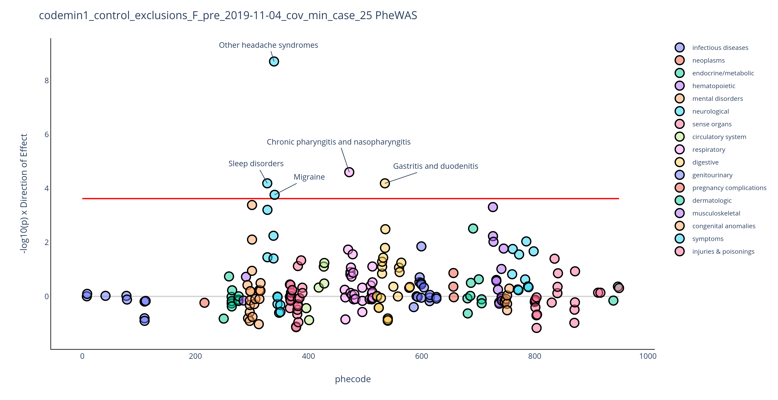
Supplemental Figure 3. Results from a PheWAS of 211 phecodes assigned at least 30 days before the index event in pediatric PCS cases and matched controls. To ensure sufficient cell counts for interpretable odds ratios, only phecodes with at least 25 affected patients were included. The red line denotes the Bonferroni threshold for phenome-wide significance (0.05/211=2.37x10⁻⁴). Phecodes plotted above the x-axis are associated with an increased odds of PCS while those plotted below the x-axis are associated with a reduced odds of PCS. Interactive plots are available at https://dennislab.ca/resources-and-software/.

