Slide 1
Parameter | Without Diabetes (N=6,801) | With Diabetes (N=1,380) | P-value
Age (years) | 44.1 (±15.3) | 56.9 (±12.9) | <0.001
Male sex (%) | 3,902 (57.4) | 838 (60.7) | 0.022
Mortalidad (%) | 421 (6.2) | 263 (19.1) | <0.001
Hospitalization (%) | 2,134 (31.4) | 888 (64.3) | <0.001
Pnenumonia (%) | 1,582 (23.3) | 703 (50.9) | <0.001
ICU admission (%) | 275 (4) | 118 (8.6) | 0.760
Invasive ventilation (%) | 254 (3.7) | 115 (8.3) | 0.417
COPD (%) | 126 (1.9) | 95 (6.9) | <0.001
Asthma (%) | 234 (3.4) | 56 (4.1) | 0.249
Immunosupression (%) | 110 (1.6) | 51 (3.7) | <0.001
Hypertension (%) | 1,003 (14.7) | 696 (50.4) | <0.001
Obesity (%) | 1,168 (17.2) | 435 (31.5) | <0.001
CKD (%) | 73 (1.1) | 88 (6.4) | <0.001
CVD (%) | 140 (2.1) | 110 (8) | <0.001
Smoking (%) | 612 (9) | 147 (10.7) | 0.052
Supplementary Table 1. Characteristics of SARS-CoV2 confirmed cases in Mexico according to diabetes status at 04/19/2020. Abbreviations: ICU= intense care unit; COPD= chronic obstructive pulmonary disease

Slide 2
Parameter | Without Obesity (N=6,581) | With Obesity (N=1,605) | P-value
Age (years) | 45.7 (±16.1) | 48.3 (±13.9) | <0.001
Male sex (%) | 3,844 (58.4) | 898 (56) | <0.001
Mortalidad (%) | 470 (7.1) | 216 (13.5) | <0.001
Hospitalization (%) | 2,265 (34.4) | 759 (47.3) | <0.001
Pnenumonia (%) | 1,702 (25.9) | 585 (36.4) | <0.001
ICU admission (%) | 278 (4.2) | 116 (7.2) | 0.034
Invasive ventilation (%) | 260 (4) | 110 (6.9) | 0.029
COPD (%) | 156 (2.4) | 65 (4) | <0.001
Asthma (%) | 200 (3) | 89 (5.5) | <0.001
Immunosupression (%) | 123 (1.9) | 38 (2.4) | 0.194
Hypertension (%) | 1,142 (17.4) | 556 (34.6) | <0.001
Diabetes (%) | 944 (14.3) | 435 (27.1) | <0.001
CKD (%) | 129 (2) | 32 (2) | 0.932
CVD (%) | 174 (2.6) | 76 (4.7) | <0.001
Smoking (%) | 542 (8.2) | 218 (13.6) | <0.001
Supplementary Table 2. Characteristics of SARS-CoV2 confirmed cases in Mexico according to obesity status at 04/19/2020. Abbreviations: ICU= intense care unit; COPD= chronic obstructive pulmonary disease

Slide 3
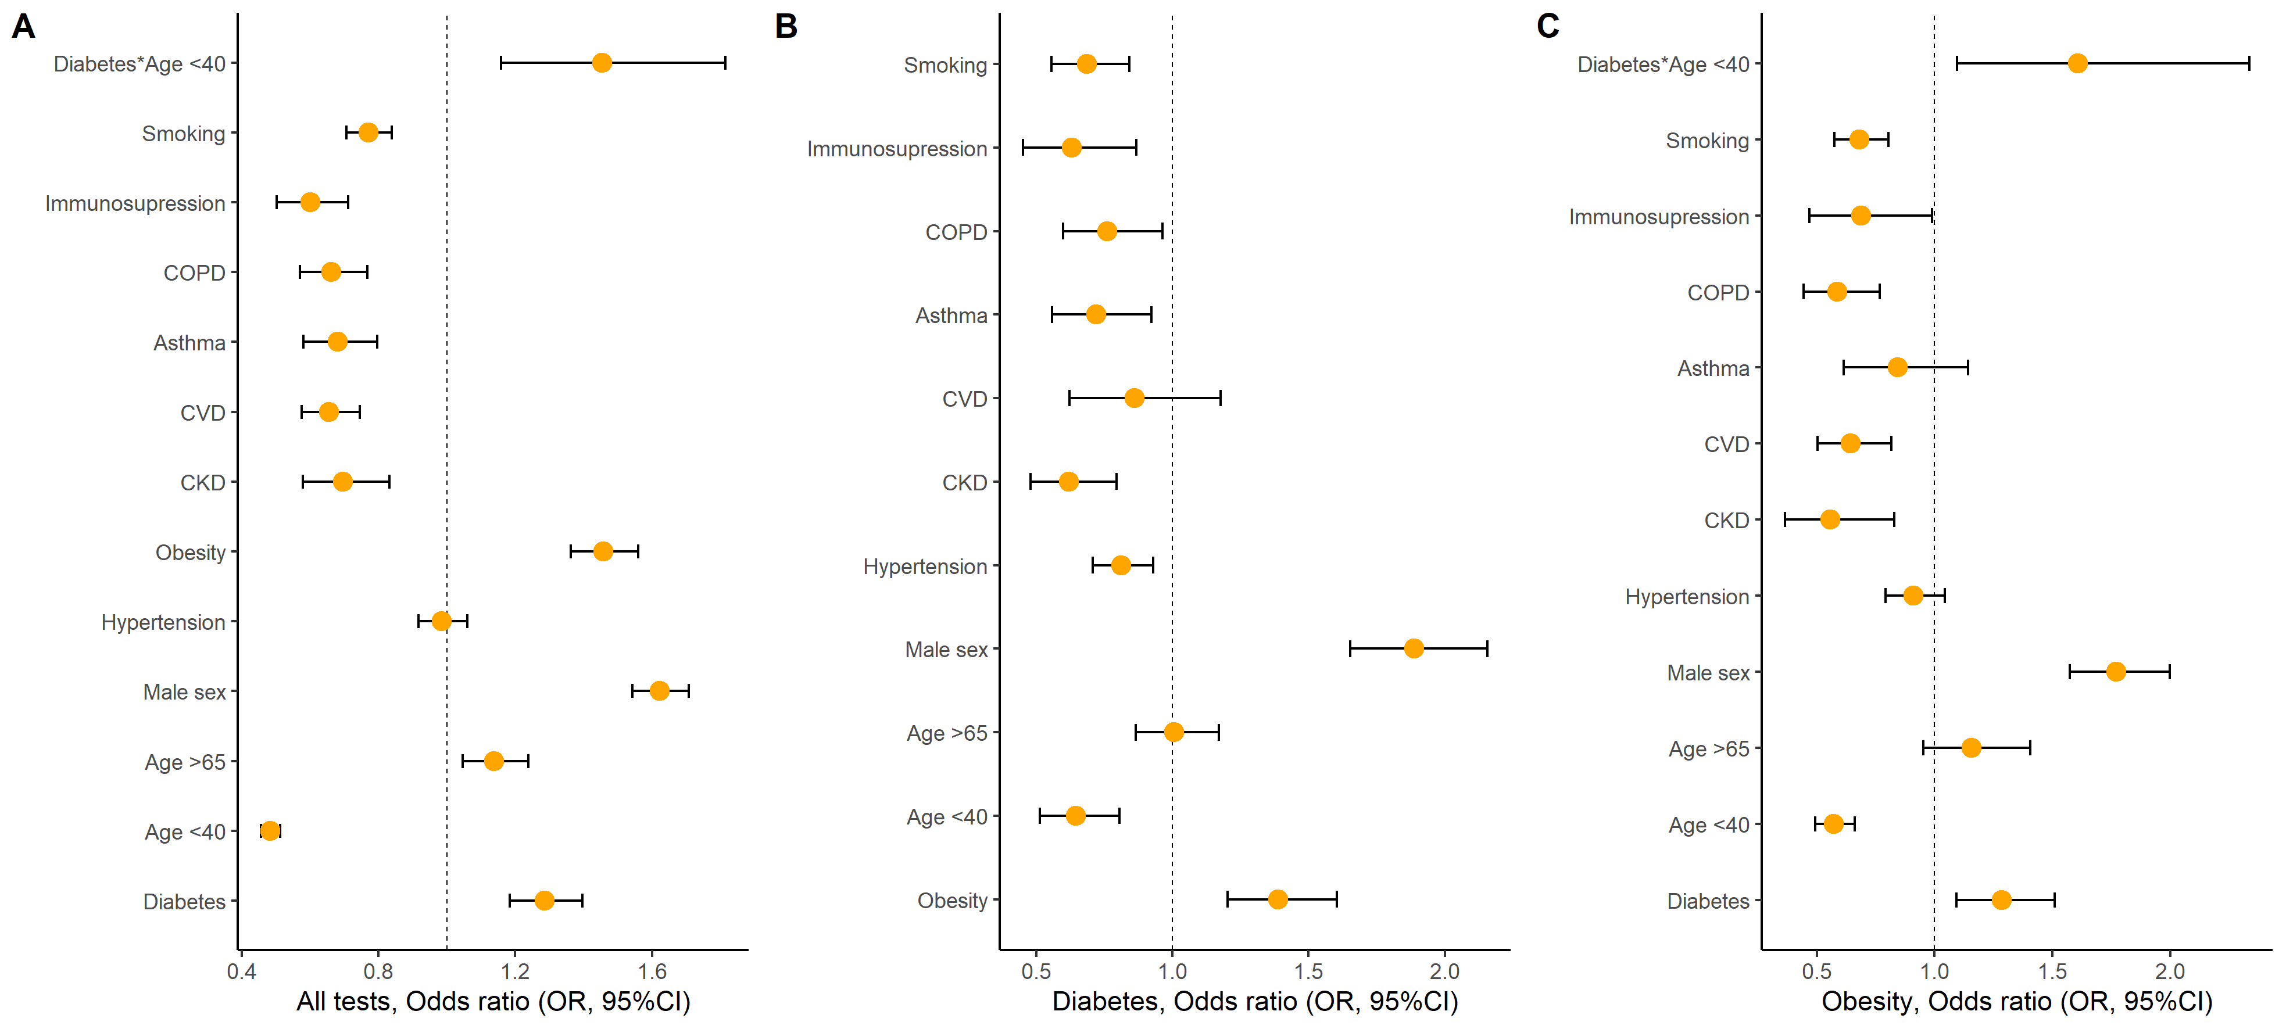
Supplementary Figure 1. Logistic regression analysis to estimate probability of SARS-CoV-2 positivity in Mexico, compared to confirmed SARS-CoV2 negative cases for all suspected cases with SARS-CoV2 status available (A) and stratified by diabetes mellitus (B) and obesity (C). Abbreviations: ICU= intense care unit; COPD= chronic obstructive pulmonary disease; CKD= chronic kidney disease; CVD= cardiovascular disease

Slide 4
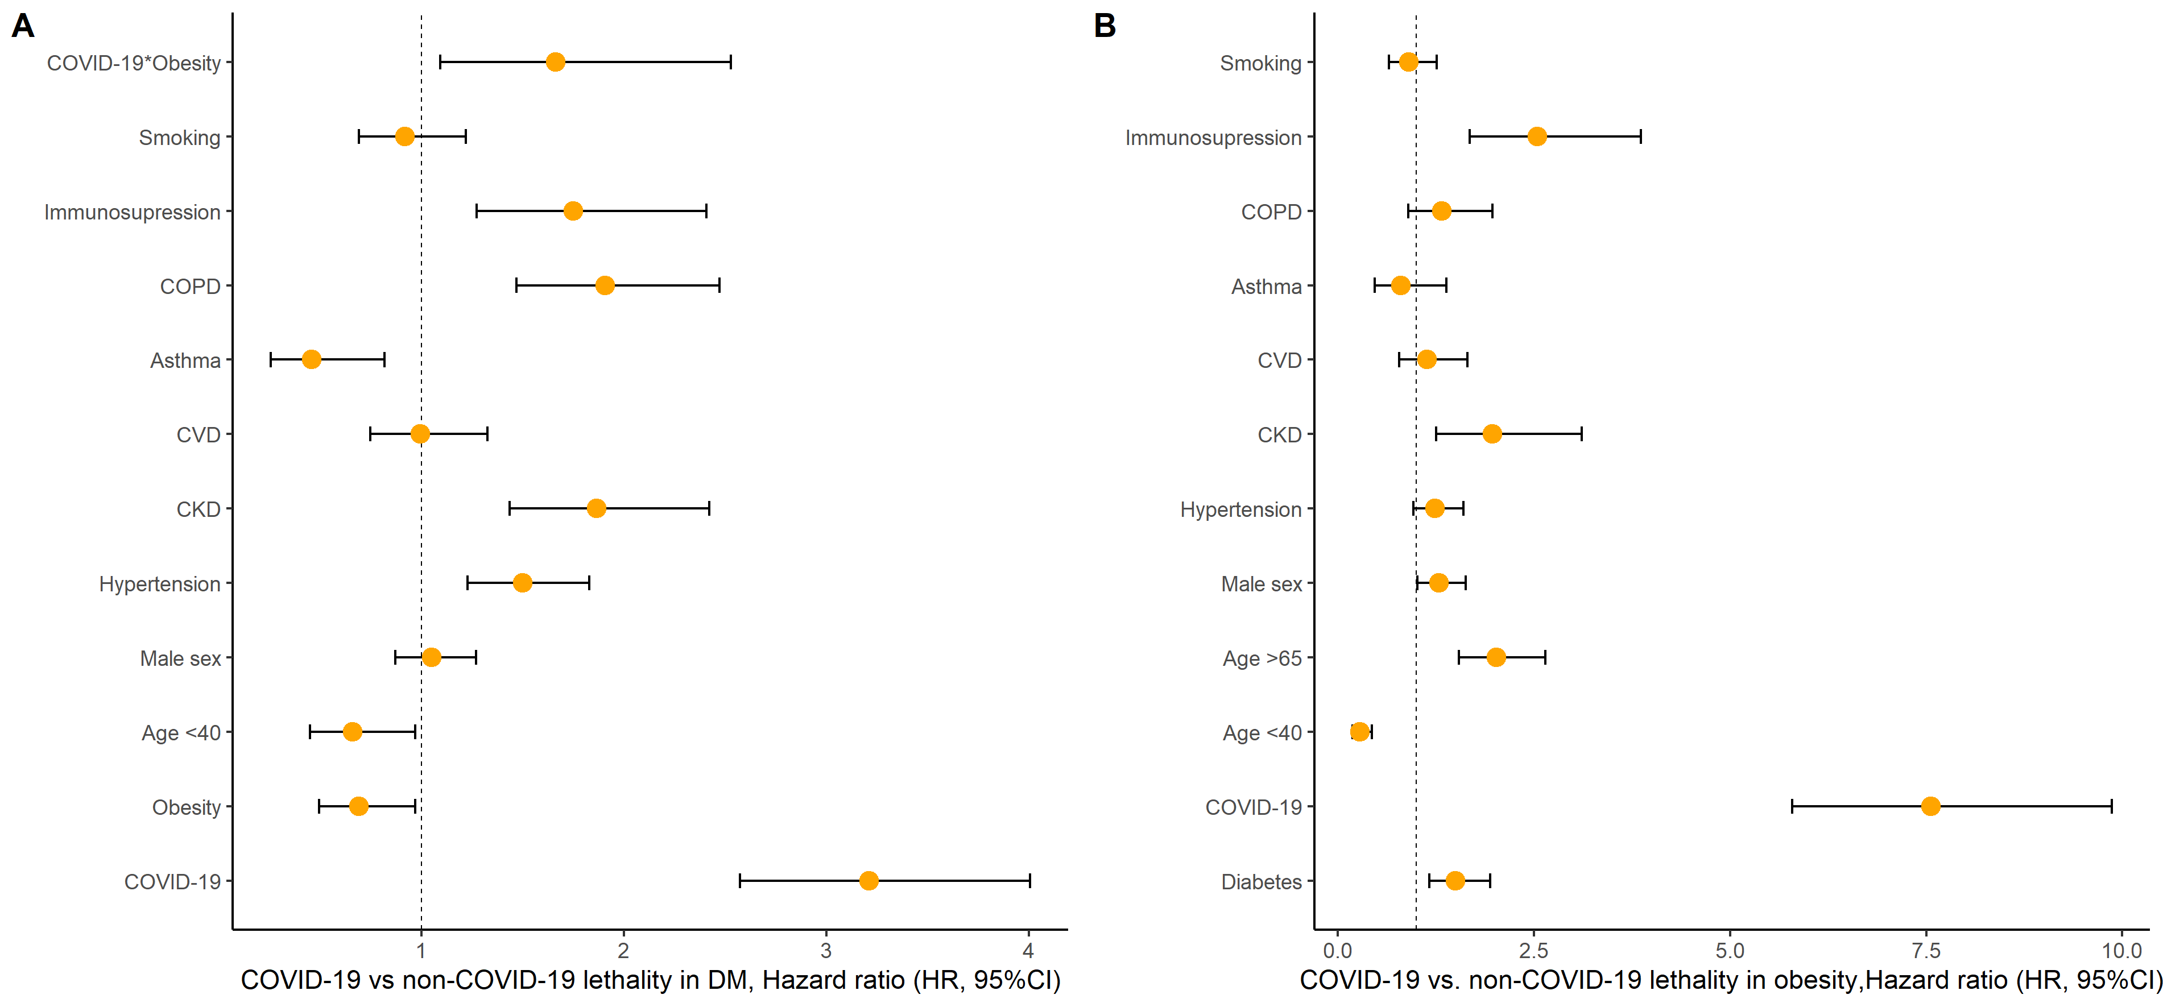
Supplementary Figure 2. Cox proportional Hazards regression analysis to estimate risk of COVID-19 and its interaction with comodbidities in patients with A) Diabetes and B) Obesity. Abbreviations: COPD= chronic obstructive pulmonary disease; CKD= chronic kidney disease; CVD= cardiovascular disease

