Slide 1
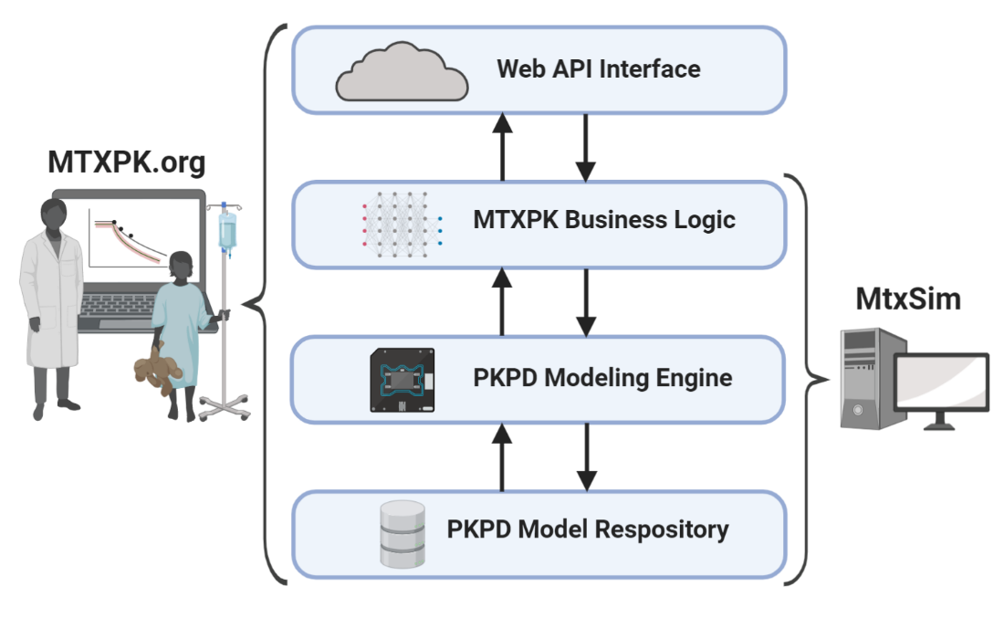
Figure S1: Architecture of MTXPK.org. MTXPK.org (left) is a web application that uses a Web API interface to interact with the end user. Commands are entered by the user then are automatically translated down a layer to the MTXPK business logic, where they undergo command processing. The logic string will call upon the general PKPD modeling engine, which uses a PKPD modeling repository to provide proper Bayesian estimation and simulation of the elimination curves. Processed information is sent back up the layering to the Web API to be presented to the end user. MtxSim (right) follows a similar logic string, but lacks the Web API interface to interact publicly with the end user.
API: Application programming interface
PKPD: Pharmacokinetic/Pharmacodynamic

Slide 2
A.
B.
Figure S2: Additional covariate analysis. Once clearance was normalized to BSA, there was no significant effect of sex (A) on clearance estimates (p = 0.39). Age did not share a significant linear relationship with normalized clearance (B). The line within the box represents the median, the box represents the inter-quartile range, with the whiskers representing the minimum and maximum values. Gray circles depict the estimated clearance values at the given age at the start of treatment. The black line represents a linear regression.

Slide 3
Figure S3: Impact of country of treatment on clearance estimates. Finnish patients had an estimated 26% faster clearance compared to Swedish, Dutch, and Norwegian patients (p < 0.001). The line within the box represents the median value. The box represents the inter-quartile range with the whiskers representing the minimum and maximum values.
*** corresponds to a p < 0.0001

Slide 4
Table S1: Model parameters for evaluation
Model Name | Trevino ª (18) |  | Kawakatsu ^{ab} (27) |  | NOPHO ^{b} – 2CP |  | NOPHO ^{b} - 3CP
CL | 111.9 ^{c} | ml/min/m² | 12 | L/h/70kg | 11.1 | L/h/1.73m² | 11 | L/h/1.73m²
 | 10.9 ^{de} | L/h/1.73m² | 10.51 | L/h/1.73m²
V(1) | - | - | 52 | L/70kg | 26.6 | L/1.73m² | 16.5 | L/1.73m²
 | - | - | 45.54 | L/1.73m²
Q(2) | - | - | 0.1 | L/h/70kg | 0.289 | L/h/1.73m² | 0.602 | L/h/1.73m²
 | - | - | 0.087 | L/h/1.73m²
V2 | - | - | 5.6 | L/70kg | 4.24 | L/1.73m² | 4.55 | L/1.73m²
 | - | - | 4.9 | L/1.73m²
Q3 | - | - | - | - | - | - | 0.111 | L/h/1.73m²
 | - | - | - | - | - | -
V3 | - | - | - | - | - | - | 13.1 | L/1.73m²
 | - | - | - | - | - | -
Vc | 9 | L/m² | - | - | - | - | - | -
Ke | 0.7 | hour⁻¹ | - | - | - | - | - | -
Kcp | 0.08 | hour⁻¹ | - | - | - | - | - | -
Kpc | 0.11 | hour⁻¹ | - | - | - | - | - | -
Rationale | Two-compartment model used by St. Jude and mtx.stjude.org |  | Two-compartment model with eGFR included in the model |  | Two-compartment model using NOPHO PK data |  | Novel three-compartment model using NOPHO PK data
ª PK parameters were estimated to a normalized 1.73m²
^{b} Additional population PK model parameters exist for this model
^{c} Value was pulled from the mtx.stjude.org website
^{d} Calculated value derived from Ke and Vc
^{e} 11.61 L/h/1.73m² would be the value if derived from mtx.stjude.org
Cl: Clearance of methotrexate from the central compartment
V1: Volume of distribution of methotrexate in the central compartment
Q2: Inter-compartmental clearance for vascular peripheral compartment
V2: Volume of distribution of methotrexate in the vascular compartment
Q3: Inter-compartmental clearance for the non-vascular compartment
V3: Volume of distribution of methotrexate in the non-vascular compartment
Vc: Volume of distribution of the centralcompartment
Ke: Elimination rate constant from the central compartment
Kcp: Elimination rate constant from the central compartment to peripheral compartment
Kpc: Elimination rate constant from the peripheral compartment to central compartment
CP: Compartment
NOPHO: Nordic Society of Pediatric Hematology and Oncology

Slide 5
Table S2: Evaluations of MTX population PK models
 | Population |  | Individual
Model | Bias (%) | Prec (%) | Bias (%) | Prec (%)
Trevino et al. (18) | -38 | 87 | 0.3 | 20
Kawakatsu et al. (27) | 7 | 60 | 0.4 | 12
NOPHO (2-CP) | 10 | 50 | 0.3 | 13
NOPHO (3-CP) | -15 | 55 | -0.2 | 9
Prec: Precision
CP: Compartment

