Slide 1
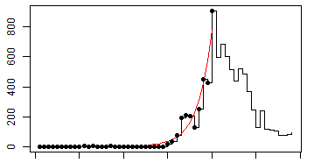
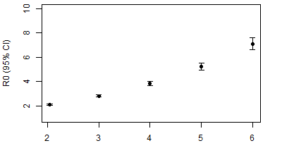
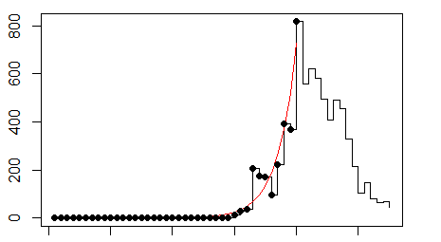
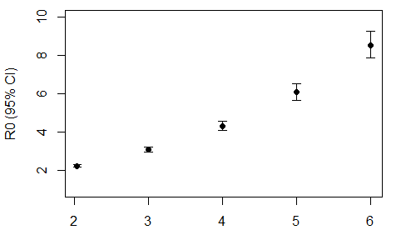
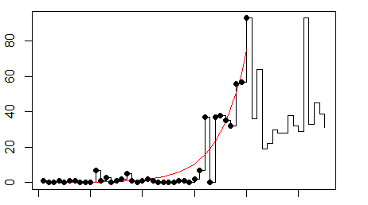
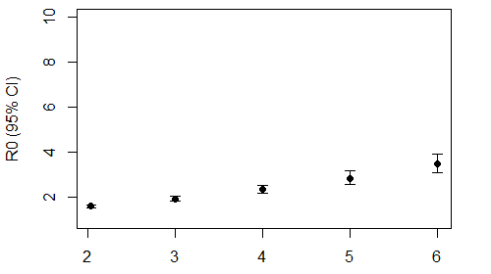
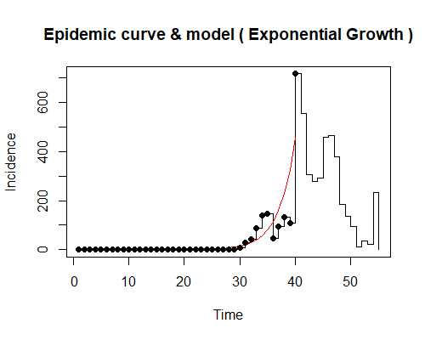
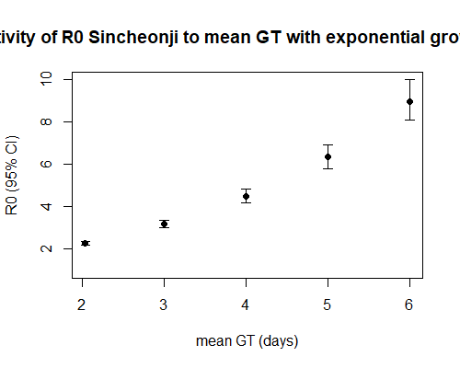
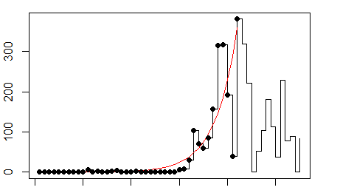
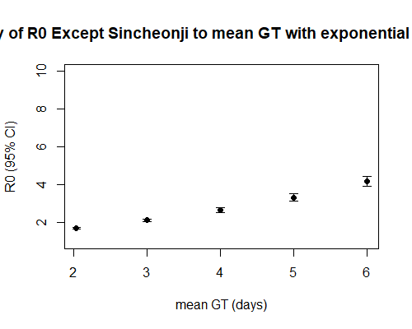
Newly confirmed cases
Total
Total
Day 1–40, R² = 0.94
days
(A)
Assumed mean generation time (day)
Newly confirmed cases
(B)
Daegu-Gyeongbuk
Daegu-Gyeongbuk
Day 1–40, R² = 0.94
days
(C)
Assumed mean generation time (day)
(D)
Newly confirmed cases
Except Daegu-Gyeongbuk
Except Daegu-Gyeongbuk
Day 1–40, R² = 0.80
days
(E)
Assumed mean generation time (day)
Newly confirmed cases
Sincheonji
(F)
Sincheonji
Day 1–40, R² = 0.88
days
(G)
Assumed mean generation time (day)
Newly confirmed cases
(H)
Except Sincheonji
Except Sincheonji
Day 1–42, R² = 0.83
days
(I)
Assumed mean generation time (day)
(J)

