Slide 1
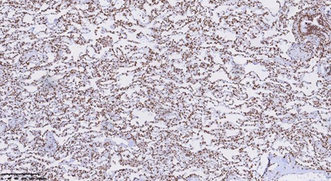
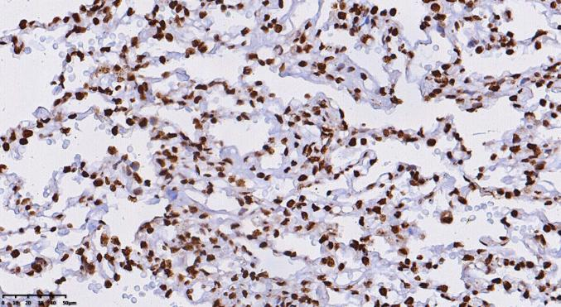
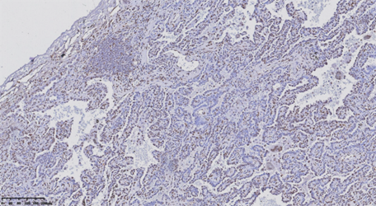
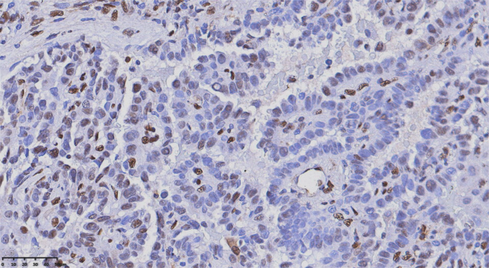
Supplementary 2: HMGB-1 protein expression by Immunohistochemistry in NSCLC.
10X
40X
A
B

Slide 2
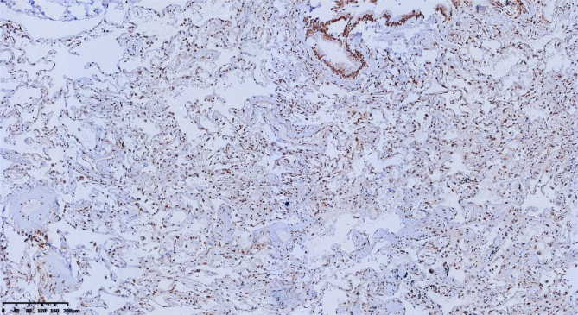
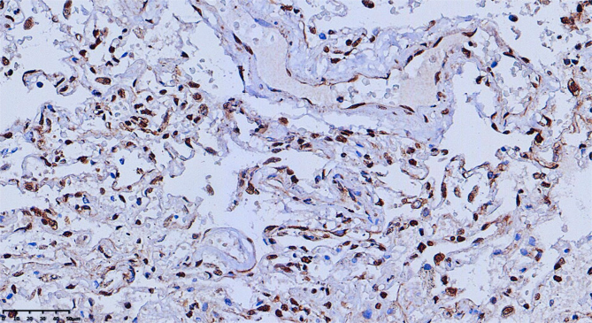
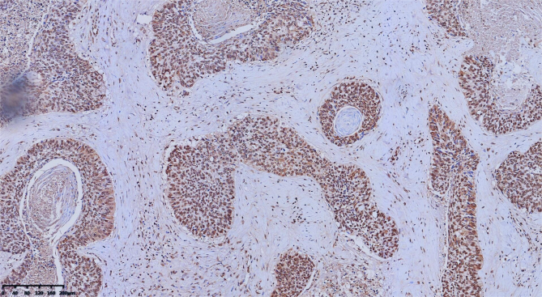
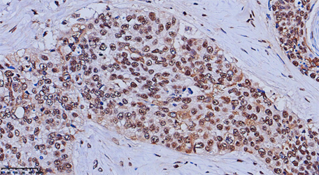
C
D
A: Healthy adjacent tissue to adenocarcinoma tissue, B: Adenocarcinoma tissue
C: Healthy adjacent tissue to squamous carcinoma tissue, D: Squamous carcinoma tissue

