Slide 1
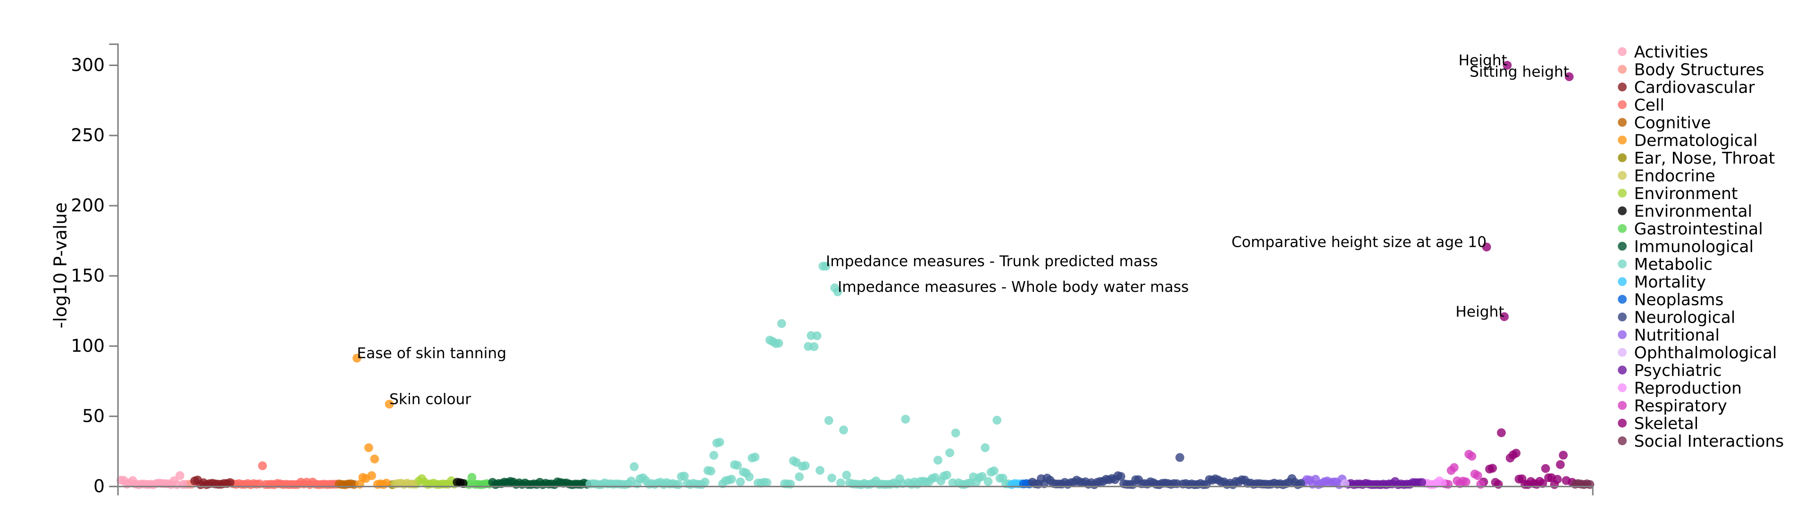
PheWAS of rs143384

Slide 2
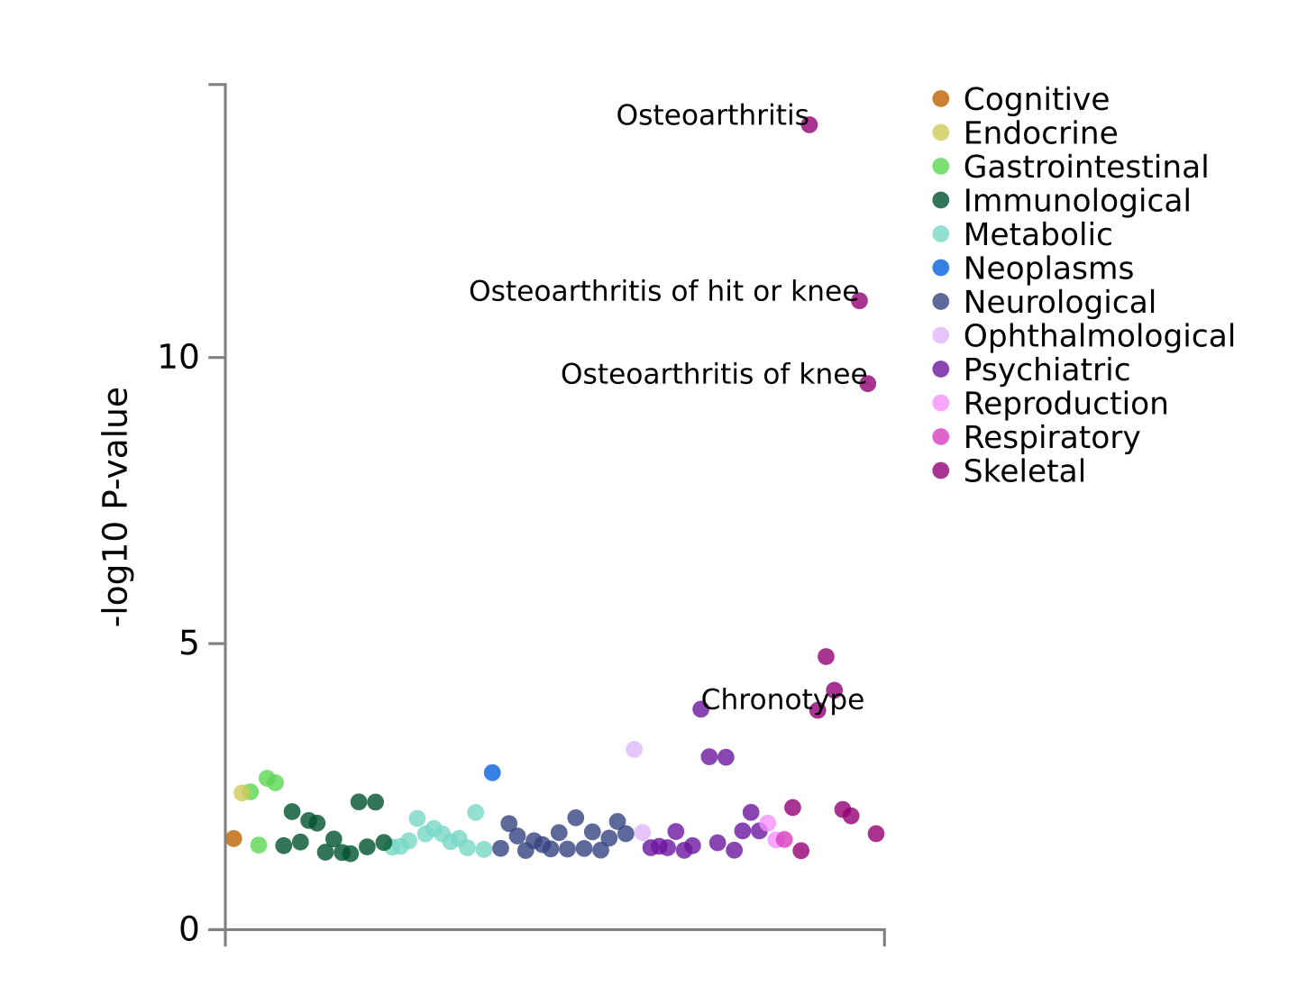
PheWAS of rs919642

Slide 3
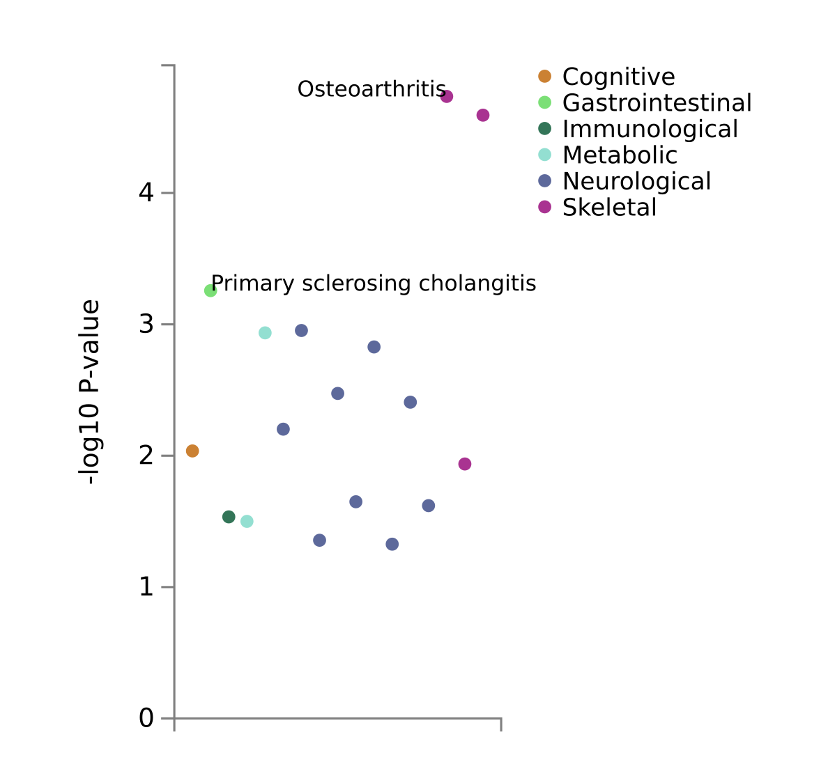
PheWAS of rs56076919

Slide 4
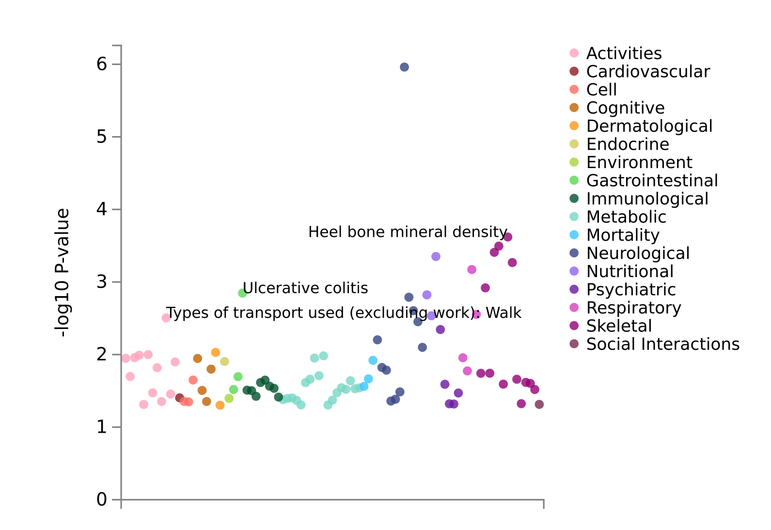
Pain type(s) experienced in last month: Knee pain
PheWAS of rs34148285

Slide 5
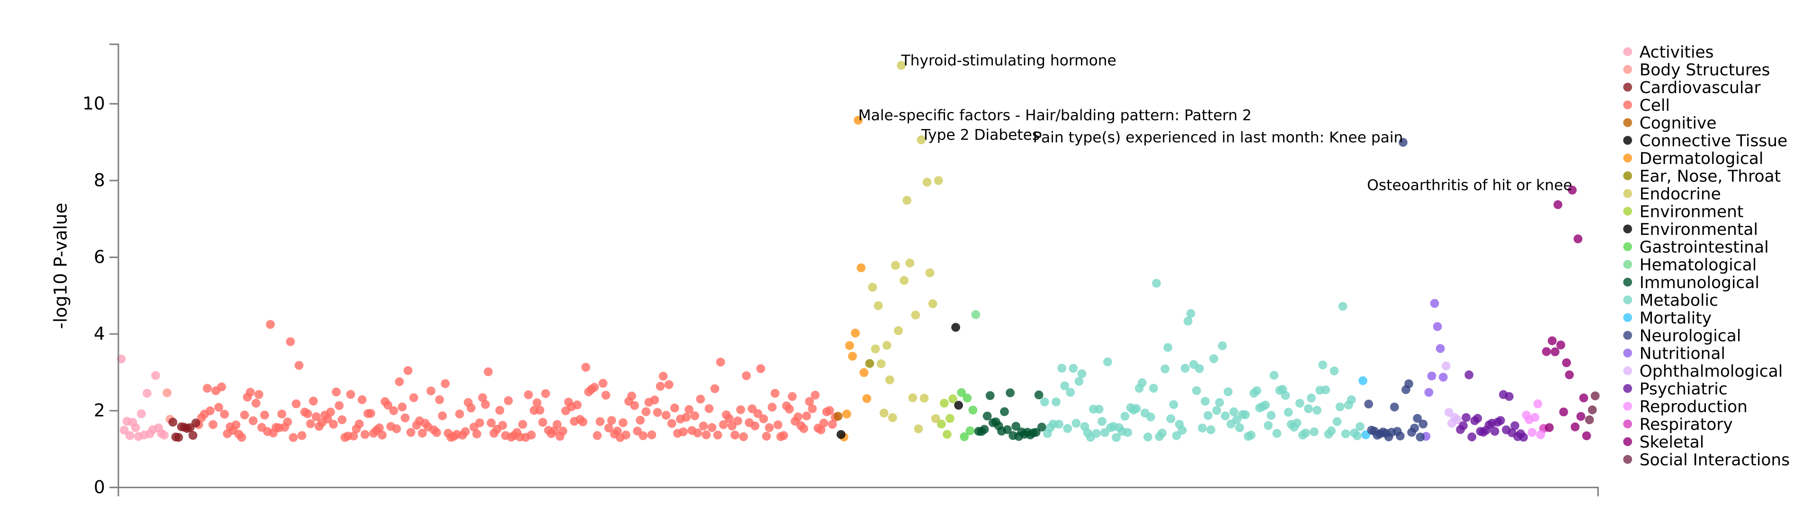
PheWAS of rs3892354

Slide 6
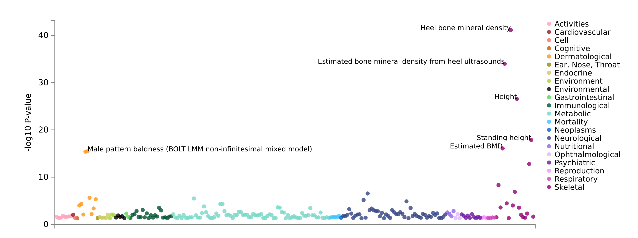
PheWAS of rs687878

Slide 7
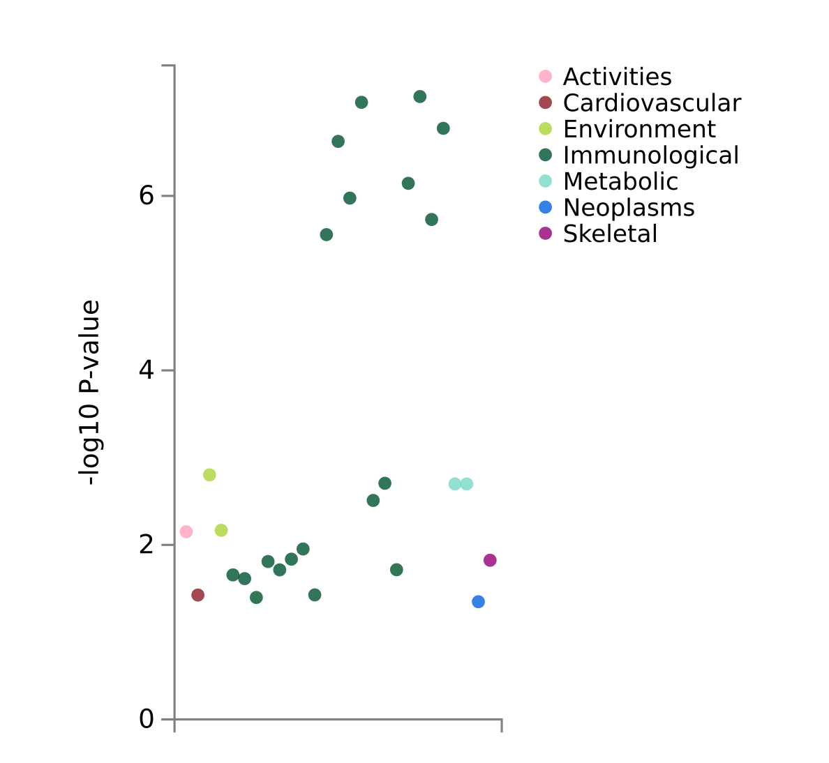
Reticulocyte count (two-way meta)
High light scatter reticulocyte count (two-way meta)
PheWAS of rs687878

Slide 8
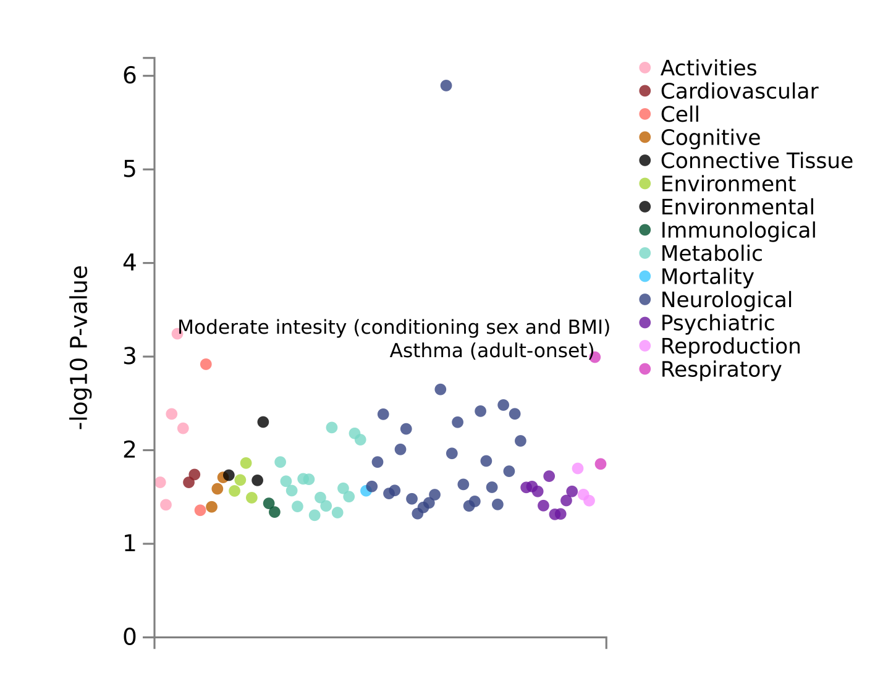
Pain type(s) experienced in last month: Knee pain
PheWAS of rs145408100

