Slide 1
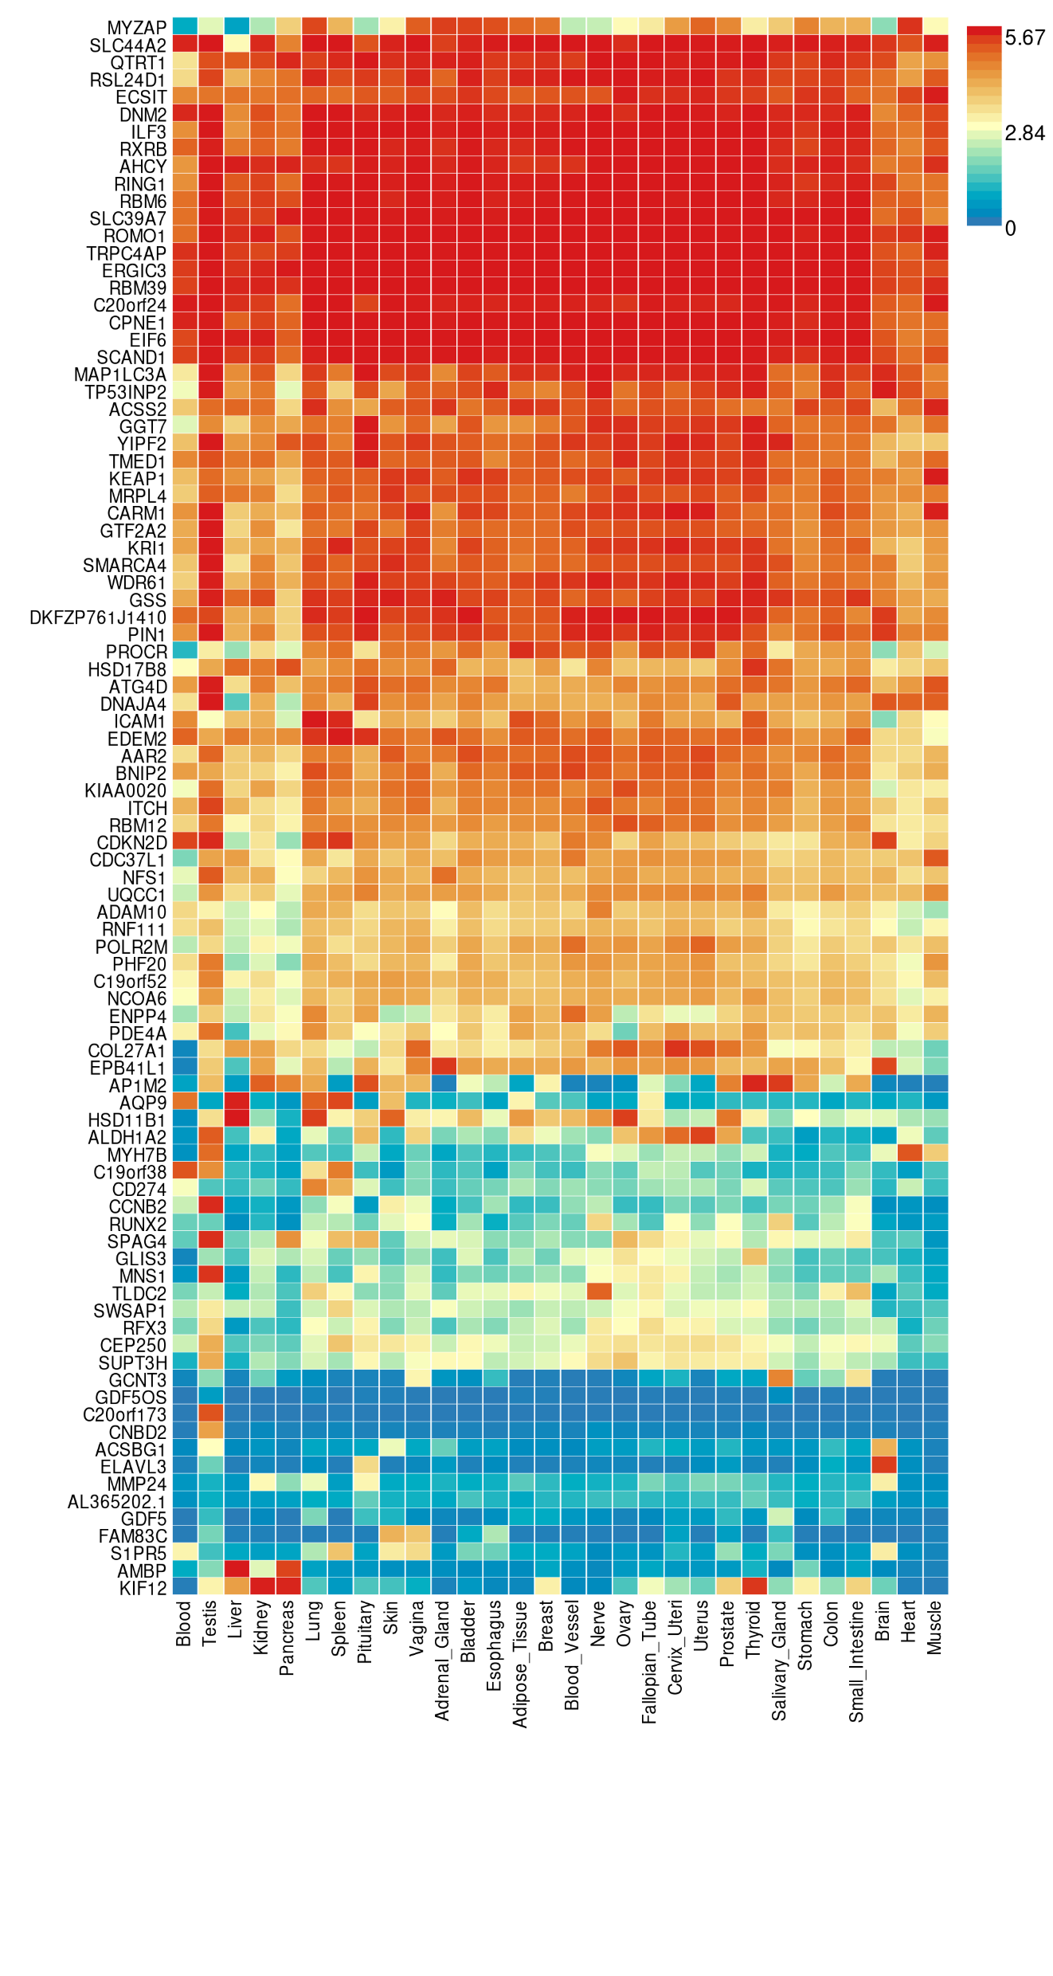
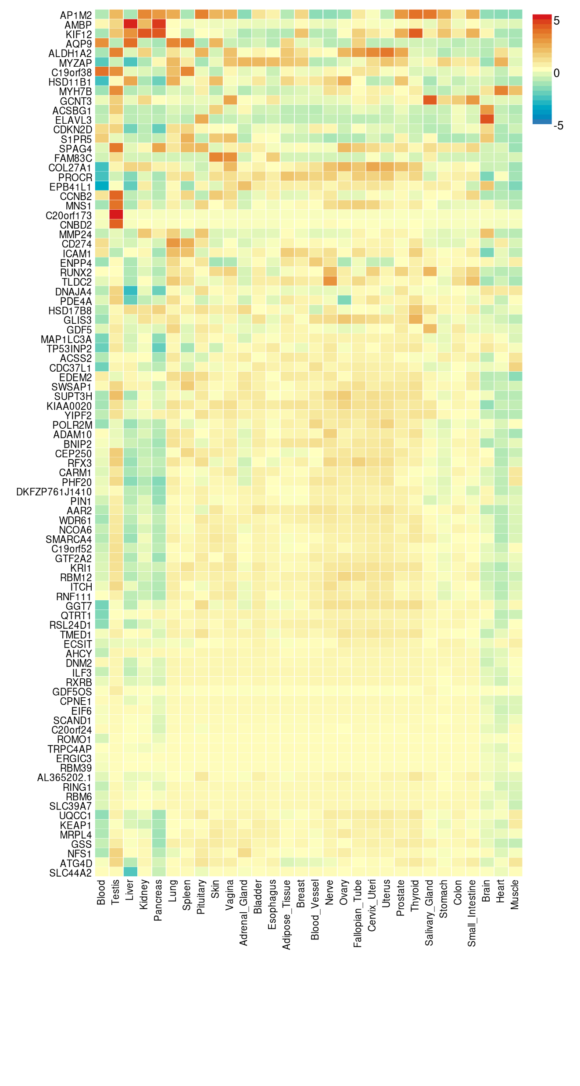
Average expression per label (log2 transformed)
Average of normalized expression per label (zero mean across samples)
GTEx v8 30 tissue types

Slide 2
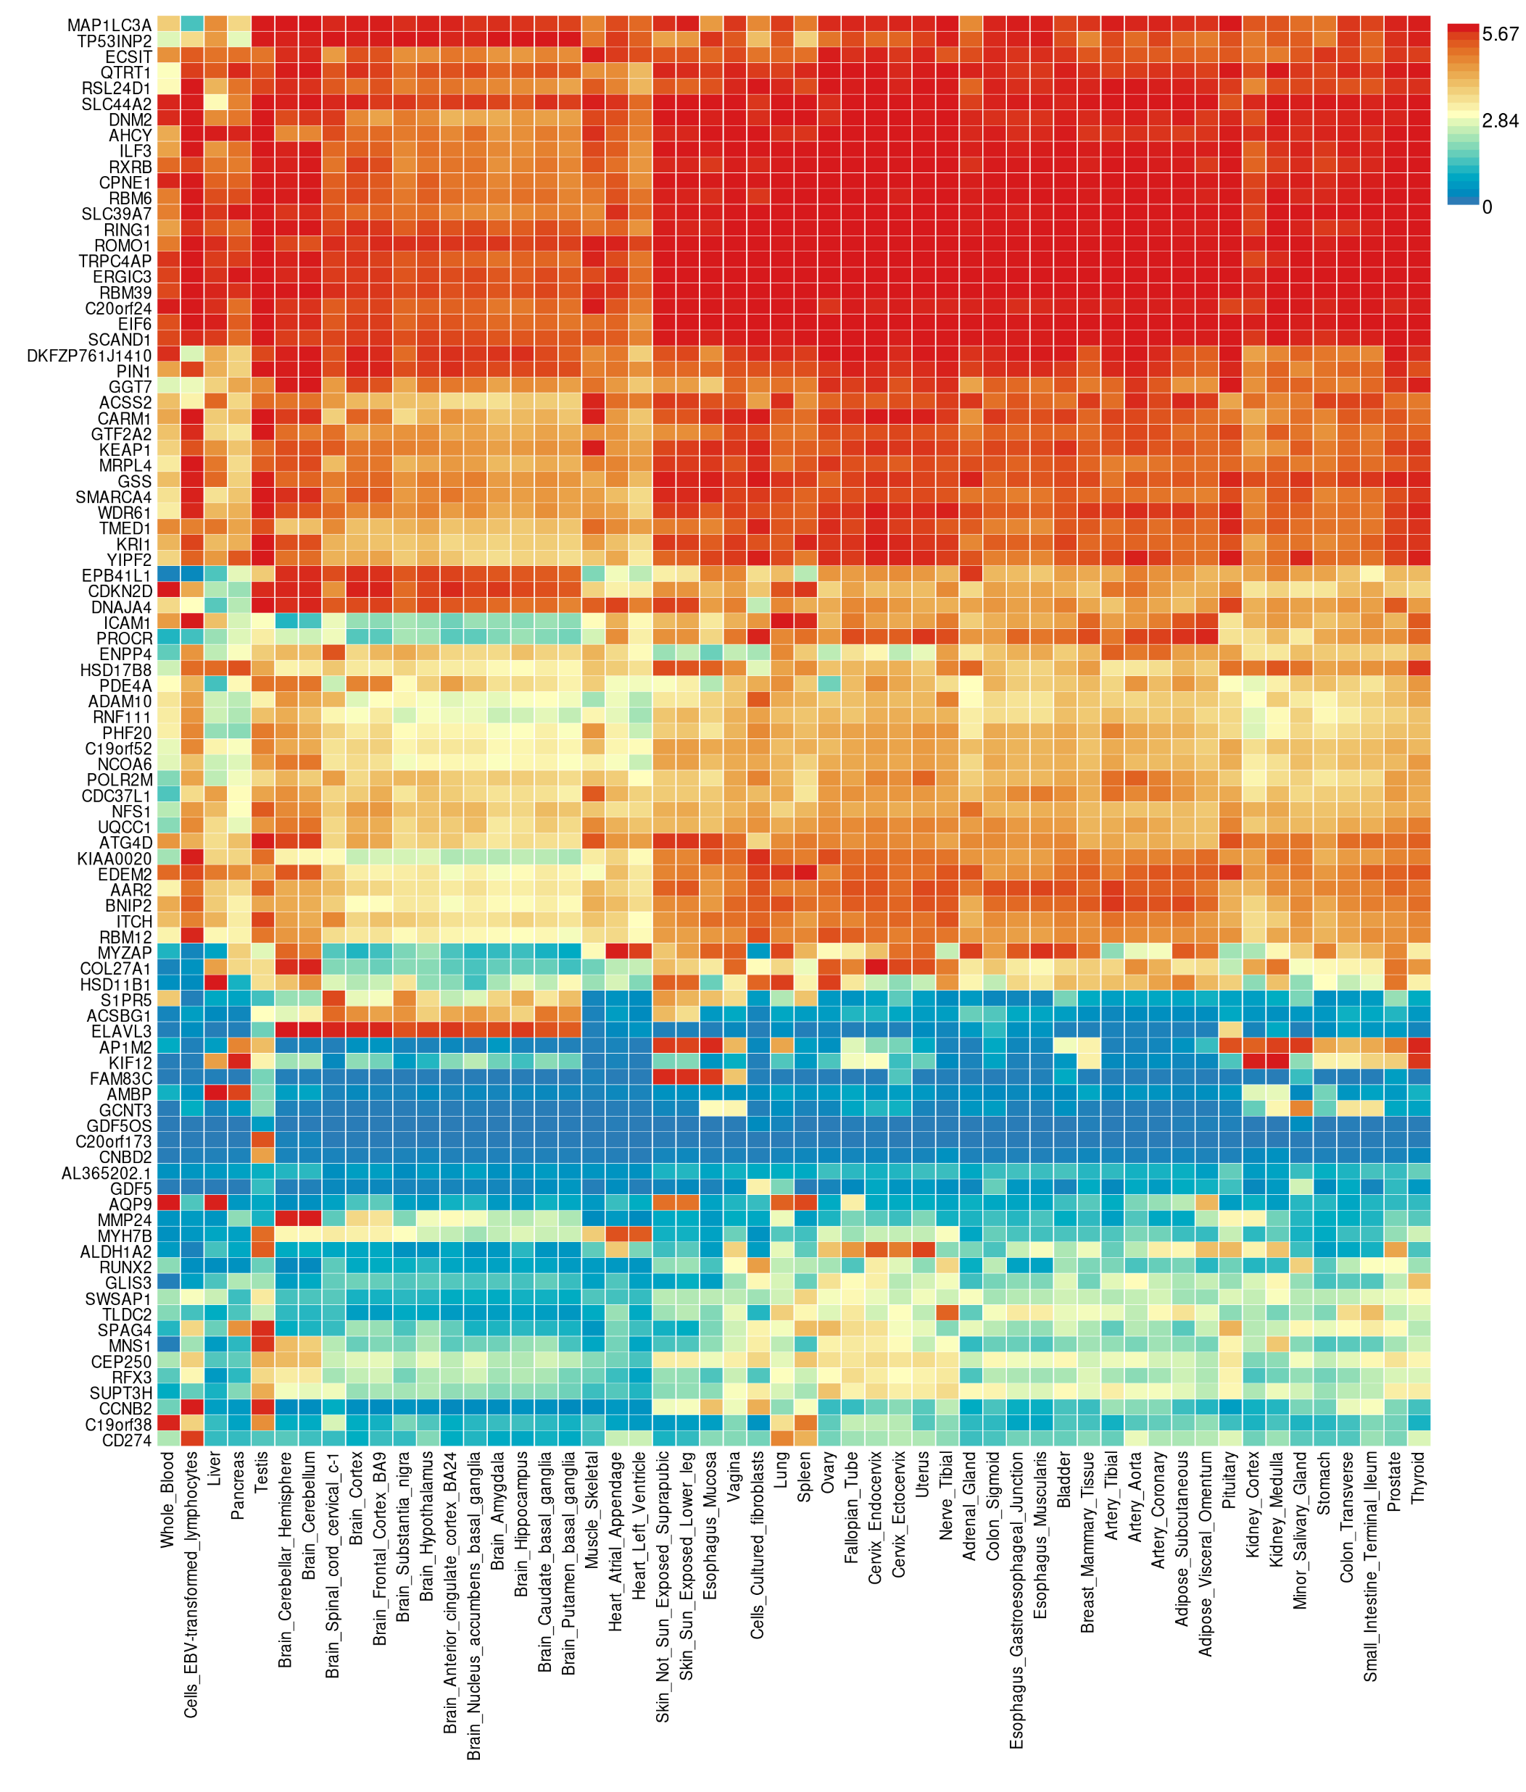
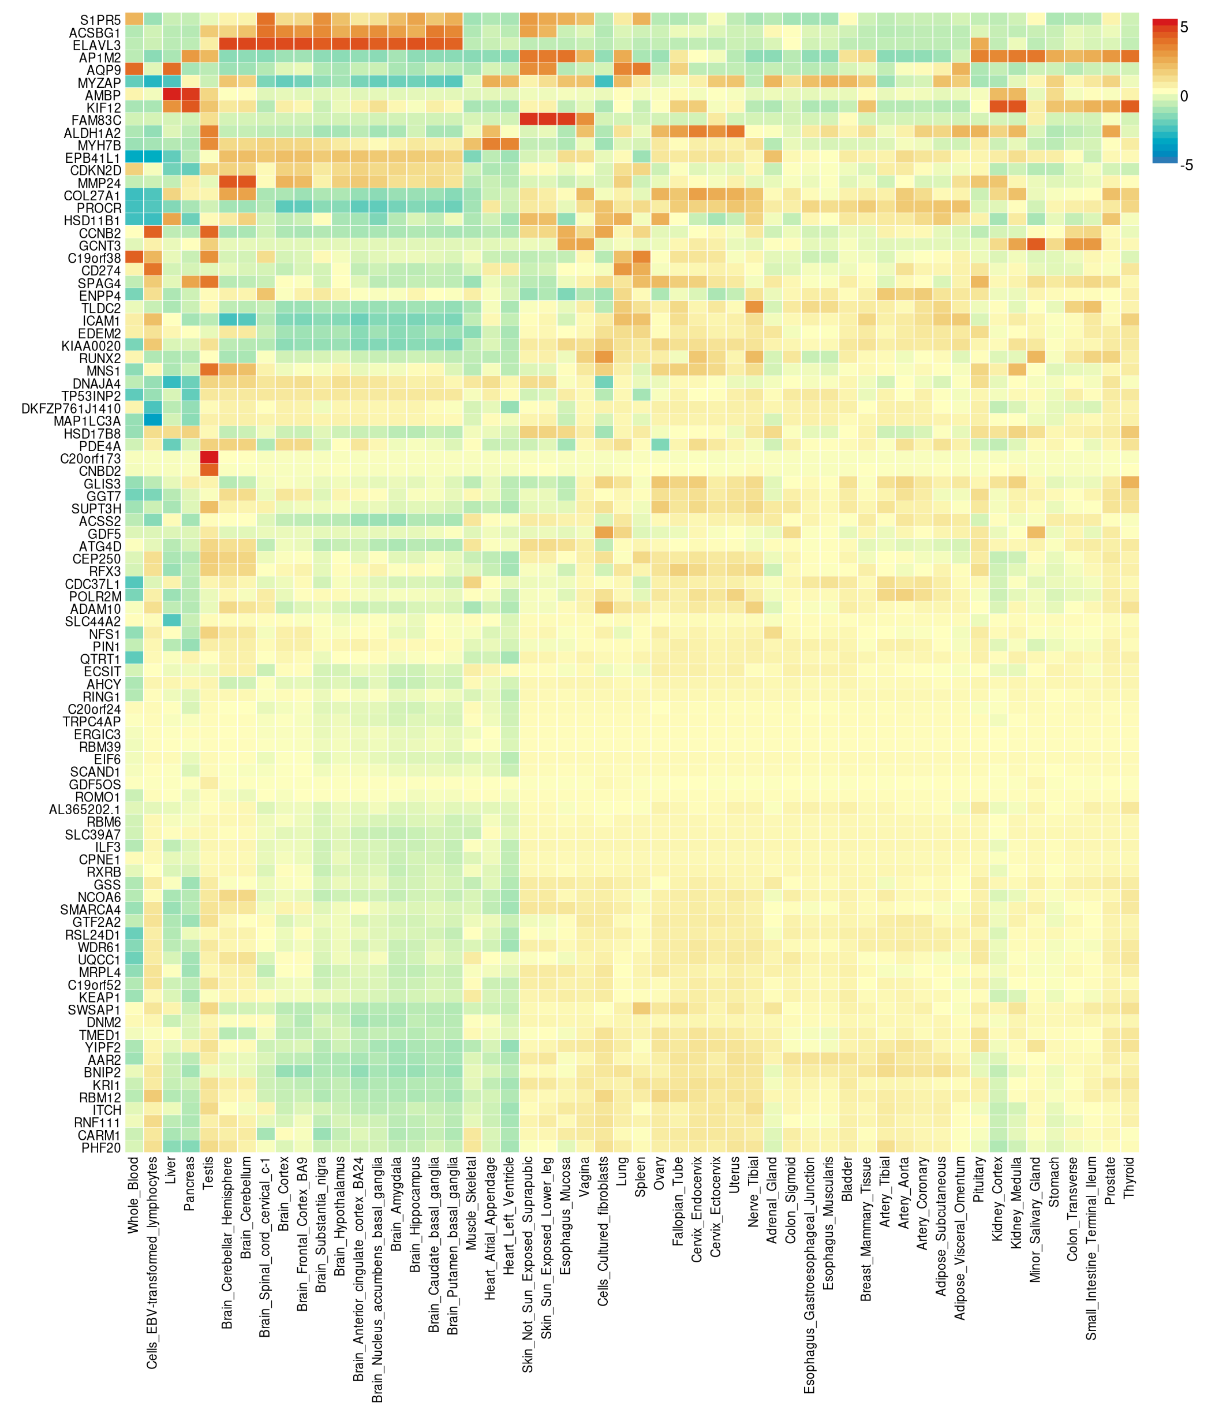
Average expression per label (log2 transformed)
Average of normalized expression per label (zero mean across samples)
GTEx v8 54 tissue types

