Slide 1
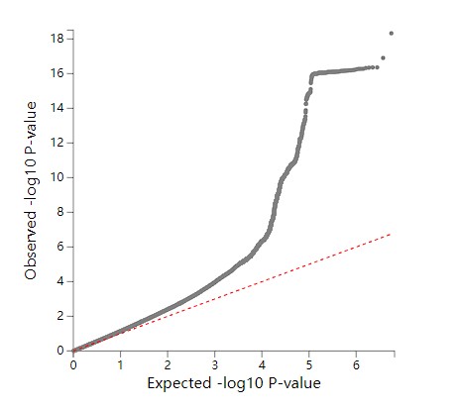
GC lambda 0.5: 1.183 GC lambda 0.1: 1.198 GC lambda 0.01: 1.250 GC lambda 0.001: 1.383

