Slide 1
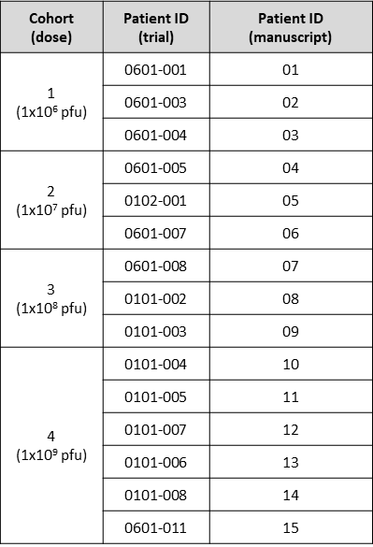
Supplementary Table 2

