Slide 1
Supplemental information

Slide 2
Table 3
Daily visits | Frequency
Clinical
History and examination | Daily
Routine observations (heart rate, blood pressure, respiratory rate, temperature, oxygen saturations) | Daily
Oxygen requirement | Daily
Ventilatory support | Daily
Renal replacement therapy | Daily
ECG | Daily

Slide 3
Blood sampling | Frequency
FBC, differential WCC (excluding eosinophils), platelets | Daily
Urea, creatinine, sodium, potassium, bicarbonate, chloride, magnesium, calcium, bilirubin , ALT, AST, Alkaline phosphatase, GGT, total protein, albumin, CRP, ferritin, triglycerides, troponin, creatinine kinase | Daily
Activated partial thromboplastin time (APTT), Prothrombin time (PT), INR, fibrinogen, D-dimer, | Daily
Thromboelastography | Daily
Glucose and/or capillary blood glucose | Daily
Biomarkers | Daily
Immune phenotyping | Baseline, D4 and D7
Virology
Oropharyngeal/nasopharyngeal swab | 1, 3, 5, 8, 11, 15 (±1 day)
Saliva | 1, 3, 5, 8, 11, 15 (±1 day)

Slide 4
Table 3: Daily assessments and blood samples. Safety bloods in italic. Virology sampling collected from the last 10 participants in each cohort.

Slide 5
Figure 8
A
A
B
C
D
E
F
G
H
I
J
K
L
M
N
O
P
Notes:
Len’s new supplemental data

Slide 6
Figure 8: Biomarkers over time.
SOC (blue)- standard of care. NAF (pink)- Nafamostat Mesylate
A-G : Dynamic changes of COVID-19 cytokine storm related cytokines IL-1β, CCL-2, IL-10, TNF⍺, IL-17A, GM-CSF, amphiregulin
H-P : Key clinical biomarkers troponin, SpO₂/FiO₂ ratio, white blood cell count, neutrophil count, monocyte count, lymphocyte count, platelets count, PT and ferritin.
Data presented as mean with best-fit line and 95% confidence intervals by linear regression. GM-CSF data were mostly below the LLOD, however, raw data was used to plot the graph.
Notes:
New legend

Slide 7
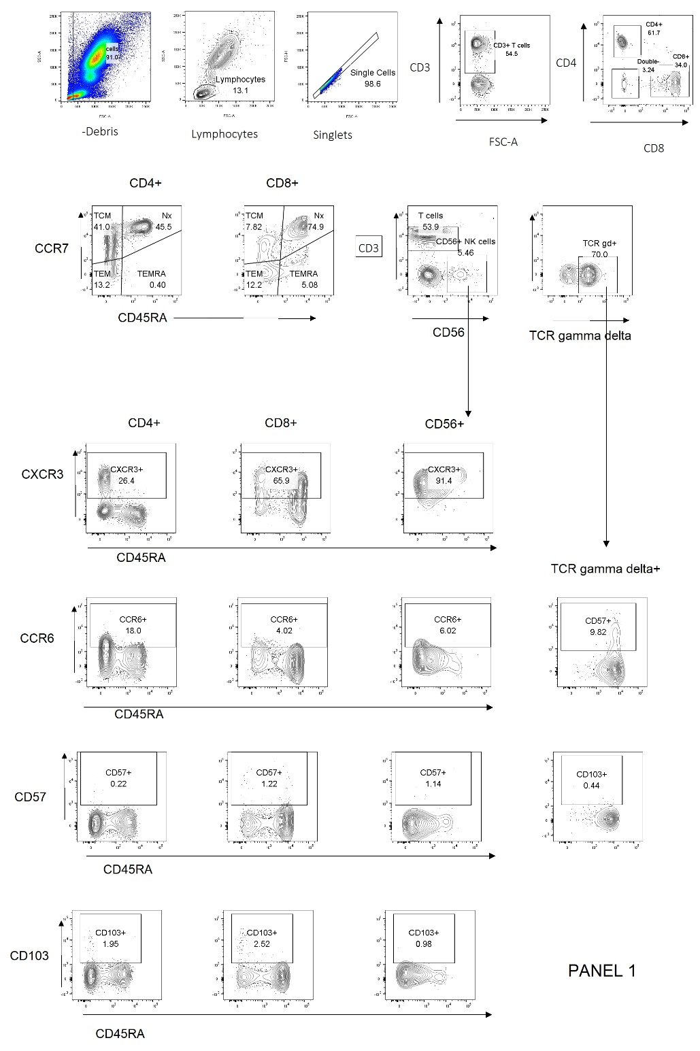
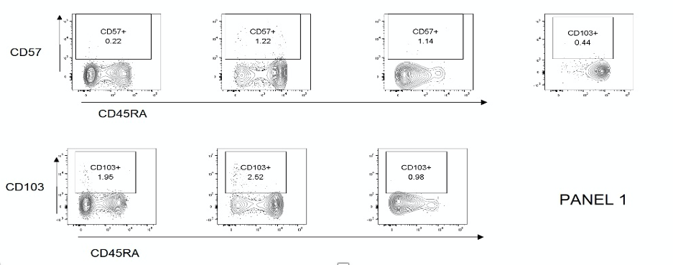
Figure 9A

Slide 8
Figure 9A: Gating strategies for T cell subsets.
After exclusion of debris and selection of lymphocytes on Fsc Vs Ssc, doublets were excluded and CD3+ T cells selected. CD4+ and CD8+ T cell subsets were selected and subdivided into naïve versus memory subsets according to expression of CD45RA and CCR7 as shown.
Expression of TCRγδ on cells expressing CD3 but negative for CD4 and CD8 was used to identify gamma-delta-T cells.

Slide 9
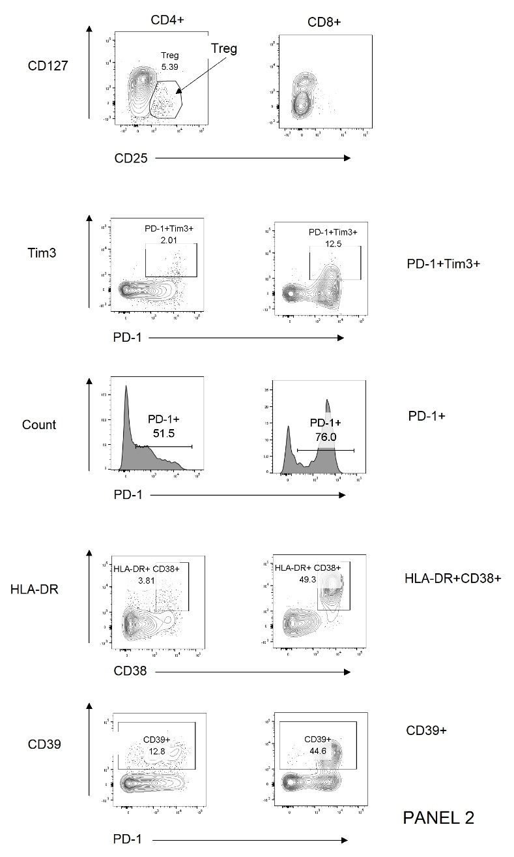
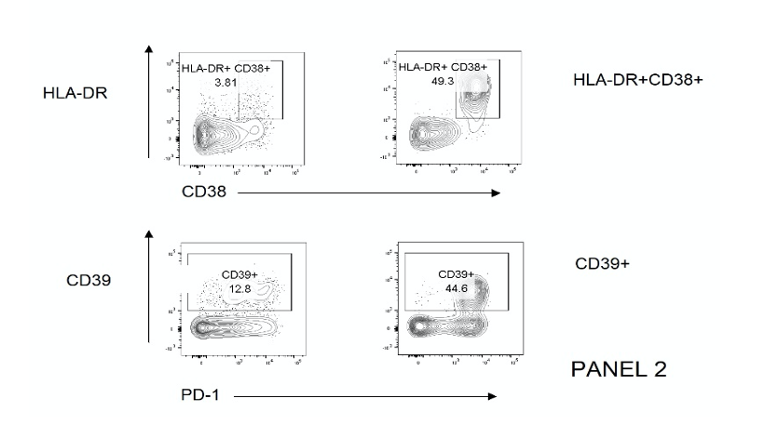
Figure 9B

Slide 10
Figure 9B: Gating strategy for T cell subsets.
CD4+ and CD8+ subsets were gated as shown previously. CD4+ T cells are shown in the left hand column and CD8+ T cells on the right. Treg were gated within the CD4+ population as CD25+CD127low cells. Activated T cells were gated as CD38+HLA-DR+ as shown.

Slide 11
Figure 9C

Slide 12
Figure 9C: Gating strategy for B cells and monocytes.
After exclusion of debris and doublets CD45+ cells were selected and subdivided into lymphocytes, monocytes and granulocytes according to CD45 expression level and side scatter properties. Within the lymphocyte gate B cells were selected as CD19+ and antibody secreting cells identified as CD27+CD38+. Lineage negative monocytes (CD3 / CD19 / CD66b / CD56-)were subdivided to classical, transitional and non-classical subsets according to expression of CD14 and CD16. A control non-covid sample showing a distinct non-classical monocyte population is also shown. Granulocytes were subdivided into Neutrophils and Eosinophils on the basis of CD16 expression.

Slide 13
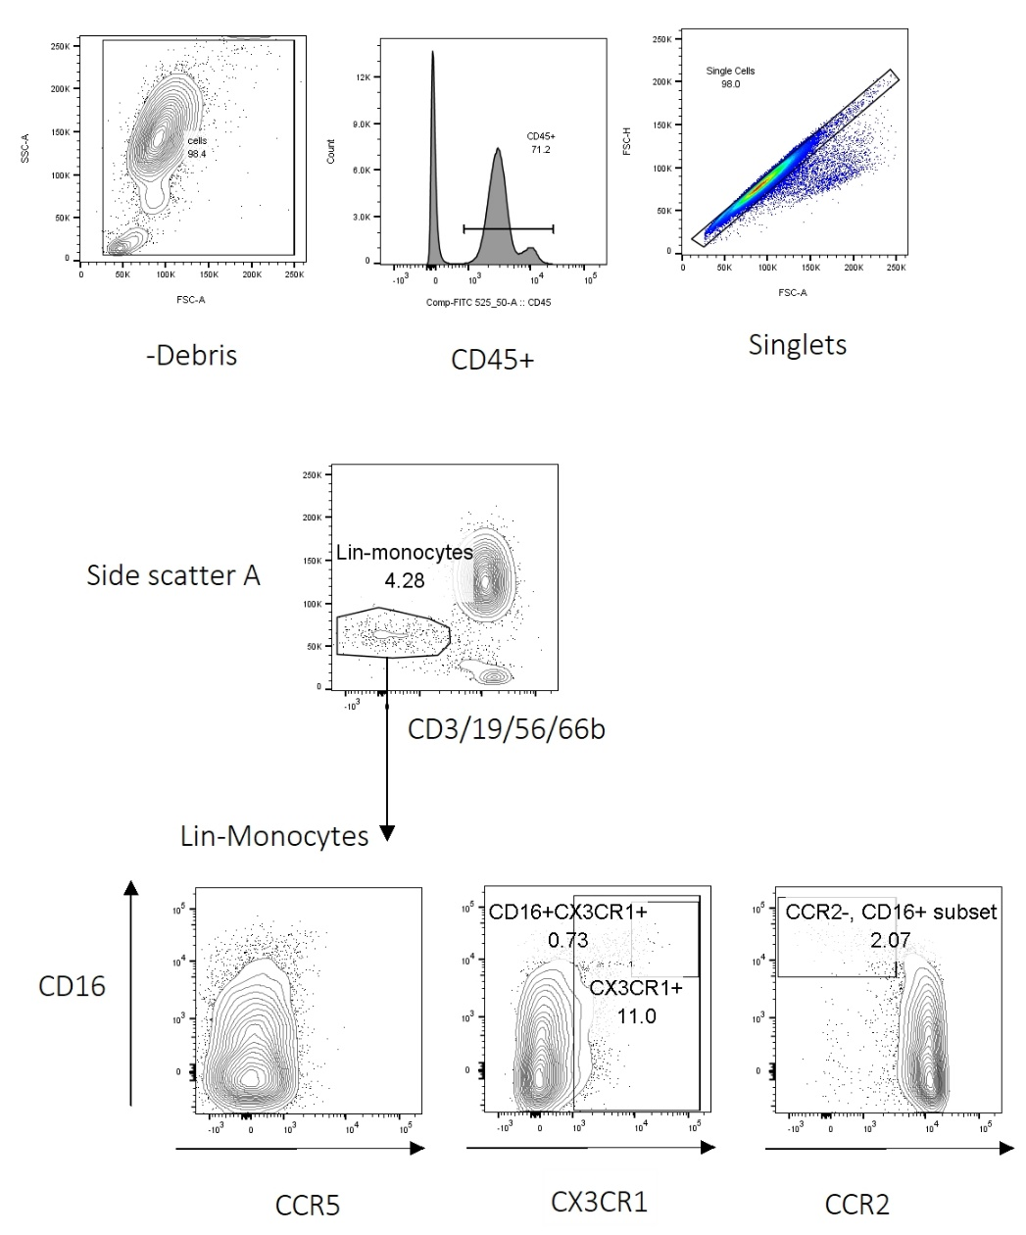
Figure 9D
Panel 4

Slide 14
Figure 9D: Gating strategy for monocyte chemokine receptors.
After exclusion of debris, CD45- events and doublets lineage negative (CD3/CD19/CD56/CD66b-) monocytes were gated for measurement of chemokine receptor expression.

Slide 15
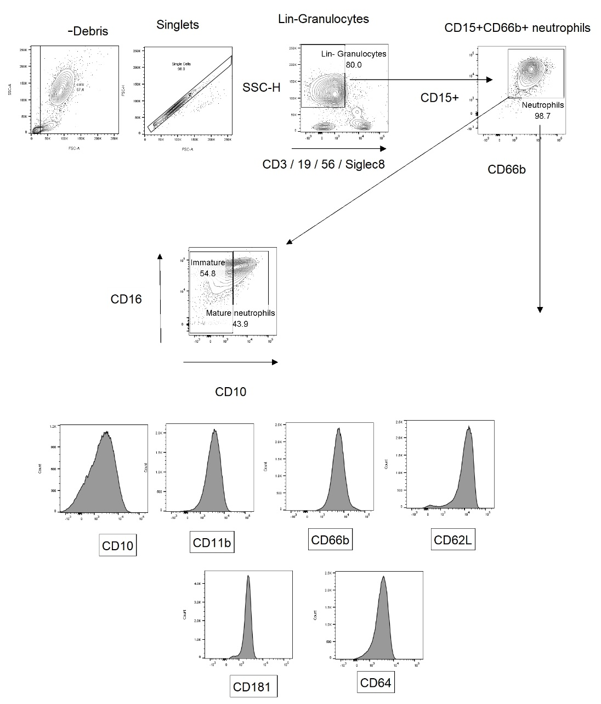
Figure 9E

Slide 16
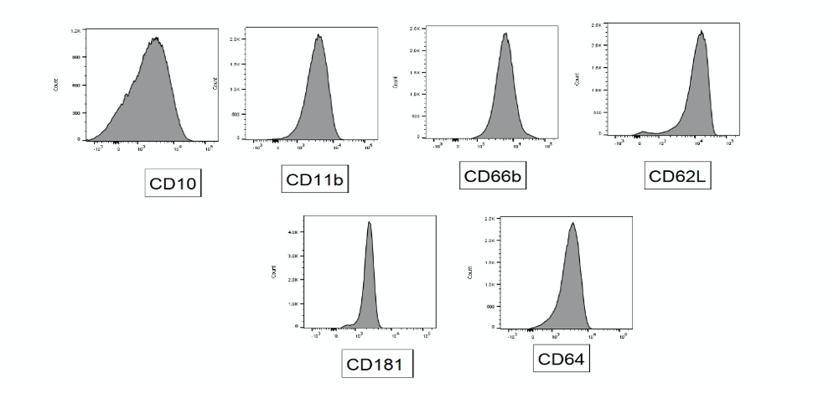

Slide 17
Figure 9E: Gating strategy for neutrophils.
After exclusion of debris and doublets SSC-H high, lineage negative (CD3/CD19/CD56/Siglec-8) events were gated and CD15+CD66b+ cells selected as neutrophils. Immature neutrophils were gated as CD10 low.

Slide 18
Table 4
Target | Flourophore | Clone | Isotype | Supplier | Cat number
CD3 | AF700 | UCHT1 | ms IgG1 | Biolegend | 300424
CD4 | BV711 | OKT4 | ms IgG2b | Biolegend | 317440
CD8 | BV421 | RPA-T8 | ms IgG1 | Biolegend | 301036
CD57 | BV605 | QA17A04 | ms igG1 | Biolegend | 393304
CD45RA | FITC | HI100 | ms IgG2b | Biolegend | 304148
CCR7 | PE-Dazzle | GO43H7 | ms IgG2a | Biolegend | 353236
CXCR3 | PE | GO25H7 | ms IgG1 | Biolegend | 353706
CCR6 | PerCP-Cy5.5 | G034E3 | ms IgG2b | Biolegend | 353406
CD103 | APC | BerACT8 | ms IgG1 | Biolegend | 350216
CD56 | APC-cy7 | HCD56 | ms IgG1 | Biolegend | 318332
CD45RO | PerCP | UCHL1 | ms IgG2a | Biolegend | 304252
TCR gamma delta | BV510 | B1 | Ms IgG1 | Biolegend | 331220
CD38 | FITC | HIT2 | ms IgG1 | Biolegend | 303504
HLA-DR | APC | L243 | ms IgG2a | Biolegend | 307610
CD39 | BV605 | A1 | ms IgG1 | Biolegend | 328236
PD-1 | PE | EH12.2H7 | ms IgG1 | Biolegend | 329905
CD25 | BV650 | V T0-72 | ms IgG2b | Biolegend | 302634
CD127 | PerCP-cy5.5 | A019D5 | ms IgG1 | Biolegend | 351321
Tim3 | PeDazzle | F38-2E2 | ms IgG1 | Biolegend | 354034
CD45 | PerCP | 2D1 | ms IgG1 | Biolegend | 368506
CD3 | AF700 | SK7 | ms IgG1 | Biolegend | 344822
CD19 | PE-dazzle | HIB19 | ms IgG1 | Biolegend | 302252
CD56 | APC-cy7 | HCD56 | ms IgG1 | Biolegend | 318332

Slide 19
Target | Flourophore | Clone | Isotype | Supplier | Cat number
CD14 | BV711 | 63D3 | msIgG1 | Biolegend | 367140
CD16 | BV421 | VNK80 | msIgG1 | Biolegend | 302038
HLA-DR | APC | L243 | ms IgG2a | Biolegend | 307610
CD66b | PE | QA17A51 | ms IgG1 | Biolegend | 392904
CD27 | PerCP-cy5.5 | M-T271 | ms IgG1 | Biolegend | 356408
CD38 | FITC | HIT2 | ms IgG1 | Biolegend | 303504
CD274 | BV650 | 29E.2A3 | ms IgG2b | Biolegend | 329740
HLA-DR | BV650 | L243 | ms IgG2a | Biolegend | 307650
CCR2 | PerCPcy5.5 | K03632 | Ms IgG2a | Biolegend | 357204
CX3CR1 | PE-dazzle | 2A9-1 | rat igG2b | Biolegend | 341624
CCR5 | APC-cy7 | J418F1 | rat igG2b | Biolegend | 359110
CD3 | APC | UCHT1 | ms IgG1 | Biolegend | 300412
CD19 | APC | HIB19 | ms IgG1 | Biolegend | 302212
CD56 | APC | HCD56 | ms IgG1 | Biolegend | 318310
Siglec8 | APC | 7C9 | msIgG1 | Biolegend | 347106
CD66b | PE | 6/40c | ms IgG1 | Biolegend | 392904
CD15 | APC-Cy7 | W6D3 | msIgG1 | Biolegend | 323048
CD11b | PerCPcy5.5 | LM2 | ms IgG1 | Biolegend | 393106
CD62L | PE-Dazzle | DREG-56 | ms IgG1 | Biolegend | 304842
CD64 | BV711 | 10.1 | ms IgG1 | Biolegend | 305042
CD16 | BV421 | 3g8 | msIgG1 | Biolegend | 302038
CD10 | BV605 | HI10a | msIgG1 | Biolegend | 312222
CD54 (ICAM-1) | AF700 | HA58 | ms IgG1 | Biolegend | 353126
CD181 (CXCR1) | AF488 | 8F1 CXCR1 | ms IgG2a | Biolegend | 320616

Slide 20
Table 4: Antibodies used for flow cytometry

Slide 21
Table 5
Result | Arm | Mean | SD | Median | Min | Max
Haemoglobin (g/L) | SoC | 127.7 | 9.41 | 126.0 | 108.0 | 157.0
 | NM | 144.0 | 11.92 | 144.00 | 122.0 | 167.0
Haematocrit (ratio) | SoC | 0.37 | 0.02 | 0.37 | 0.32 | 0.44
 | NM | 0.41 | 0.03 | 0.41 | 0.34 | 0.47
Red Cell Count (10^12/L) | SoC | 4.28 | 0.42 | 4.18 | 3.62 | 5.20
 | NM | 4.75 | 0.33 | 4.80 | 3.83 | 5.31
Mean cell volume (fl) | SoC | 87.27 | 6.32 | 89.00 | 73.00 | 102.0
 | NM | 86.21 | 3.42 | 86.00 | 80.00 | 94.00
Mean cell Hb (pg) | SoC | 29.97 | 2.41 | 30.40 | 24.40 | 34.40
 | NM | 30.32 | 1.33 | 30.45 | 27.10 | 32.60
Mean cell Hb Conc (g/L) | SoC | 344.1 | 12.44 | 344.0 | 317.0 | 399.0
 | NM | 352.0 | 9.56 | 352.0 | 329.0 | 383.0
White cell count (10^9/L) | SoC | 10.01 | 4.12 | 9.05 | 3.60 | 22.80
 | NM | 12.20 | 4.98 | 11.15 | 4.80 | 36.10
Neutrophil count (10^9/L) | SoC | 7.51 | 3.33 | 7.26 | 2.12 | 18.93
 | NM | 10.10 | 4.58 | 9.38 | 3.07 | 29.89
Lymphocytes (10^9/L) | SoC | 1.67 | 1.58 | 1.19 | 0.29 | 9.58
 | NM | 1.18 | 0.67 | 0.97 | 0.24 | 2.99

Slide 22
Result | Arm | Mean | SD | Median | Min | Max
Monocyte count (10^9/L) | SoC | 0.76 | 0.30 | 0.71 | 0.15 | 1.71
 | NM | 0.86 | 0.55 | 0.74 | 0.22 | 3.59
Basophil count (10^9/L) | SoC | 0.03 | 0.02 | 0.02 | 0.00 | 0.15
 | NM | 0.03 | 0.06 | 0.01 | 0.00 | 0.46
Eosinophil count (10^9/L) | SoC | 0.06 | 0.05 | 0.05 | 0.00 | 0.21
 | NM | 0.05 | 0.07 | 0.02 | 0.00 | 0.27
Platelet count (10^9/L) | SoC | 295.2 | 85.69 | 282.5 | 131.0 | 555.0
 | NM | 301.6 | 165.4 | 265.0 | 92.00 | 900.0
Random Glucose (mmol/L) | SoC | 7.86 | 2.67 | 7.20 | 4.20 | 19.70
 | NM | 9.11 | 4.47 | 7.60 | 3.80 | 25.00
Urea (mmol/L) | SoC | 6.13 | 2.37 | 5.90 | 2.10 | 12.40
 | NM | 8.20 | 3.08 | 7.70 | 3.90 | 23.30
Sodium (mmol/L) | SoC | 138.3 | 2.55 | 138.0 | 132.0 | 143.0
 | NM | 136.7 | 3.69 | 137.0 | 117.0 | 145.0
Potassium (mmol/L) | SoC | 4.03 | 0.39 | 4.10 | 3.30 | 5.10
 | NM | 4.44 | 0.52 | 4.40 | 3.40 | 5.90
Chloride (mmol/L) | SoC | 102.3 | 2.72 | 102.0 | 92.00 | 108.0
 | NM | 102.9 | 3.75 | 103.0 | 88.0 | 111.0

Slide 23
Result | Arm | Mean | SD | Median | Min | Max
Magnesium (mmol/L) | SoC | 0.83 | 0.09 | 0.83 | 0.61 | 1.06
 | NM | 0.87 | 0.10 | 0.87 | 0.63 | 1.08
Bicarbonate (mmol/L) | SoC | 25.05 | 2.42 | 25.00 | 20.00 | 31.00
 | NM | 22.10 | 2.55 | 22.00 | 16.00 | 31.00
Creatinine (micromole/L) | SoC | 69.38 | 10.86 | 67.00 | 53.00 | 111.0
 | NM | 82.56 | 22.06 | 75.00 | 54.00 | 176.0
Total protein (g/L) | SoC | 61.47 | 5.56 | 61.00 | 50.00 | 77.00
 | NM | 62.35 | 5.25 | 63.00 | 51.00 | 73.00
Albumin (g/L) | SoC | 28.20 | 2.48 | 28.00 | 23.00 | 35.00
 | NM | 29.74 | 3.62 | 30.00 | 21.00 | 38.00
AST (U/L) | SoC | 46.13 | 35.10 | 37.00 | 11.00 | 182.0
 | NM | 43.19 | 33.64 | 32.00 | 12.00 | 228.0
Bilirubin (micromole/L) | SoC | 9.58 | 3.72 | 9.00 | 4.0 | 27.00
 | NM | 11.62 | 5.02 | 10.00 | 6.00 | 39.00
GGT (U/L) | SoC | 101.8 | 81.11 | 85.00 | 20.00 | 328.0
 | NM | 66.78 | 50.08 | 51.00 | 14.00 | 224.0
ALT (U/L) | SoC | 55.79 | 56.90 | 34.50 | 7.00 | 325.0
 | NM | 62.52 | 57.79 | 44.00 | 13.00 | 304.0

Slide 24
Result | Arm | Mean | SD | Median | Min | Max
Alk Phos (U/L) | SoC | 88.54 | 33.35 | 78.00 | 37.00 | 167.0
 | NM | 81.08 | 24.42 | 77.00 | 36.00 | 142.0
LDH (U/L) | SoC | 348.7 | 133.4 | 319.0 | 181.0 | 913.0
 | NM | 427.5 | 110.7 | 428.0 | 200.0 | 675.0
Ferritin (micromol/L) | SoC | 843.5 | 766.9 | 478.5 | 25.00 | 3159
 | NM | 918.3 | 516.3 | 844.0 | 213.0 | 2833
CRP (mg/L) | SoC | 39.54 | 48.07 | 23.00 | 1.00 | 235.0
 | NM | 34.60 | 51.72 | 17.00 | 1.00 | 314.0
Troponin (ng/L) | SoC | 6.20 | 8.16 | 4.00 | 1.00 | 57.00
 | NM | 3.83 | 5.90 | 2.50 | 1.00 | 61.00
Triglycerides (mmol/L) | SoC | 2.01 | 1.05 | 1.80 | 0.80 | 6.70
 | NM | 1.78 | 0.85 | 1.60 | 0.50 | 5.20
D-Dimer (ng/ml) | SoC | 5275 | 13260 | 349.5 | 149.0 | 69000
 | NM | 1248 | 2254 | 421.0 | 150.0 | 12443
Creatine kinase (U/L) | SoC | 110.2 | 252.2 | 39.00 | 7.00 | 1677
 | NM | 84.67 | 128.3 | 49.00 | 10.00 | 1080
INR (ratio) | SoC | 1.10 | 0.18 | 1.10 | 0.80 | 1.70
 | NM | 1.09 | 0.21 | 1.00 | 0.90 | 2.00

Slide 25
Result | Arm | Mean | SD | Median | Min | Max
Prothrombin time (seconds) | SoC | 13.18 | 2.14 | 13.00 | 10.00 | 21.00
 | NM | 12.99 | 2.55 | 12.00 | 10.00 | 24.00
Fibrinogen (g/L) | SoC | 3.99 | 0.86 | 4.00 | 2.50 | 6.30
 | NM | 4.30 | 1.00 | 4.20 | 2.50 | 8.10
APTT (seconds) | SoC | 26.66 | 3.57 | 26.00 | 20.00 | 40.00
 | NM | 29.01 | 5.62 | 28.00 | 17.00 | 62.00
Protein C (IU/ml) | SoC | 1.31 | 0.27 | 1.34 | 0.69 | 1.82
 | NM | 1.26 | 0.33 | 1.22 | 0.70 | 2.73
Antithrombin (IU/ml) | SoC | 1.12 | 0.24 | 1.09 | 0.73 | 2.00
 | NM | 1.22 | 0.16 | 1.20 | 0.89 | 1.60
Table 5: Summary clinical safety haematological and biochemical blood results outcome by group- (SoC) standard of care versus IV NM. Blood results checked daily for all patients during their time in the trial.

Slide 26
Table 6
Variable | Mean | 95% HPD Interval Lower limit | 95% HPD Interval Upper limit
Haemoglobin (g/L) | 3.263 | -4.24 | 10.74
Haematocrit (ratio) | -.272 | -6.19 | 5.835
Red cell count (109/L) | -.086 | -5.66 | 5.853
Mean cell volume (fl) | -.539 | -6.24 | 4.508
Mean Cell Hb (pg) | 0.125 | -5.54 | 5.587
Mean Cell Hb Conc (g/L) | 3.815 | -4.02 | 11.06
White Cell Count (109/L) | 2.024 | -3.80 | 7.596
Neutrophil Count (109/L) | 2.003 | -3.65 | 7.416
Lymphocytes (109/L) | 0.091 | -5.47 | 5.465
Monocyte Count (109/L) | 0.340 | -4.73 | 5.678
Basophil Count (109/L) | 0.278 | -5.15 | 5.423
Eosinophil Count (109/L) | 0.481 | -9.10 | 9.770
Platelet Count (109/L) | 6.598 | -28.7 | 41.32
Random Glucose (micromole/L) | 1.228 | -4.30 | 7.034
Urea (mmol/L) | 0.417 | -4.97 | 6.035
Sodium (mmol/L) | -2.23 | -7.98 | 3.329
Potassium (mmol/L) | 0.315 | -5.02 | 5.484
Chloride (mmol/L) | -1.34 | -7.22 | 4.785
Variable | Mean | 95% HPD Interval Lower limit | 95% HPD Interval Upper limit
Magnesium (mmol/L) | -.380 | -5.83 | 5.180
Bicarbonate (mmol/L) | -1.53 | -7.23 | 4.276
Creatinine (micromole/L) | 10.57 | 2.427 | 18.92
Total Protein (g/L) | 0.991 | -4.84 | 7.070
Albumin (g/L) | -.076 | -6.26 | 5.955
AST (U/L) | -2.03 | -22.2 | 18.51
Total Bilirubin (micromole/L) | 0.503 | -4.63 | 6.035
GGT (U/L) | -2.97 | -30.9 | 26.08
ALT (U/L) | 9.056 | -21.6 | 38.86
Alk Phos (U/L) | 3.947 | -3.87 | 12.61
LDH (U/L) | 18.15 | -21.6 | 58.21
Ferritin (micromole/L) | 113.5 | -44.9 | 278.0
CRP (mg/L) | 4.135 | -15.9 | 24.59
Troponin (ng/L) | -4.24 | -11.2 | 2.885
Triglycerides (mmol/L) | 0.061 | -5.49 | 5.674
D-Dimer (ng/ml) | 321.6 | -102 | 1122
Creatinine Kinase (U/L) | -18.8 | -74.6 | 38.20
INR (ratio) | 0.021 | -5.39 | 5.539

Slide 27
Variable | Mean | 95% HPD Interval Lower limit | 95% HPD Interval Upper limit
Prothrombin time (seconds) | 0.064 | -5.36 | 5.442
Fibrinogen (g/L) | 0.542 | -5.00 | 6.216
APTT (seconds) | 2.042 | -3.91 | 7.923
Protein C (IU/ml) | -.036 | -6.16 | 5.834
Antithrombin (IU/ml) | -.251 | -6.43 | 5.969
O2 Saturation (%) | 0.021 | -5.84 | 5.528
Respiratory Rate (bpm) | -.140 | -5.46 | 5.418
Systolic Blood Pressure (mm Hg) | -6.24 | -17.0 | 3.918
Diastolic Blood Pressure (mm Hg) | -2.35 | -9.45 | 4.478
Temperature (degrees C) | 0.150 | -5.36 | 5.496
Pulse (bpm) | 3.821 | -4.70 | 12.34
ECG Rate | -2.53 | -11.3 | 6.479
ECG QTc | -12.4 | -26.8 | 1.915

Slide 28
Table 6 Continuous outcome variable results: haematological and biochemical safety laboratory outcomes and vital signs.

Slide 29
Table 7
 | E gene Nafamostat Nasopharyngeal swab Ct values |  |  |  |  |  |  |  |  |  |  |  | E gene SoC NT Nasopharyngeal swab Ct values
Day 1 | 28.78 | 16.32 | 22.93 | 45 | 32.53 | 29.47 | 20.97 | 33.02 | 32.25 | 23.3 |  |  | 27.56 | 31.26 | 45 | 15.56 | 39.56 | 26.37 | 45 | 45 | 23.9 | 24.36 | 29.05
Day 3 | 30 | 18.45 | 24.24 | 45 | 33.99 | 24.7 | 45 | 29.56 | 24.66 |  |  |  | 32.33 | 45 | 16.76 | 45 | 29.39 | 45 | 45 | 45 | 28.11 | 23.09
Day 5 | 20.22 | 32.79 | 28.36 | 31.32 | 23.35 | 45 | 33.45 | 30.54 |  |  |  |  | 19.65 | 45 | 31.78
 | S gene Nafamostat Nasopharyngeal swab Ct values |  |  |  |  |  |  |  |  |  |  |  | S gene SOC Nasopharyngeal swab Ct values
Day 1 | 28.88 | 16.55 | 22.34 | 45 | 31.99 | 28.81 | 20.07 | 32.22 | 31.22 | 23.29 |  |  | 26.56 | 31.58 | 45 | 14.96 | 45 | 25.89 | 45 | 38.55 | 22.69 | 23.32 | 28.44
Day 3 | 29.58 | 19.54 | 23.68 | 45 | 36.24 | 23.69 | 45 | 28.78 | 27.54 |  |  |  | 32.33 | 45 | 16.76 | 45 | 29.39 | 45 | 45 | 45 | 28.11 | 23.09
Day 5 | 20.22 | 32.79 | 28.36 | 31.32 | 23.35 | 45 | 33.45 | 30.54 |  |  |  |  | 19.65 | 45 | 31.78

Slide 30
 | E gene Nafamostat saliva Ct values |  |  |  |  |  |  |  |  |  |  |  | E gene SoC saliva Ct values
Day 1 | 29.45 | 17.65 | 21.45 | 45 | 33.45 | 30.22 | 21.11 | 33.56 | 33.21 | 23.66 |  |  | 28.56 | 32.43 | 45 | 15.33 | 45 | 33.45 | 39.1 | 25.77 | 24.44 | 24.78 | 29.55
Day 3 | 20.43 | 25.43 | 45 | 32.33 | 35.66 | 34.41 | 33.43 | 28.44 | 24.55 |  |  |  | 32.54 | 45 | 19.32 | 45 | 45 | 26.55 | 45 | 27.12
Day 5 | 22.43 | 27.45 | 37.66 | 33.56 | 35.44 | 30.33 | 25.66 |  |  |  |  |  | 35.22 | 20.31 | 45 | 45 | 45 | 29.45 | 30.12
 | S gene Nafamostat saliva Ct values |  |  |  |  |  |  |  |  |  |  |  | S gene SoC saliva Ct values
Day 1 | 29.56 | 16.56 | 22.87 | 45 | 33.99 | 30.88 | 21.88 | 33.67 | 33.87 | 23.77 |  |  | 27.77 | 31.76 | 45 | 15.78 | 45 | 33.99 | 45 | 25.9 | 24.82 | 25.66 | 29.88
Day 3 | 19.73 | 24.43 | 45 | 34.1 | 36.77 | 34.88 | 34.34 | 39.15 | 24.77 |  |  |  | 33.12 | 45 | 18.89 | 45 | 45 | 26.77 | 45 | 28.31 | 30.89
Day 5 | 21.56 | 26.44 | 38.67 | 33.76 | 35.88 | 30.89 | 25.44 |  |  |  |  |  | 35.56 | 20.56 | 45 | 45 | 45 | 28.45

Slide 31
Table 7 Altona RT-PCR Ct values

Slide 32
Figure 10
Altona E
copies/mL | Ct value
43000 | 31.45
46400 | 30.91
3300 | 33.45
40300 | 32.2
43001 | 31.5
530000 | 28.24
230 | 36.36
Altona S
Copies/mL | Ct value
43000 | 31.81
46400 | 31.1
3300 | 32.9
40300 | 32.41
43000 | 31.76
530000 | 28.5
230 | 35.25

Slide 33
Figure 10 QMCD linear panel. Altona Ct to copies/mL conversion with linear regression.

