Slide 1
A trans-ancestry genome-wide association study of unexplained chronic ALT elevation as a proxy for nonalcoholic fatty liver disease with histological and radiological validation. Vujkovic M, Ramdas S, et al.

Slide 2
Supp Fig 1. Exclusion and inclusion criteria for samples in each stage of analysis
Genotyped with HARE ancestry classified:
430,400
HARE classification
European Americans
African Americans
Hispanic Americans
Asian Americans
Stage 1
235,445
Stage 2
73,807
Stage 1
63,107
Stage 2
19,395
Stage 1
25,323
Stage 2
8,836
Stage 1
2,963
Stage 2
1,524
Excluded:
viral hepatitis
215,784
67,903
50,940
16,157
20,744
7,585
2,423
1,294
Excluded:
other liver disease
181,795
56,485
43,625
13,503
17,666
6,143
1,888
953
Excluded:
alcohol dependence
159,870
49,378
34,573
11,013
14,827
5,138
1,757
835
Excluded:
intermediate ALT
125,985
38,212
27,777
9,587
11,210
3,908
1,343
573

Slide 3
Supp Fig 2 (EA)

Slide 4
Supp Fig 3 (AA)

Slide 5
Supp Fig 4 (HISP)

Slide 6
Supp Fig 5 (ASN)

Slide 7
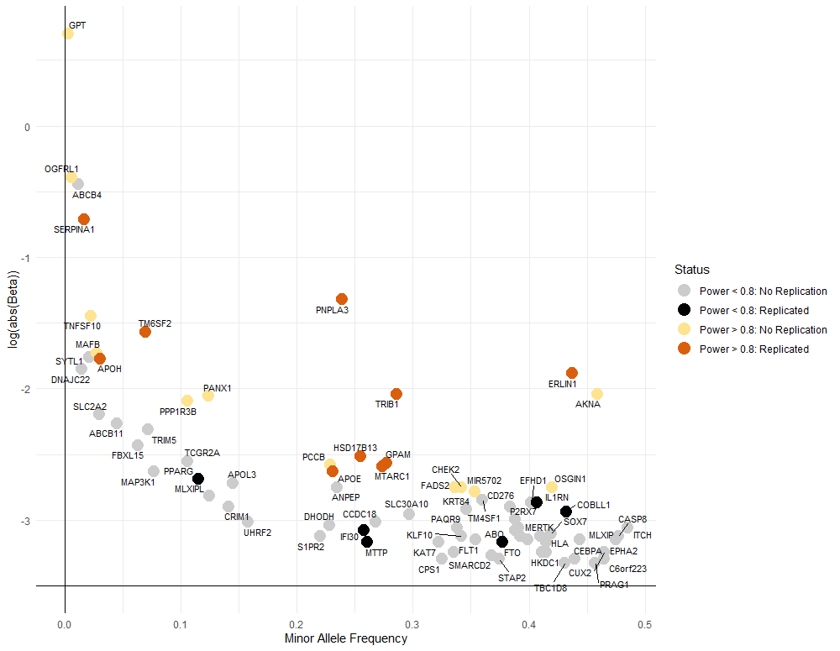
Supp Figure 6

Slide 8
Supp Figure 7

Slide 9
Supp Figure 8

Slide 10
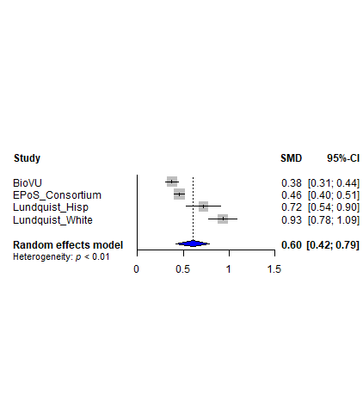
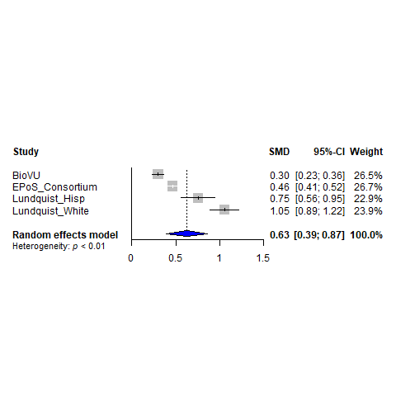
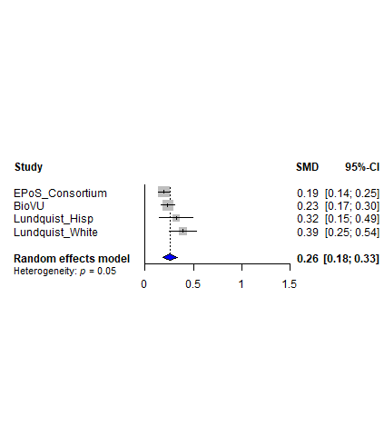
Supp Figure 9
a. GRS-77 (all)
b. GRS-9 (established)
c. GRS-68 (novel)

Slide 11
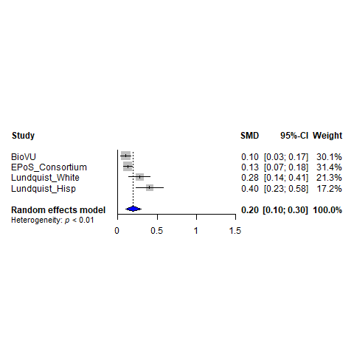
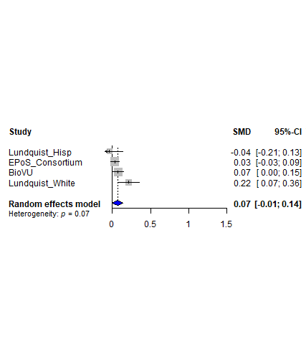
Supp Figure 10
a. GRS-Replicated
b. GRS-Nominal
c. GRS-Not-Replicated

Slide 12
Supp Figure 11
European American
Trans-Ethnic
rs1169292
rs1626329

Slide 13
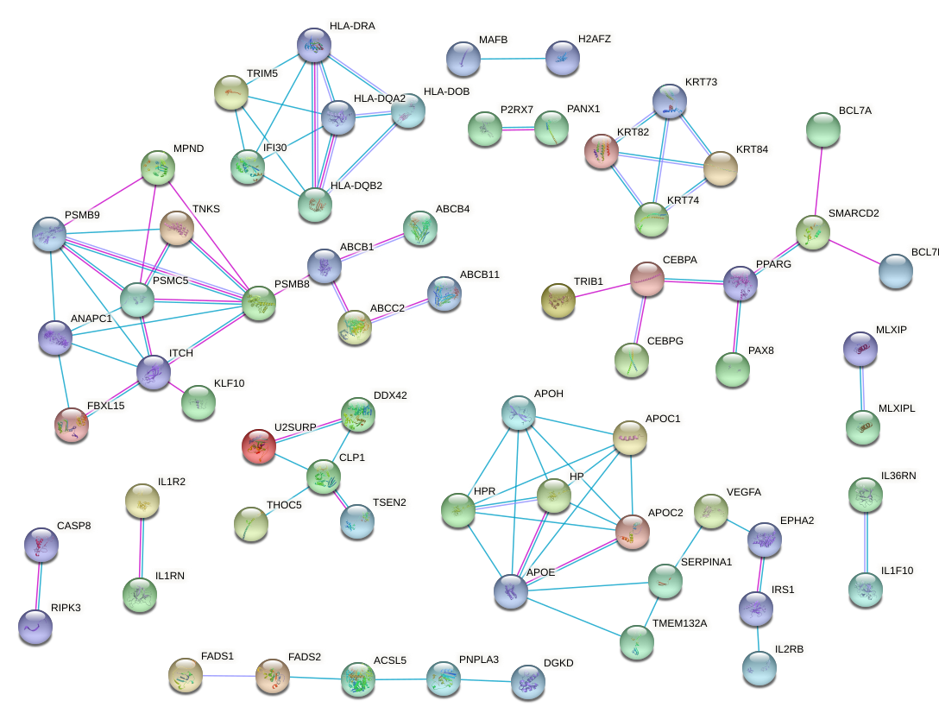
Supp Figure 12 (PPI)

Slide 14
Supp Figure 13

Slide 15
Supp Figure 14
a. GRS-Liver
b. GRS-Liver+Metabolic
c. GRS-Liver+Inflammation
d. GRS-Liver+Metabolic+Inflammation

